Slide 1
Texas Record Exchange

Slide 2
2023-2024

Slide 4
* New slide since Spring 2023 training

Slide 5
Current Known Issues
Record Threshold
The system should allow up to 10,000 records for processing. This is currently not working as expected.
TEA recommends sending a maximum of 5,000 records per file at this time.
Once the issue is resolved, TEA will inform users that the record threshold can be increased.
LEAs should utilize the Census Block Group Map to for any confidence percentage less than 100% to ensure an accurate Census Block Group is identified and assigned.
* New slide since Spring 2023 training

Slide 32
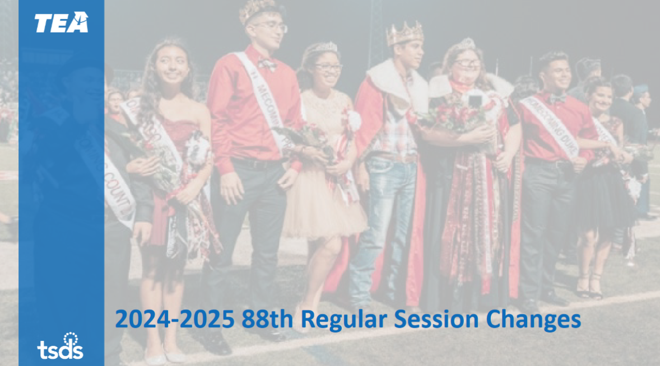

Slide 34
Frequently Asked Questions
What do I do if the Census Block Group Tool does not give me a 100% confidence score?
TEA guidance is to use the Census Block Group Map if the CBGT does not return a 100% confidence score.
Who may I contact at the Texas Workforce Commission (TWC) when I need to retire a Unique ID created by them?
Please contact gwen.Snyder@twc.Texas.gov for any assistance.

Slide 35
Frequently Asked Questions continued 1
HB 1416 – TREx Accelerated Instruction
1. If a campus provides accelerated instruction under HB 4545, should they also report the Expanded
Learning Opportunity “tutoring” activity during PEIMS Submissions 3 or 4?
Accelerated instruction under HB 4545 may be provided outside of the regular school day. Still, it is not
a factor in the Expanded Learning Opportunity (ELO) reported in PEIMS Submissions 3 or 4. As defined
in the Texas Education Data Standards, ELOs should be included in PEIMS Submissions 3 or 4 if the LEA
implements an ELO program (i.e., extended day, extended year, or structured program outside of the
regular school day).
2. What if the STUDENT-ACCELERATED-INSTRUCTION-PARTICIPATION (TE151/TC50) changes for the
student during the school year?
If the STUDENT-ACCELERATED-INSTRUCTION-PARTICIPATION (TE151/TC50) changes during the school
year, the LEA will only transfer the STUDENT-ACCELERATED-INSTRUCTION-PARTICIPATION (TE151/TC50)
that the student participates in at the tome of withdrawal or what they were partocipating in at the end
of the school year

Slide 36
Frequently Asked Questions continued 2
HB 3 – Trex Discipline
1. What discipline information will be sent through the new TREx discipline button?
The new TREx discipline button will allow an LEA to transfer five prior years of PEIMS reported
discipline. The LEA will still need to send the current year PEIMS reportable discipline with the other
records sent in TREx.
2. What are the consequences to an LEA if they do not share discipline and behavior threat assessment
information with the next LEA requesting records?
The program area will address this question in a future communication. For any policy questions such
as these, please contact the Safe and Supportive School Program at
SafeandSupportiveSchoolProgram@tea.texas.gov

Slide 37
Frequently Asked Questions continued 3

Slide 38
Frequently Asked Questions continued 4

Slide 39
Technical Resources
Technical Resources
Census Block Group Map Instructions
Census Block Group API Instructions
Census Block Tier Mapping for 2023
State Funding Division:
State Funding Webpage
Knowledge Base Articles:
TSDSKB-595: Census Block Group Number Information / FAQs

Slide 40
Questions?
Thank you for attending.

