Slide 1
STUDENT ATTENDANCE ACCOUNTING HANDBOOK (SAAH)

Slide 2
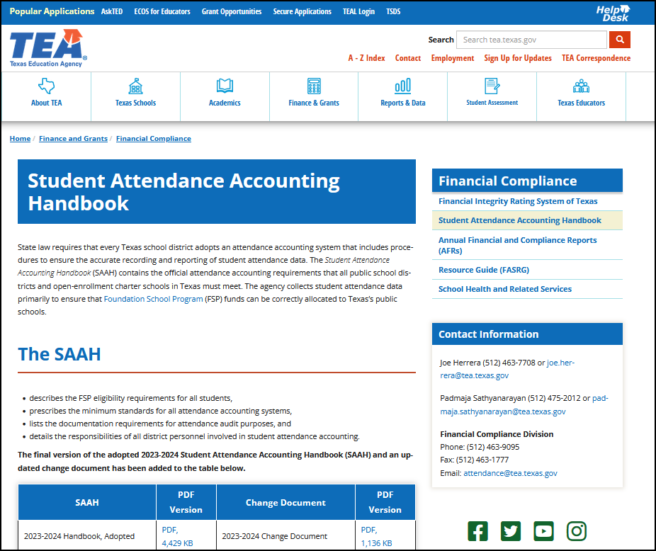
de SAAH Location

Slide 3
Contin SAAH: Why and How

Slide 4
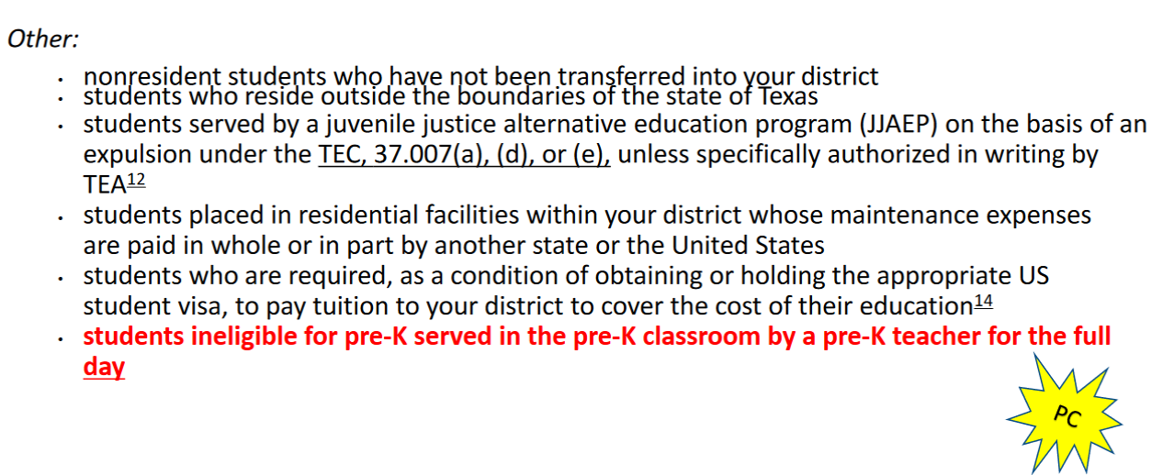
SAAH Section 3.2.1.5.3 ADA Code 4
SAAH Section 3.2.1.5 and 3.2.1.6 ADA Codes 4 and 5 have new examples listed.
A nonresident student who is charged tuition for the purposes of reducing local revenue

Slide 5
SAAH Section 3.2.1.6 ADA Code 5

Slide 6
SAAH Section 3.2.2 Funding Eligibility

Slide 7
SAAH Section 3.2.2.2 (HB 3803)

Slide 8
SAAH Section 3.3.1 (HB 1008)

Slide 9
SAAH Section 3.3.2 District Responsibility to Secure Records

Slide 10
SAAH Section 3.4.4 (HB3)

Slide 11
SAAH Section 3.4.4 (HB2892 and HB 1959)

Slide 12
SAAH Section 3.6.3 Requirements for a Student to Be Considered Present for FSP (Funding) Purposes

Slide 13
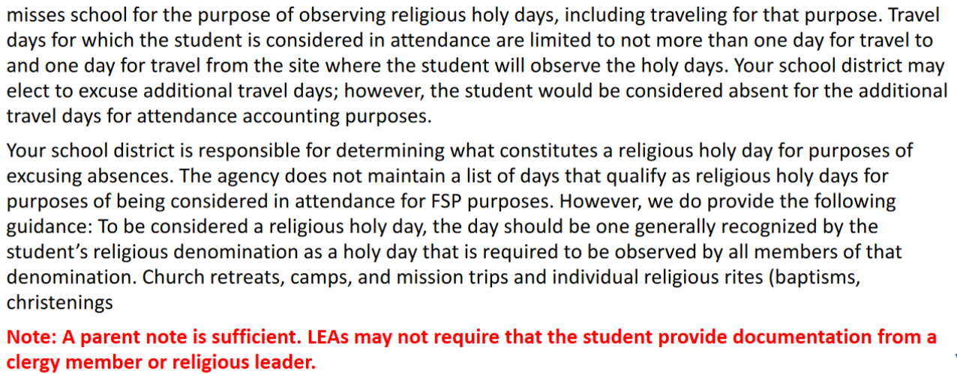
SAAH Section 3.6.3 (HB 1212) Religious Holy Days

Slide 14
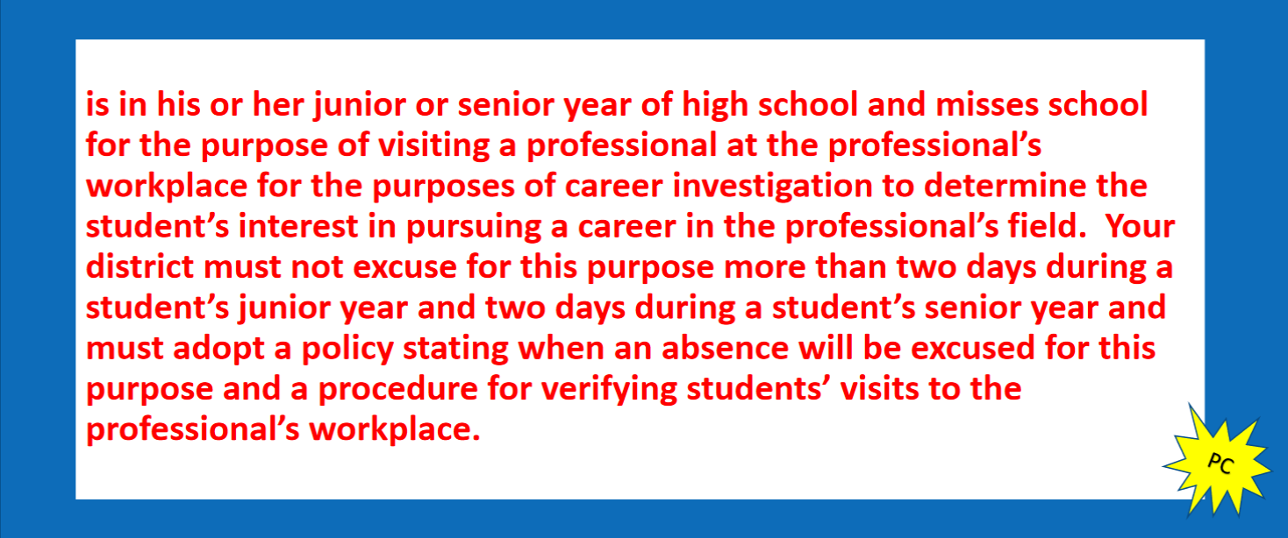
SAAH Section 3.6.3 (SB 68) Career Exploration
Explore career path should be handled the same way as a college day. Up to 2 days as a Junior and 2 days as a senior. A total of 8 days may be approved for both college day and career exploration.

Slide 15
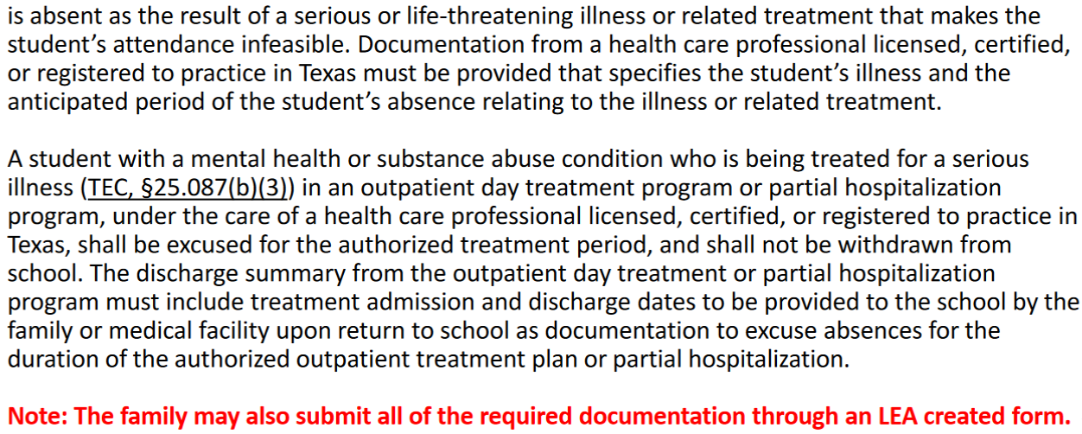
SAAH Section 3.6.3 Life-Threatening Illness Update

Slide 16
SAAH Section 3.7 General Education Homebound (GEH) Program

Slide 17
SAAH Section 3.7 General Education Homebound (GEH) Program

Slide 18
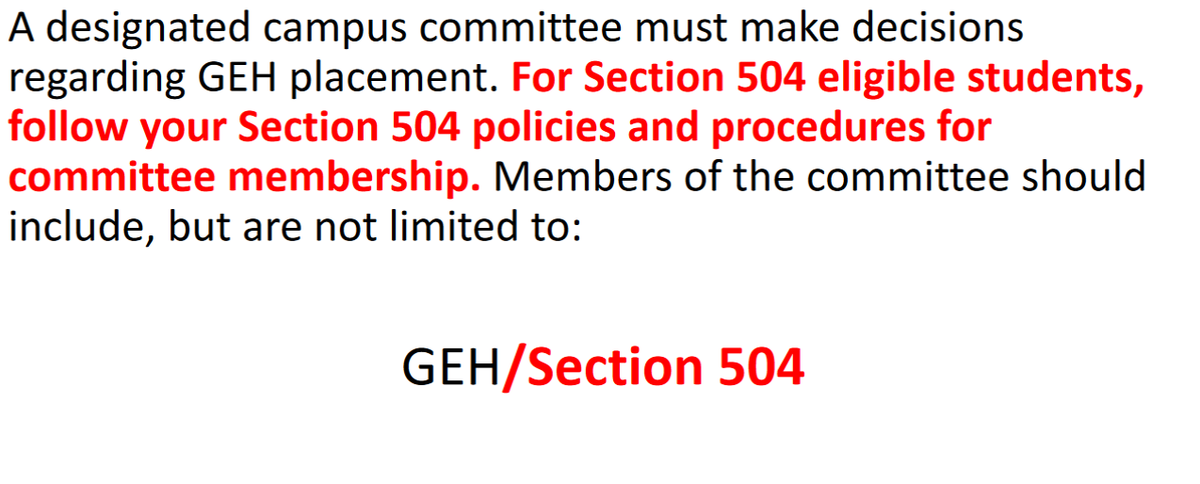
SAAH Section 3.7.2 GEH Committee

Slide 19
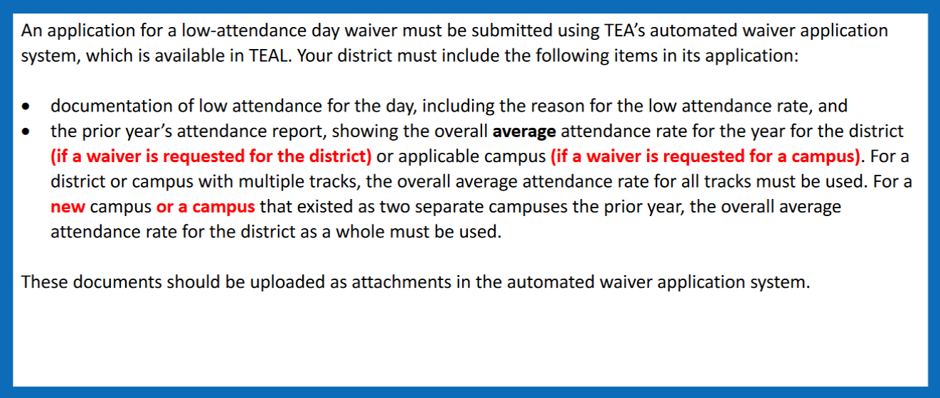
SAAH Section 3.8.1.4 Low-Attendance Waivers

Slide 20
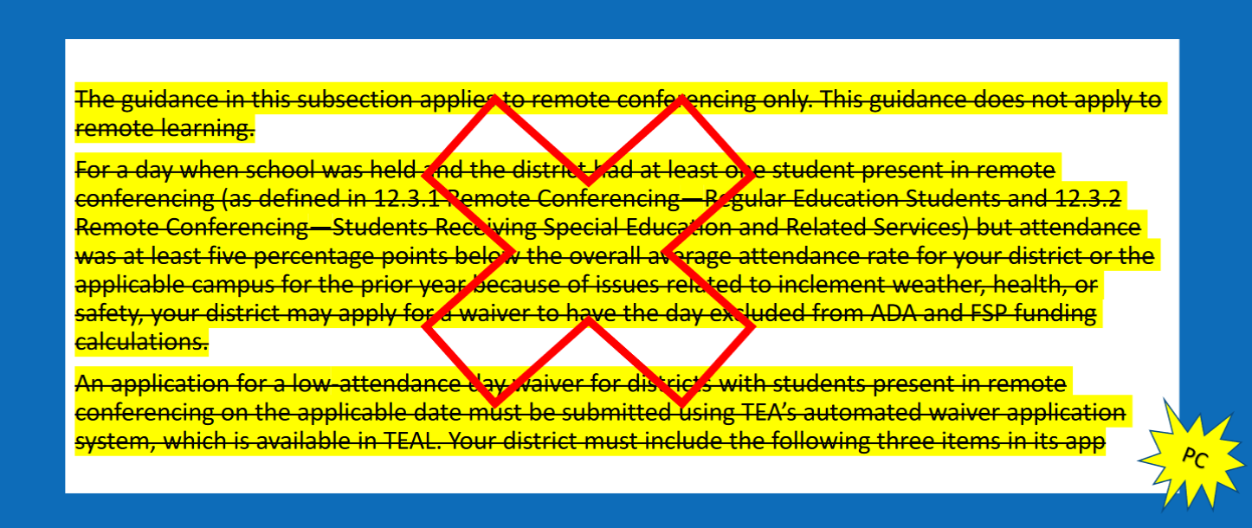
SAAH Section 3.8.1.5 Low-Attendance Waivers-Remote Conferencing

Slide 21
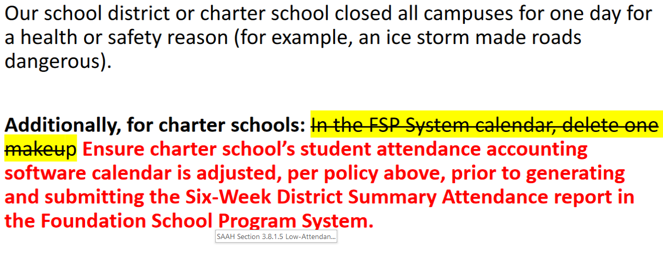
SAAH Section 3.8.2 Closures for Bad Weather or Other Issues of Health and Safety

Slide 22
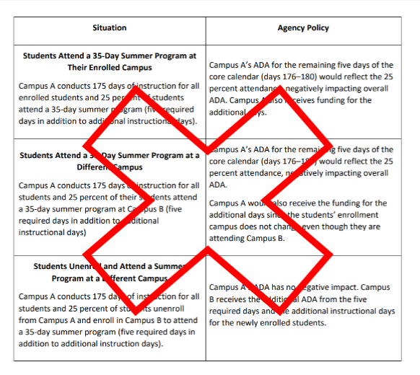
SAAH Section 3.8.3 Summer School and State Funding

Slide 23
SAAH Section 4.3.3 Enrollment Procedures for a Student Who Is New to Your District but was Previously Receiving Special Education Services

Slide 24
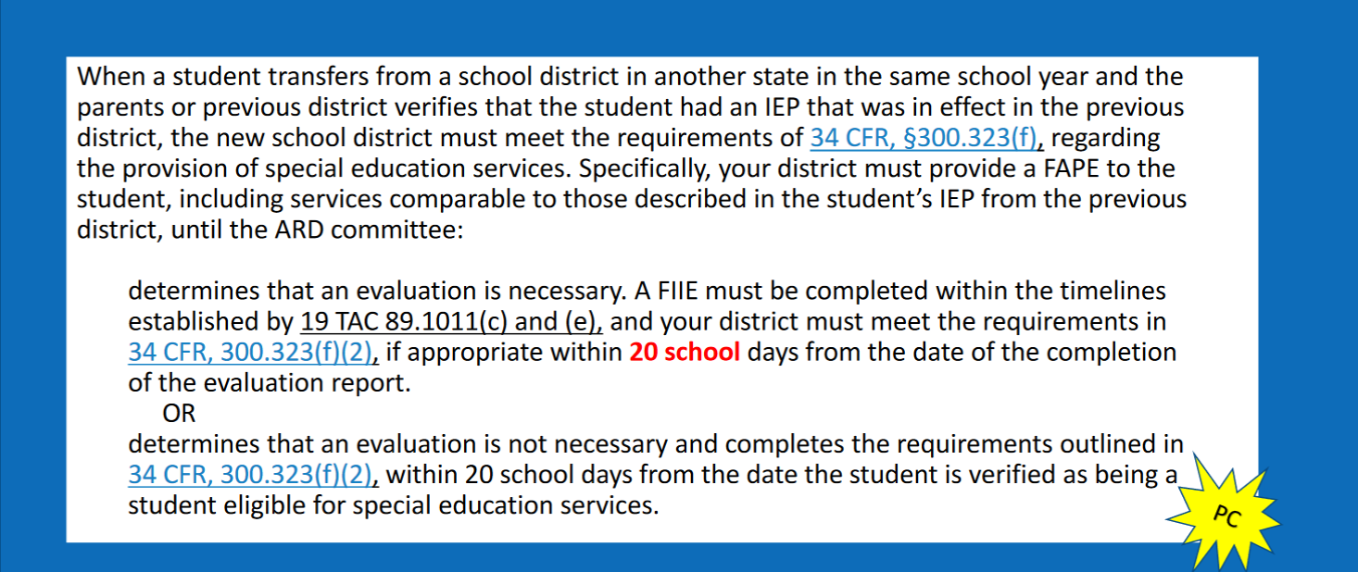
SAAH Section 4.3.3 Enrollment Procedures for a Student Who Is New to Your District but was Previously Receiving Special Education Services

Slide 25
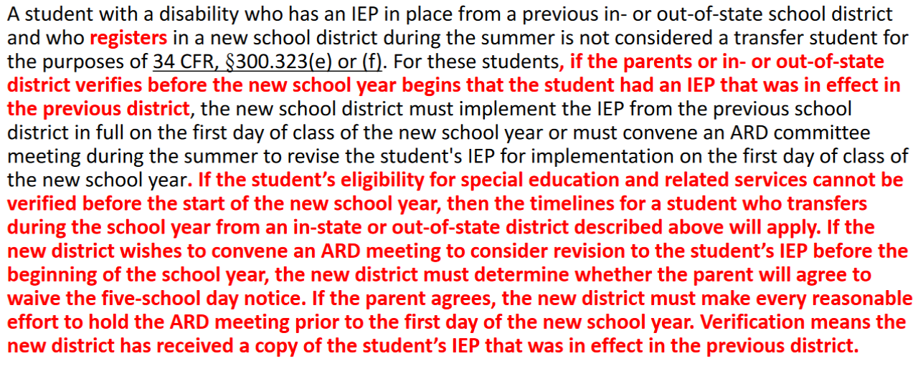
SAAH Section 4.3.3.2 Summer Enrollment Procedures

Slide 26
SAAH Section 4.7.2 Code 01 Homebound

Slide 27
SAAH Section 4.18.5 Codes 40 – Mainstream Examples

Slide 28
SAAH Section 4.18.5 Codes 41 and 42 – Resource Room/Service Examples

Slide 29
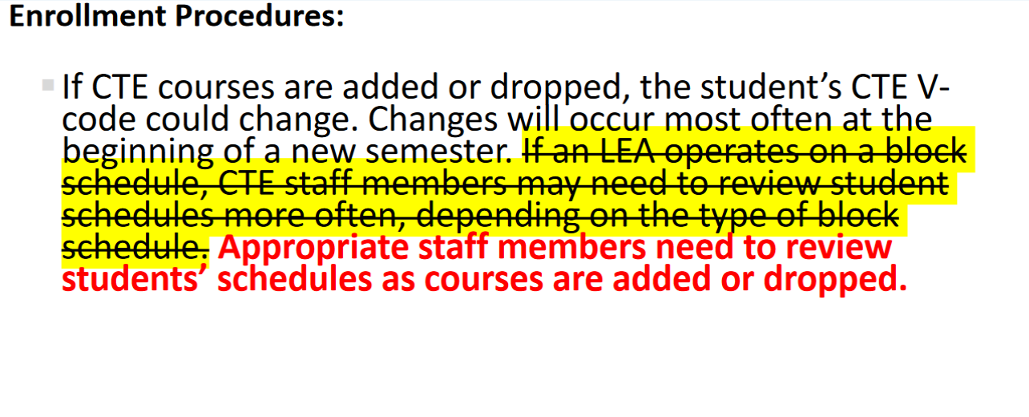
SAAH Section 5.3

Slide 30
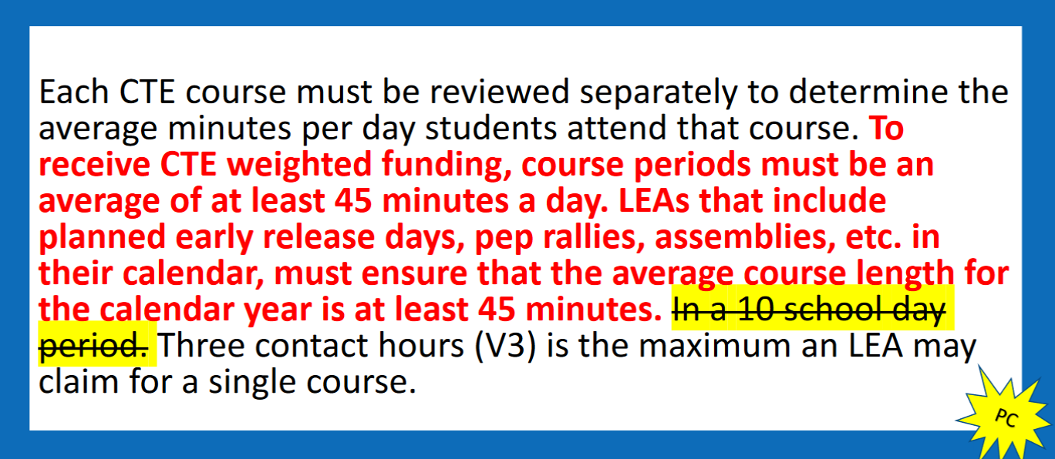
SAAH Section 5.5 (Contact Hour) Codes

Slide 31
SAAH Section 5.5 (Contact Hour) Codes

Slide 32
SAAH Section 5.5.1 (Referring to Operating a Block Schedule)

Slide 33
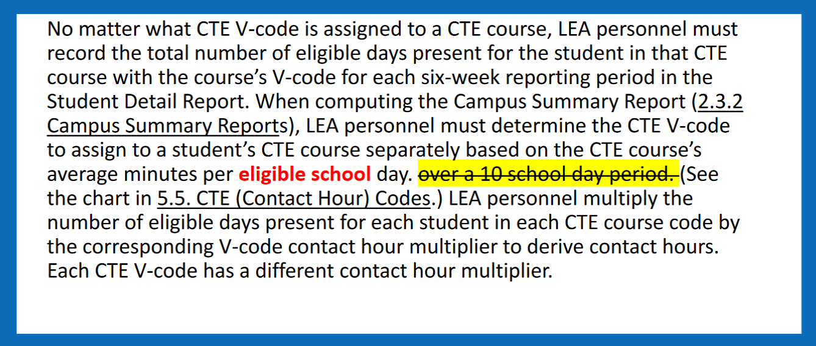
SAAH Section 5.6 Computing Contact Hours

Slide 34
SAAH Section 5.6 Computing Contact Hours

Slide 35
SAAH Section 5.7.5 Required Site Visits by Teachers

Slide 36
SAAH Section 5.10 Documentation

Slide 37
SAAH Section 5.12 Examples

Slide 38
SAAH Section 5.12 Examples 3

Slide 39
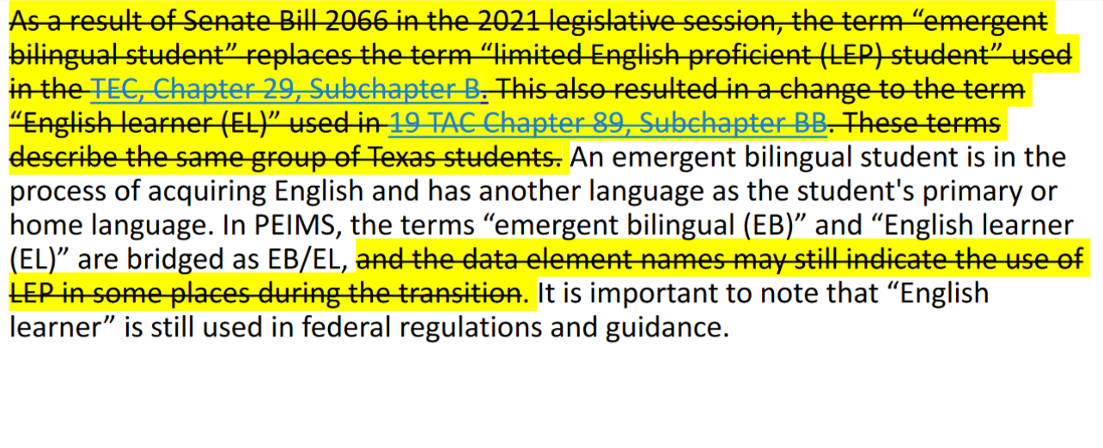
SAAH Section 6 Bilingual/English as a Second Language (ESL)

Slide 40
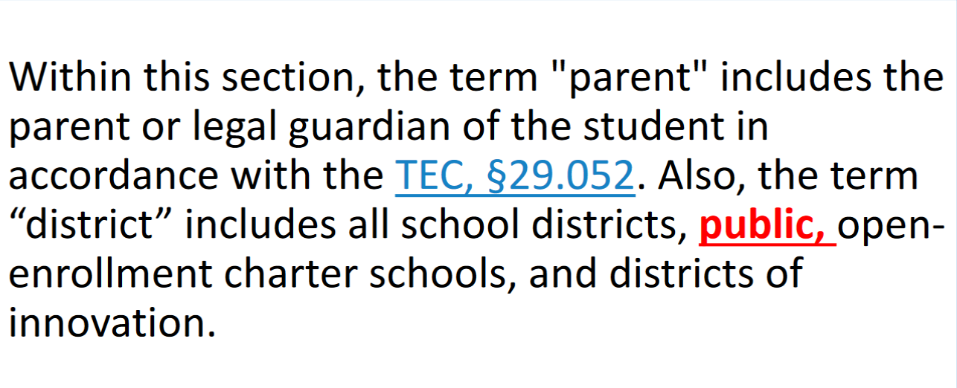
SAAH Section 6 Bilingual/English as a Second Language (ESL)

Slide 41
SAAH Section 6.2 Identification of EB Students and Enrollment Procedures

Slide 42
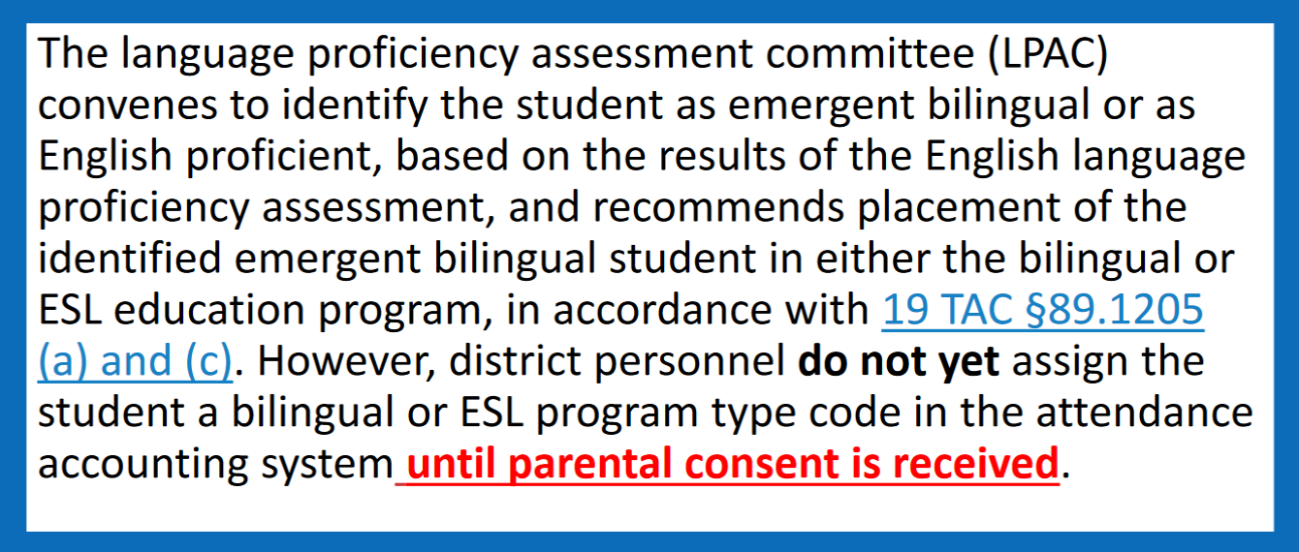
SAAH Section 6.2 Identification of EB Students and Enrollment Procedures

Slide 43
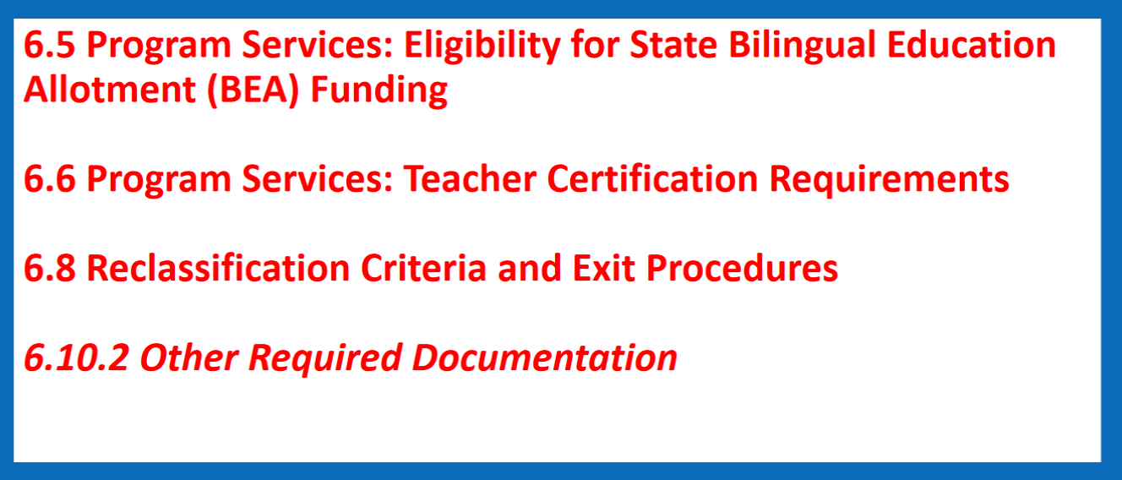
SAAH Section 6

Slide 44
SAAH Section 7.2 Eligibility

Slide 45
SAAH Section 7.2.6

Slide 46
SAAH Section 9 Pregnancy-Related Services (PRS)

Slide 47
SAAH Section 9 Pregnancy-Related Services (PRS)

Slide 48
SAAH 11.5.1 ADSY Program Design

Slide 49
SAAH 11.6 Optional Flexible School Day Program (OFSDP)

Slide 50
SAAH 11.6.4 (SB 1647)

Slide 51
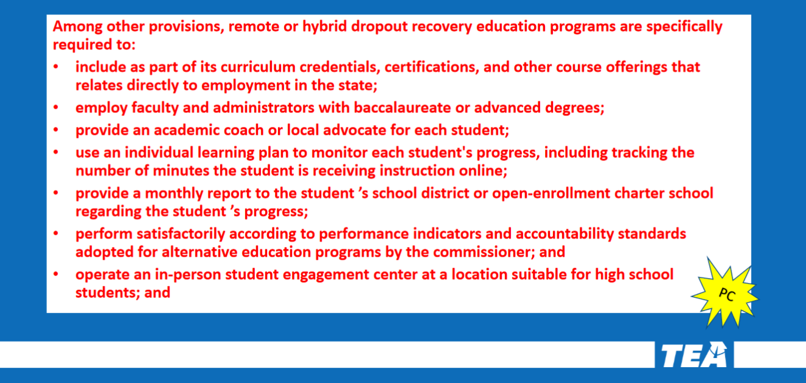
SAAH 11.6.4 (SB 1647)

Slide 52
SAAH 11.6.4 (SB 1647)

Slide 53
SAAH 11.6.4 (SB 1647)

Slide 54
SAAH 11.6.4 (SB 1647)

Slide 55
SAAH 12.3.1 Remote Conferencing-Regular Education Students

Slide 56
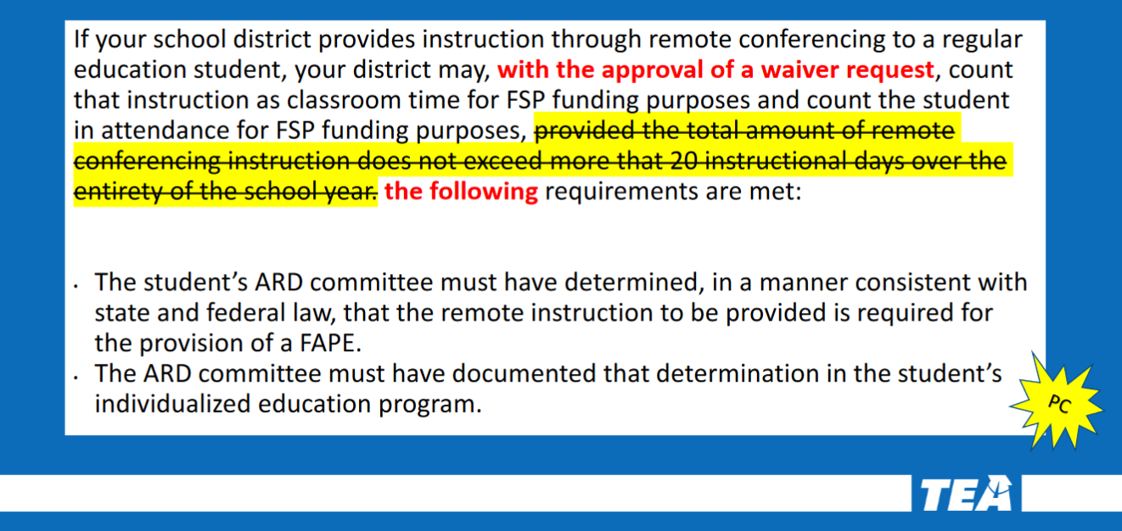
SAAH 12.3.1 Remote Conferencing-Special Education Students

Slide 57
SAAH 12.3.2 Remote Conferencing-Special Education Students

Slide 58
SAAH: 13 Glossary

Slide 59
SAAH: 13 Glossary

Slide 60
SAAH: 13 Glossary

Slide 61
SAAH: 13 Glossary

Slide 62
SAAH: 13 Glossary

Slide 63
SAAH: 13 Glossary

Slide 64
SAAH: 13 Glossary

