Slide 1
CCT Exam Topic 1: General Networking
Cisco Certified Technician: CCT
Supporting Cisco Routing & Switching Network Devices
Section 1.1
Use the OSI and TCP/IP models and their associated protocols to explain how data flows in a network
(This topic is covered in Intro to Networks v7 – 3.5, 4.2.1, 6.1.1, 8.1.1, 14.1.1)

Slide 2
CCT Exam Topic 1: General Networking
Cisco Certified Technician: CCT
Supporting Cisco Routing & Switching Network Devices
Section 1.2
Describe the basic functionality and key differences of this hardware: LAN switch, router, and wireless access points
(This topic is covered in Intro to Networks v7 – 1.2.3, 1.2.4, 1.3.2, 1.4.2)

Slide 3
CCT Exam Topic 1: General Networking
Cisco Certified Technician: CCT
Supporting Cisco Routing & Switching Network Devices
Section 1.3
Differentiate between these Layer 2 technologies: Ethernet, Fast Ethernet, Gigabit Ethernet, Serial, and Optical

Slide 4
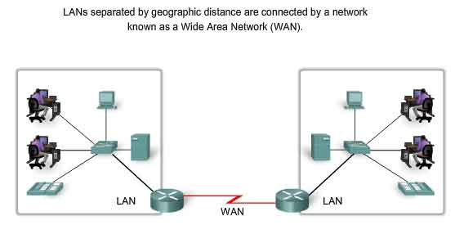
Cisco Certified Technician: CCT
Supporting Cisco Routing & Switching Network Devices
Differentiate Between Layer 2 Technologies Types of LAN Technology
One way to categorize networks is to divide them into local-area networks (LAN) and wide-area networks (WAN).
LANs typically are connected workstations, printers, and other devices within a limited geographic area such as a building.
All the devices in the LAN are under the common administration of the owner of that LAN, such as a company or an educational institution.
Most LANs today are Ethernet LANs.

Slide 5
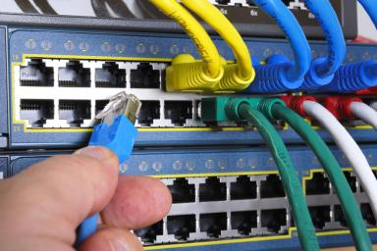
Cisco Certified Technician: CCT
Supporting Cisco Routing & Switching Network Devices
Differentiate Between Layer 2 Technologies Local-area networks - Ethernet
Ethernet is the most widely used LAN technology today.
Defined in the IEEE 802.2 and 802.3 standards.
802.3 standard defines rules for configuring an Ethernet network and also specifies how the elements in an Ethernet network interact with one another.
Since 1973, Ethernet standards have evolved specifying faster and more flexible versions of the technology.
Supports data bandwidths of 10 Mb/s, 100 Mb/s, 1000 Mb/s (1 Gb/s), 10,000 Mb/s (10 Gb/s), 40,000 Mb/s (40 Gb/s), and 100,000 Mb/s (100 Gb/s)

Slide 6
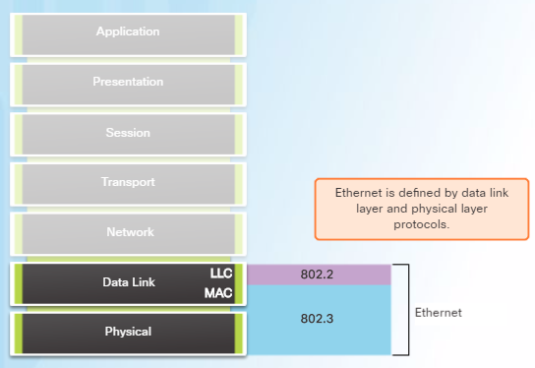
Cisco Certified Technician: CCT
Supporting Cisco Routing & Switching Network Devices
Differentiate Between Layer 2 Technologies Local-area networks - Ethernet
Ethernet operates in the data link layer and the physical layer.
Ethernet relies on the two separate sublayers of the data link layer to operate, the Logical Link Control (LLC) and the MAC sublayers.
Popular because it strikes a good balance between speed, cost and ease of installation. These benefits, combined with wide acceptance in the computer marketplace and the ability to support virtually all popular network protocols, make Ethernet an ideal networking technology for most computer users today.
A standard Ethernet network can transmit data at a rate up to 10 Megabits per second (10 Mbps).
OSI model

Slide 7
Cisco Certified Technician: CCT
Supporting Cisco Routing & Switching Network Devices
Differentiate Between Layer 2 Technologies Local-area networks - Fast Ethernet
Fast Ethernet standard (IEEE 802.3u) was established in 1995 for Ethernet networks that need higher transmission speeds.
This standard raises the Ethernet speed limit from 10 Mbps to 100 Mbps with only minimal changes to the existing cable structure.
Fast Ethernet provides faster throughput for video, multimedia, graphics, Internet surfing and stronger error detection and correction.

Slide 8
Cisco Certified Technician: CCT
Supporting Cisco Routing & Switching Network Devices
Differentiate Between Layer 2 Technologies Local-area networks - Fast Ethernet
Initially designed for copper-based twisted pair cable networks and included the 100 Base-TX, 100 Base-T4 and 100 Base-T2 standards.
Uses CAT5 and higher-rated twisted pair copper cable to connect various hubs, switches and end-nodes.
Length of the cable in copper-based fast Ethernet is restricted to 100 meters.
Fiber-based fast Ethernet standards 100 Base-FX, 100 Base SX, 100 Base BX and 100 Base LX10 use one or more strands and modes of fiber optics to transmit data.
100Base-FX which is used primarily to connect hubs and switches together either between wiring closets or between buildings.
100Base-FX uses multimode fiber-optic cable to transport Fast Ethernet traffic.

Slide 9
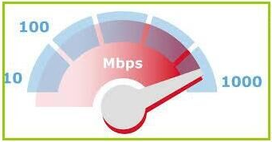
Cisco Certified Technician: CCT
Supporting Cisco Routing & Switching Network Devices
Differentiate Between Layer 2 Technologies Local-area networks - Gigabit Ethernet
Defined in the IEEE 802.3z.
Developed to meet the need for faster communication networks with applications such as multimedia and Voice over IP (VoIP).
GigE is a version of Ethernet that runs at speeds 10 times faster than 100Base-T.
GigE was released only a few years after Fast Ethernet, but was not widely used until the internet demands increased around 2010.
Used as a backbone in many networks, particularly those of large organizations.
Existing Ethernet LANs with 10 and 100 Mbps cards can feed into a Gigabit Ethernet backbone to interconnect high performance switches, routers and servers.

Slide 10
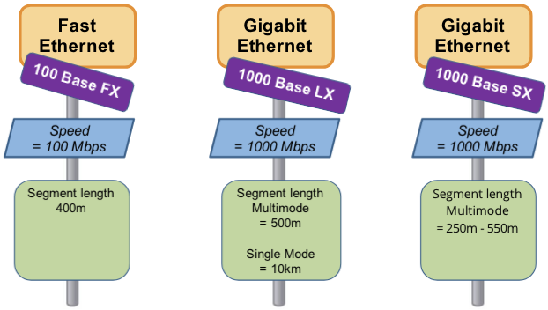
Cisco Certified Technician: CCT
Supporting Cisco Routing & Switching Network Devices
Differentiate Between Layer 2 Technologies Local-area networks - Fiber Media Comparison

Slide 11
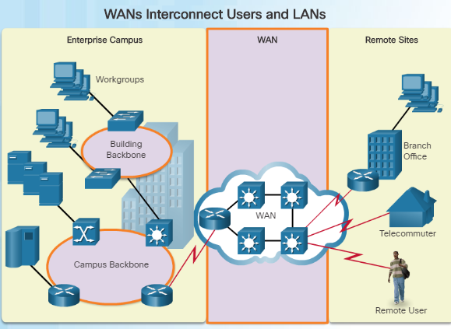
Cisco Certified Technician: CCT
Supporting Cisco Routing & Switching Network Devices
Differentiate Between Layer 2 Technologies Wide-area networks - WANs
A WAN operates beyond the geographic scope of a LAN.
WANs are used to interconnect the enterprise LAN to remote LANs in branch sites and telecommuter sites.
A WAN is owned by a service provider whereas a LAN is typically owned by an organization.
An organization must pay a fee to use the WAN service provider’s network services to connect remote sites.
Service providers provide links to interconnect remote sites for the purpose of transporting data, voice, and video.

Slide 12
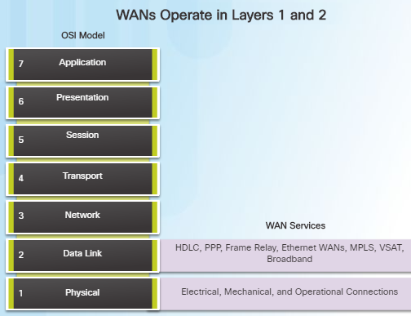
Cisco Certified Technician: CCT
Supporting Cisco Routing & Switching Network Devices
Differentiate Between Layer 2 Technologies Wide-area networks - WANs
WAN operations focus primarily on the physical and data link layer of the OSI Model.
Data link layer requirements include physical addressing, flow control and encapsulation.
WAN access standards are defined and managed by a number of recognized authorities:
TIA/EIA (Telecommunications Industry Association and the Electronic Industries Alliance)
ISO (International Organization for Standardization)
IEEE (Institute of Electrical and Electronics Engineers)
Layer 1 protocols describe how to provide electrical, mechanical, operational, and functional connects to the services of a communications service provider.
Layer 2 protocols define how data is encapsulated and the mechanisms for transferring the resulting frames.

Slide 13
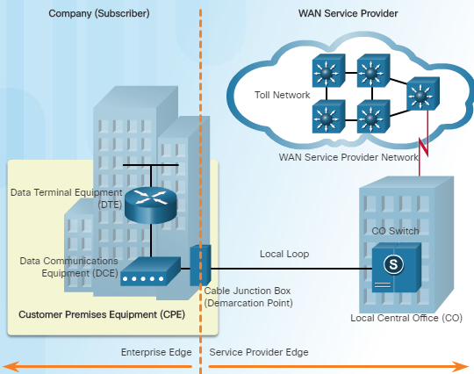
Cisco Certified Technician: CCT
Supporting Cisco Routing & Switching Network Devices
Differentiate Between Layer 2 Technologies Wide-area networks - Common WAN Terminology
One primary difference between a WAN and a LAN is that a company must subscribe to an outside WAN service provider to use WAN carrier network services.
Terminology commonly used to describe WAN connections:
Customer Premises Equipment (CPE) – Consists of devices and inside wiring located on the enterprise edge connecting to a carrier
Data Communications Equipment (DCE) – Also called circuit-terminating equipment, the DCE consists of devices that put data on the local loop. The DCE primarily provides an interface to connect subscribers to a communication link on the WAN cloud.

Slide 14
Cisco Certified Technician: CCT
Supporting Cisco Routing & Switching Network Devices
Differentiate Between Layer 2 Technologies Wide-area networks – Common WAN Terminology
Data Terminal Equipment (DTE) – The customer devices that pass the data from a customer network or host computer for transmission over the WAN. The DTE connects to the local loop through the DCE.
Demarcation Point – This is a point established in a building to separate customer equipment from service provider equipment.
Local Loop (“last mile”) – The actual copper or fiber cable that connects the CPE to the CO of the service provider.
Central Office (CO) – The CO is the local service provider facility or building that connects the CPE to the provider network.
Toll network – This consists of the long-haul, all-digital, fiber-optic communications lines and other equipment inside the WAN provider network.

Slide 15
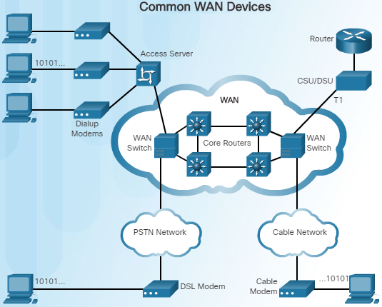
Cisco Certified Technician: CCT
Supporting Cisco Routing & Switching Network Devices
Differentiate Between Layer 2 Technologies Wide-area networks – WAN Devices
There are many types of devices that are specific to WAN environments:
Dialup modem – Legacy WAN technology that converts (modulates) the digital signals produced by a computer into voice frequencies which are transmitted over the analog lines of the public telephone network to another modem for demodulation.
Access server – Legacy technology where the server controls and coordinates dialup modem, dial-in and dial-out user communications.
Broadband modem – A type of digital modem used with high-speed DSL or cable Internet service. Both operate in a similar manner to the voiceband modem, but use higher broadband frequencies and transmission speeds.

Slide 16
Cisco Certified Technician: CCT
Supporting Cisco Routing & Switching Network Devices
Differentiate Between Layer 2 Technologies Wide-area networks –WAN Devices
CSU/DSU - Digital-leased lines require a CSU and a DSU. The CSU provides termination for the digital signal and ensures connection integrity through error correction and line monitoring. The DSU converts line frames into frames that the LAN can interpret and vice versa.
Router – Provides internetworking and WAN access interface ports that are used to connect to the service provider.
Core router/Multilayer switch – A router or multilayer switch that resides within the middle or backbone of the WAN.

Slide 17
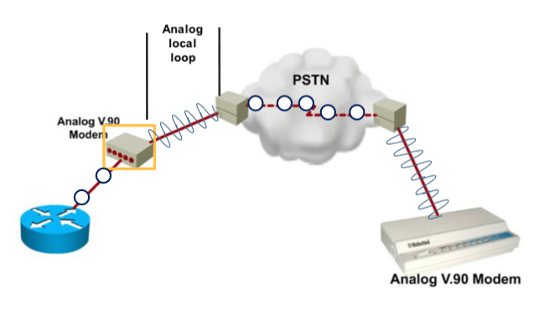
Cisco Certified Technician: CCT
Supporting Cisco Routing & Switching Network Devices
Differentiate Between Layer 2 Technologies Wide-area networks – Circuit Switching
A circuit-switched network is one that establishes a dedicated circuit (or channel) between nodes and terminals before the users may communicate.
Circuit switching operates like a dial-up connection.
Communication cannot start until the connection is established through the service provider network.
Dialing a number to make a call is an example of circuit switching technology.
The two most common types of circuit-switched WAN technologies are the public switched telephone network (PSTN) and the Integrated Services Digital Network (ISDN).

Slide 18
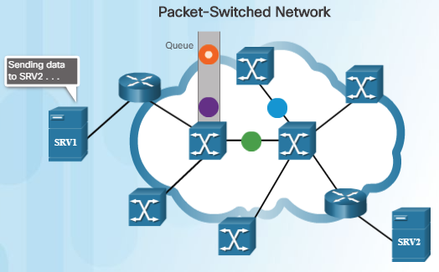
Cisco Certified Technician: CCT
Supporting Cisco Routing & Switching Network Devices
Differentiate Between Layer 2 Technologies Wide-area networks – Circuit Switching
A circuit-switched network is one that establishes a dedicated circuit (or channel) between nodes and terminals before the users may communicate.
Circuit switching operates like a dial-up connection.
Communication cannot start until the connection is established through the service provider network.
Dialing a number to make a call is an example of circuit switching technology.
The two most common types of circuit-switched WAN technologies are the public switched telephone network (PSTN) and the Integrated Services Digital Network (ISDN).

Slide 19
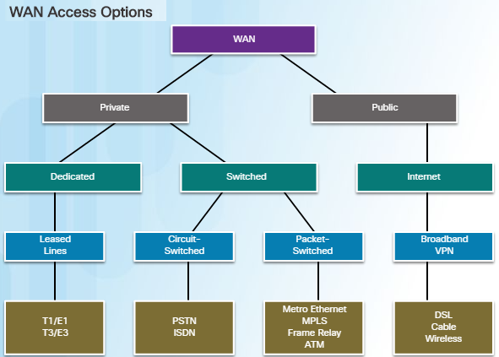
Cisco Certified Technician: CCT
Supporting Cisco Routing & Switching Network Devices
Differentiate Between Layer 2 Technologies Wide-area networks – Connection Options
There are several WAN access connection options that ISPs can use to connect the local loop to the enterprise edge.
Each option has distinct advantages and disadvantages as well as differences with technology, speed, and cost.
There are two ways an enterprise can obtain WAN access:
Private WAN infrastructure – Choices may include dedicated point-to-point leased lines, circuit-switched links such as PSTN or ISDN, and packet switched links such as Ethernet WAN, ATM, or Frame Relay.
Public WAN infrastructure – Service providers may offer broadband Internet using DSL, cable, or satellite access. Data traveling between corporate sites over a public WAN should be protected using VPNs.

Slide 20
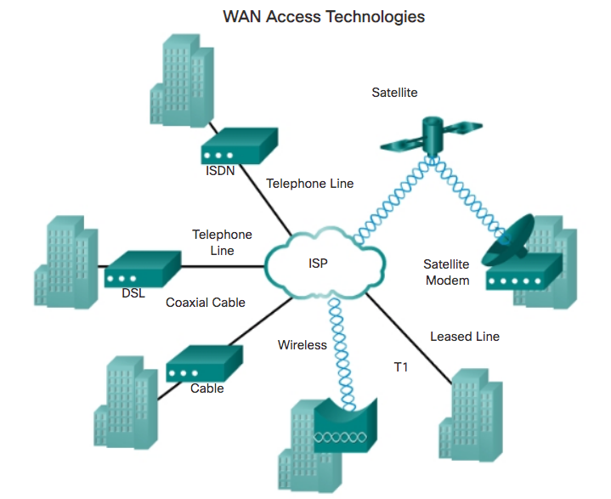
Cisco Certified Technician: CCT
Supporting Cisco Routing & Switching Network Devices
Differentiate Between Layer 2 Technologies Wide-area networks – WAN Access Technologies
ISDN - Integrated Services Digital Network (ISDN) is a set of communication standards for simultaneous digital transmission of voice, video, data, and other network services over the traditional circuits of the public switched telephone network.
Satellite - Satellite connections offer connectivity anywhere in the world. A satellite Internet connection is an arrangement in which the upstream (outgoing) and the downstream (incoming) data are sent from, and arrive at, a computer through a satellite.
Satellite Modem - A satellite modem or satmodem is a modem used to establish data transfers using a communications satellite as a relay. A satellite modem's main function is to transform an input bitstream to a radio signal and vice versa.

Slide 21
Cisco Certified Technician: CCT
Supporting Cisco Routing & Switching Network Devices
Differentiate Between Layer 2 Technologies Wide-area networks – WAN Access Technologies
Leased Lines (T1) - A leased line, also known as a dedicated line, connects two locations for private voice and/or data telecommunication service. A leased line is not a dedicated cable; it is a reserved circuit between two points. The leased line is always active and available for a fixed monthly fee.
Wireless WAN - Wireless WAN is a wide area network in which separate areas of coverage or cells are connected wirelessly to provide service to a large geographic area.
Cable - Cable Internet access is a form of broadband Internet access which uses the same infrastructure as a cable television.
DSL - Digital Subscriber Line Internet is a technology that connects your home to the internet over telephone lines. DSL is great for light internet use, such as web browsing or email. It is not recommended for activities that require significant speed, such as multi-screen HD video streaming or multiplayer, online gaming.

Slide 22
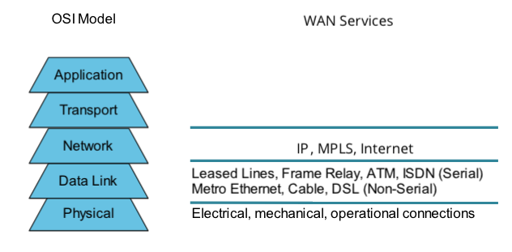
Cisco Certified Technician: CCT
Supporting Cisco Routing & Switching Network Devices
Differentiate Between Layer 2 Technologies Wide-area networks – WAN Access Technologies
Most WAN protocols and technologies are layer 2 protocols (data link layer). The key WAN protocols that are in use are Asynchronous Transfer Mode (ATM), Broadband Access, Frame Relay, Point-to-Point Protocol (PPP), Synchronous Optical Network (SONET), Synchronous Digital Hierarchy (SDH), X.
WAN Access and the OSI Model

Slide 23
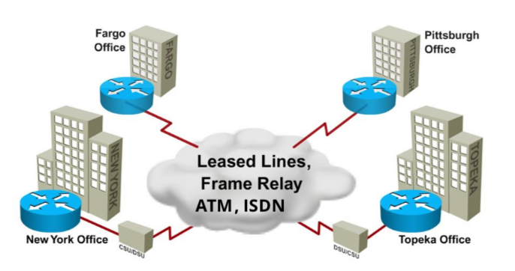
Cisco Certified Technician: CCT
Supporting Cisco Routing & Switching Network Devices
Differentiate Between Layer 2 Technologies Wide-area networks – Point-to-Point Connections
One of the most common types of WAN connections is the point-to-point connection.
A point-to-point connection is also referred to as a serial of leased line connection because the lines are leased from a carrier and are dedicated for use by the company leasing the lines.
Companies pay for a continuous connection between two remote sites, and the line is continuously active and available.
Leased lines are priced based on the bandwidth required and the distance between the two connected points.

Slide 24
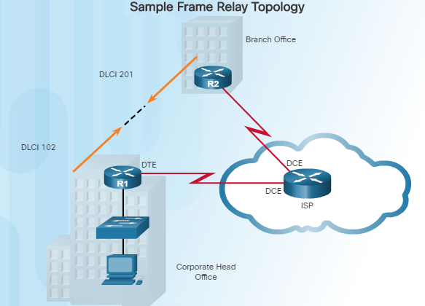
Cisco Certified Technician: CCT
Supporting Cisco Routing & Switching Network Devices
Differentiate Between Layer 2 Technologies Wide-area networks – Point-to-Point Connections
Frame Relay is a packet-switching protocol that was known to be cost-effective.
Shared bandwidth technology.
All customers share the same provider circuits to interconnect their remote sites.
Each router needs only a singe WAN interface, even when multiple virtual circuits are to be used.
In Frame Relay, the end of each connection has a number to identify it called a data link connection identifier (DLCI). Any station can connect with any other simply by stating the address of that station and DLCI number of the line it must use.

Slide 25
CCT Exam Topic 1: General Networking
Cisco Certified Technician: CCT
Supporting Cisco Routing & Switching Network Devices
Section 1.4
Describe LAN Cabling
(This topic is covered in Intro to Networks v7 – 4.4 and 4.5

Slide 26
CCT Exam Topic 1: General Networking
Cisco Certified Technician: CCT
Supporting Cisco Routing & Switching Network Devices
Section 1.5
Describe the function of the CSU/DSU

Slide 27
Cisco Certified Technician: CCT
Supporting Cisco Routing & Switching Network Devices
Describe what a CSU/DSU does CSU/DSU
Video:
https://www.professormesser.com/network-plus/n10-007/wan-termination/

Slide 28
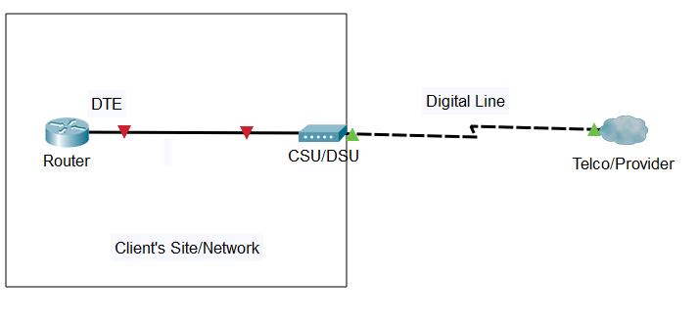
Cisco Certified Technician: CCT
Supporting Cisco Routing & Switching Network Devices
Describe what a CSU/DSU does CSU/DSU
A CSU/DSU (channel service unit/data service unit) is a digital-interface device used to connect data terminal equipment (DTE), such as a router, to a digital circuit, such as a T1 line. A CSU/DSU is the equivalent of the modem for an entire LAN.
CSU/DSU can be used to connect a router to a digital circuit such as Leased Line or Frame Relay connection.

Slide 29
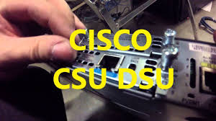
Cisco Certified Technician: CCT
Supporting Cisco Routing & Switching Network Devices
Describe what a CSU/DSU does CSU/DSU
A CSU/DSU converts a digital data frame from the communications technology used on a local area network (LAN) into a frame appropriate to a wide-area network (WAN) and vice versa.
Digital lines, such as T1 and T3 carrier lines, require a channel service unit (CSU) and a data service unit (DSU). The two are often combined into a single piece of equipment, called the CSU/DSU. The CSU provides termination for the digital signal and ensures connection integrity through error correction and line monitoring. The DSU converts the T-carrier line frames into frames that the LAN can interpret and vice versa.
For example, if you have a Web business from your own home and have leased a digital line (perhaps a T-1 or fractional T-1 line) to a phone company or a gateway at an Internet service provider, you have a CSU/DSU at your end and the phone company or gateway host has a CSU/DSU at its end.

Slide 30
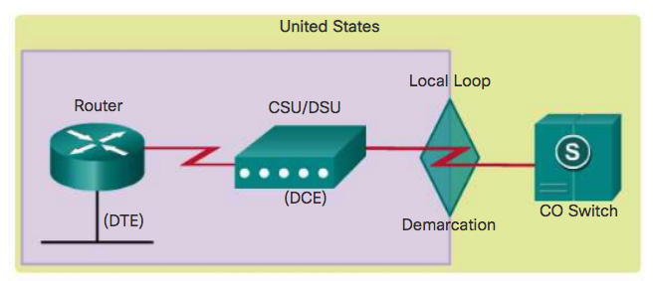
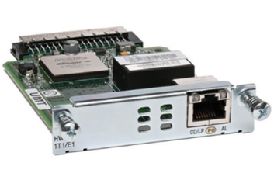
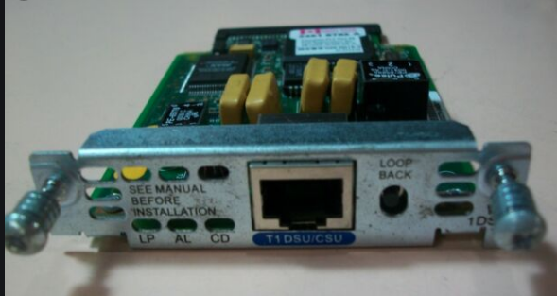
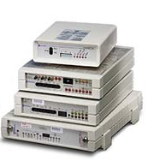
Cisco Certified Technician: CCT
Supporting Cisco Routing & Switching Network Devices
Describe what a CSU/DSU does CSU/DSU
Channel Service Unit (CSU)
Receives and transmits signals from and to the WAN line
Provides a barrier for electrical interference from either side of the unit
Can also echo loopback signals from the phone company for testing purposes
Data Service Unit (DSU)
Manages line control and converts input and output
Manages timing errors and signal regeneration
Provides a modem-like interface between the router as Data Terminal Equipment (DTE) and the CSU
CSU/DSUs are made as separate products or are sometimes part of a T-1 WAN card.

Slide 31
CCT Exam Topic 1: General Networking
Cisco Certified Technician: CCT
Supporting Cisco Routing & Switching Network Devices
Section 1.6
Describe Telco termination point

Slide 32
Cisco Certified Technician: CCT
Supporting Cisco Routing & Switching Network Devices
Describe Telco Termination Point Demarcation Point
Video:
https://www.professormesser.com/network-plus/n10-007/wan-termination/

Slide 33
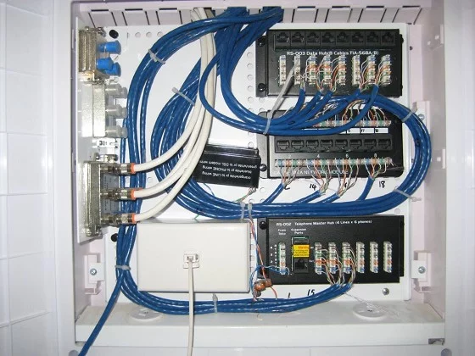
Cisco Certified Technician: CCT
Supporting Cisco Routing & Switching Network Devices
Describe Telco Termination Point Demarcation Point
A demarcation point (demarc) is the physical point at which a telecommunications company's public network ends and the customer's private network begins. The demarcation point is often the point at which the cable physically enters the building, but this varies from one country to another.
Defines where the telephone company’s responsibility for maintenance ends and the consumer's responsibility begins.
Referred to as a network terminating interface or demarc.
The termination often occurs in the telecommunications closet and the customer is responsible for maintaining, repairing and replacing the equipment.

Slide 34
Cisco Certified Technician: CCT
Supporting Cisco Routing & Switching Network Devices
Describe Telco Termination Point Demarcation Point
In the United States, a telco provides the local loop into the customer premises and the customer provides the active equipment such as the channel service unit/data service unit (CSU/DSU) on which the local loop is terminated.

Slide 35
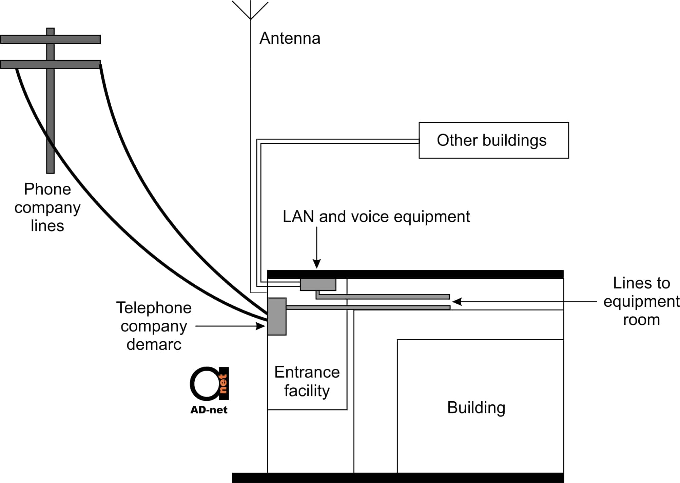
Cisco Certified Technician: CCT
Supporting Cisco Routing & Switching Network Devices
Describe Telco Termination Point Demarcation Point

Slide 36
CCT Exam Topic 1: General Networking
Cisco Certified Technician: CCT
Supporting Cisco Routing & Switching Network Devices
Section 1.7
Describe an IPv4 and IPv6 address and subnet (This topic is covered in Intro to Networks v7 – 3.7.2, 11.1, 12.2)

Slide 37
CCT Exam Topic 1: General Networking
Cisco Certified Technician: CCT
Supporting Cisco Routing & Switching Network Devices
Section 1.8
Describe the function of FTP, TFTP and Ping
(This topic is covered in Intro to Networks v7 – Sections 3.3.4, 14.1.3, 14.2.4, 14.3.4, 15.1.3, 15.5.1, and Module 13

Slide 38
Cisco Certified Technician: CCT
Supporting Cisco Routing & Switching Network Devices
Describe Cisco IOS Software Operation
Describe what TFTP does
Trivial File Transfer Protocol (TFTP) is a software utility used for transferring files.
TFTP was designed to be small and easy to implement, and therefore it lacks most of the advanced features offered by more robust file transfer protocols. It is generally only used on local area networks (LAN) and uses UDP well-known port number 69.
It is good practice to keep a backup copy of the Cisco IOS Software image in case the system image in the router becomes corrupted or accidentally erased. It is also good practice to keep a backup copy of the configuration file.

Slide 39
Cisco Certified Technician: CCT
Supporting Cisco Routing & Switching Network Devices
Describe Cisco IOS Software Operation
Describe what TFTP does
Using a network TFTP server allows image and configuration uploads and downloads over the network. The network TFTP server can be another router, a workstation, or a host system.
Cisco frequently releases new versions of the IOS and the TFTP server can also be used to upload a new IOS to a router or switch.
Many free versions of tftp are available. The lab uses http://tftpd32.jounin.net/tftpd32_download.html

Slide 40
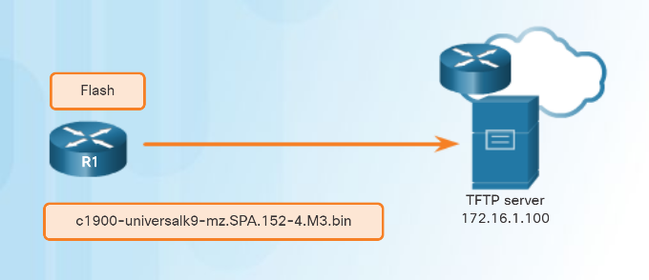
Cisco Certified Technician: CCT
Supporting Cisco Routing & Switching Network Devices
Describe Cisco IOS Software Operation
Perform software upgrade or downgrade using TFTP
Using a network TFTP server allows image and configuration uploads and downloads over the network. The network TFTP server can be another router, a workstation, or a host system.
In Figure 1, the network administrator wants to create a backup of the current image file on the router (c1900-universalk9-mz.SPA.152-4.M3.bin) to the TFTP server at 172.16.1.100.

Slide 41
Cisco Certified Technician: CCT
Supporting Cisco Routing & Switching Network Devices
Describe Cisco IOS Software Operation
Perform software upgrade or downgrade using TFTP
To create a backup of the Cisco IOS image to a TFTP server, perform the following three steps:
Step 1. Ensure that there is access to the network TFTP server. Ping the TFTP server to test connectivity.
Step 2. Verify that the TFTP server has sufficient disk space to accommodate the Cisco IOS Software image. Use the show flash: command on the router to determine the size of the Cisco IOS image file. The file in the example is 68831808 bytes long.
Step 3. Copy the image to the TFTP server using the copy source-url destination-url command.
After issuing the command using the specified source and destination URLs, the user is prompted for the source file name, IP address of the remote host, and destination file name. The transfer will then begin.
Verify connectivity to the server.
R1# ping 172.16.1.100
Type escape sequence to abort.
Sending 5, 100-byte ICMP Echos to 172.16.1.100, timeout is 2
Seconds:
!!!!!
Success rate is 100 percent (5/5),
Round-trip min/avg/max = 56/56/56/ ms
Verify the image size.
R1# show flash:
-# - --length-- -----date/time------path
68831808 Apr 2 2013 21:29:58 +00:00
c1900-universalk9-mz.SPA.152-4.M3.bin
<output omitted>
Copy image to TFTP server.
R1# copy flash0:
Source filename []? c1900-universalk9-mz.SPA.152-4.M3.bin
Address or name of remote host []? 172.16.1.100
Destination filename [c1900-universalk9-mz.SPA.152-4.M3.bin]?
!!!!!!!!!!!!!!!!!!!!!!!!!!!!!!!!!!!!!!!!!!!!!!!!!!!!
<output omitted>
68831808 bytes copied in 363468 secs (269058 bytes/sec)

Slide 42
Cisco Certified Technician: CCT
Supporting Cisco Routing & Switching Network Devices
Describe Cisco IOS Software Operation
Perform software upgrade or downgrade using TFTP
Cisco frequently releases new versions of the IOS to resolve bugs and provide new features.
Follow these steps to upgrade the software on a Cisco router:
Step 1. Select a Cisco IOS image file that meets the requirements in terms of platform, features, and software. Download the file from cisco.com and transfer it to the TFTP server.
Step 2. Verify connectivity to the TFTP server. Ping the TFTP server from the router. The output in Figure 2 shows the TFTP server is accessible from the router.

Slide 43
Cisco Certified Technician: CCT
Supporting Cisco Routing & Switching Network Devices
Describe Cisco IOS Software Operation
Perform software upgrade or downgrade using TFTP
Step 3. Ensure that there is sufficient flash space on the router that is being upgraded. The amount of free flash can be verified using the show flash: command. Compare the free flash space with the new image file size. The show flash: command in Figure 3 is used to verify free flash size. Free flash space in the example is 182,394,880 bytes.
Step 4. Copy the IOS image file from the TFTP server to the router using the copy tftp command. After issuing this command with specified source and destination URLs, the user will be prompted for IP address of the remote host, source file name, and destination file name. The transfer of the file will then begin.
Step 5. Use the show flash command to verify that the file was successfully copied.

Slide 44
Activity to Complete
Cisco Certified Technician: CCT
Supporting Cisco Routing & Switching Network Devices
3.5.1 - Lab - Managing Router Configuration Files with Terminal Emulation Software
Review
2.8.1 - Lab - Managing Device Configuration Files Using TFTP, Flash, and USB
2.8.2 - Packet Tracer - Using a TFTP Server to Upgrade a Cisco IOS Image

Slide 45
Cisco Certified Technician: CCT
Supporting Cisco Routing & Switching Network Devices
Describe Cisco IOS Software Operation
Perform software upgrade or downgrade using USB
Step 1. Select a Cisco IOS image file that meets the requirements in terms of platform, features, and software. Download the file from cisco.com and transfer it to a FAT32 formatted USB flash drive.
Step 2. Boot router and Install USB flash drive.
Step 3. Establish session in PuTTY or TeraTerm via console connection
Step 4. Enter enable command to enter privileged mode.
Step 5. Enter: copy usb0:isr4200-universalk9_ias.16.09.03.SPA.bin bootflash: command. This copies the IOS from the usb flash drive to the router.
Step 6. Reload. To ensure that the router boots from this new IOS Use control and Pause/break to interrupt the boot process and enter ROMMON.
R1> enable
R1# copy usb0: isr4300-universalk9.03.16.05.S.155-3.S5-ext.SPA.bin bootflash:
R1# reload
rommon>

Slide 46
Cisco Certified Technician: CCT
Supporting Cisco Routing & Switching Network Devices
Describe Cisco IOS Software Operation
Perform software upgrade or downgrade using USB
Step 7. In ROMMON use command confreg 0x2142 so that on next reload the router will bypass the current saved configuration.
Step 8. In ROMMON Enter command: boot bootflash:isr4200-universalk9_ias.16.09.03.SPA.bin this ensures that the router will boot from the new IOS.
Step 9. Use enable to enter privileged mode and configure terminal to go into global configuration mode. Enter command: boot system bootflash:isr4200-universalk9_ias.16.09.03.SPA.bin to boot from this IOS.
Step 10. To return router to default boot mode on next reload use config-reg 0x2102 command
Step 11. Save this configuration using copy running config-startup config command
Step 12. Reload router and then issue show version command to verify that the router booted from the new IOS.
rommon> confreg 0x2142
rommon> boot bootflash:isr4300-universalk9.03.16.05.S.155-3.S5-ext.SPA.bin
R1>enable
R1# configure terminal
R1(config)# boot system bootflash:isr4300-universalk9.03.16.05.S.155-3.S5-ext.SPA.bin
R1(config)# config-reg 0x2102
R1(config)# exit
R1# copy running config-startup config
R1# show version
Cisco IOS XE Software, Version 03.16.05.S - Extended Support Release
Cisco IOS Software, ISR Software (X86_64_LINUX_IOSD-UNIVERSALK9-M), Version Version 15.5 (3)S5, RELEASE SOFTWARE (fc2)
.
. <output omitted>
.
Configuration register is 0x2102

Slide 47
CCT Exam Topic 1: General Networking
Cisco Certified Technician: CCT
Supporting Cisco Routing & Switching Network Devices
Section 1.9
Describe the function of Telnet and SSH
(This topic is covered in Intro to Networks v7 – 16.4.4, 17.2.2, 17.6.4)

Slide 48
Cisco Certified Technician: CCT

