Slide 1
Ed-Fi API: Future of PEIMS
2023

Slide 2
How do you feel about Ed Fi Upgrade?

Slide 3
Comparison of Legacy XML to Ed Fi API
Notes:
Kim presents

Slide 4
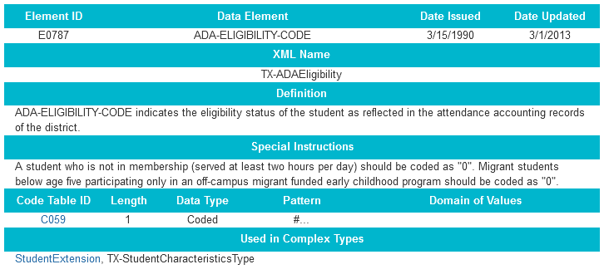
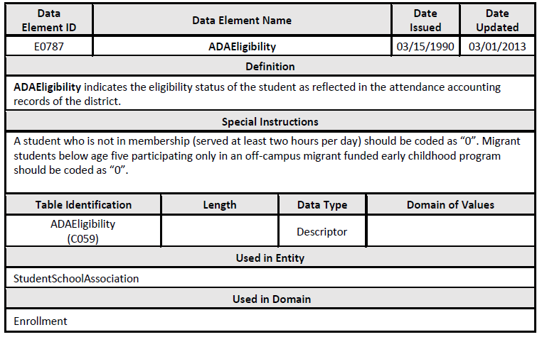
What is the SAME?
DATA ELEMENTS

Slide 5
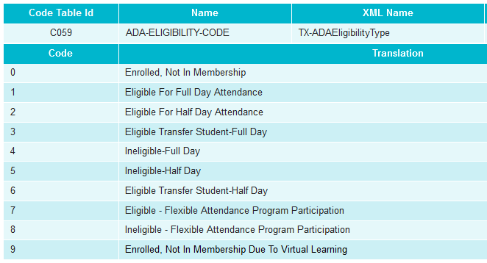
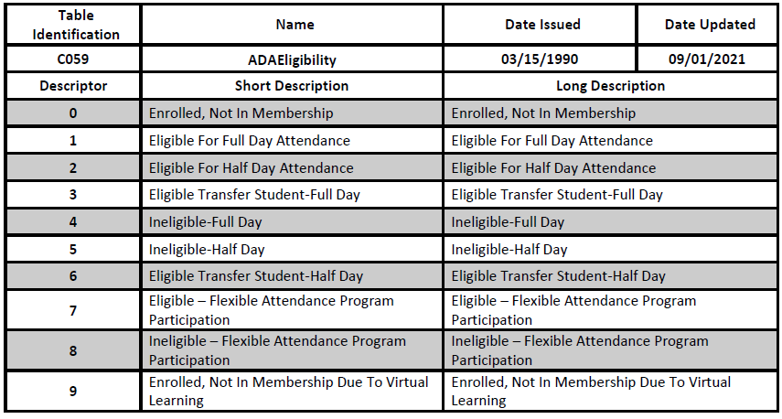
What is the SAME?
CODE TABLES = DESCRIPTORS

Slide 6
What is the SAME?
<TX-SchoolELO>
<TX-ELOType>04</TX-ELOType>
<TX-SchoolELOActivity>
<TX-ELOActivityCode>01</TX-ELOActivityCode>
<TX-ELODaysScheduledPerYear>20</TX-ELODaysScheduledPerYear>
<TX-ELOMinutesScheduledPerDay>120</TX-ELOMinutesScheduledPerDay>
</TX-SchoolELOActivity>
</TX-SchoolELO>
</TX-SchoolELOS>
SUB COMPLEX TYPE = ENTITY

Slide 7
What is the SAME?
TSDS PROMOTION/VALIDATION/REPORTS

Slide 8
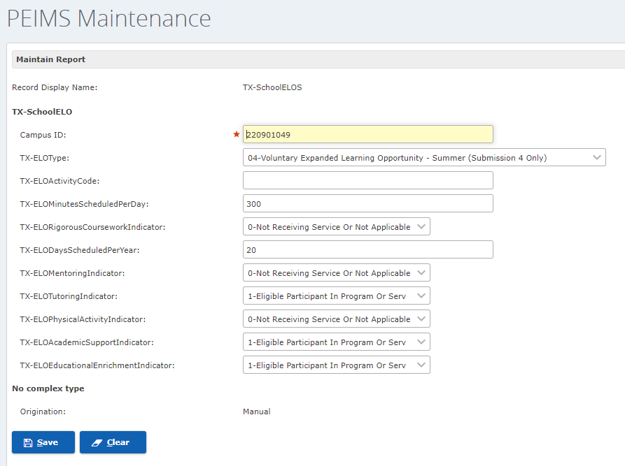
PEIMS MAINTAIN AREA
What is DIFFERENT?
XXXX

Slide 9
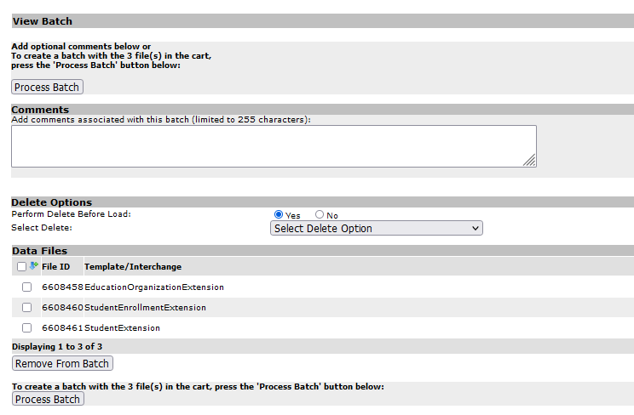
CURRENT = XML
What is DIFFERENT?
XXXX

Slide 10
File Upload
FUTURE = API
API Calls (Application Program Interface)
Will have either add, update or logical delete
Payload - Data SIS sent
Data River - flows only one way
Notes:
so what does that mean…

Slide 11
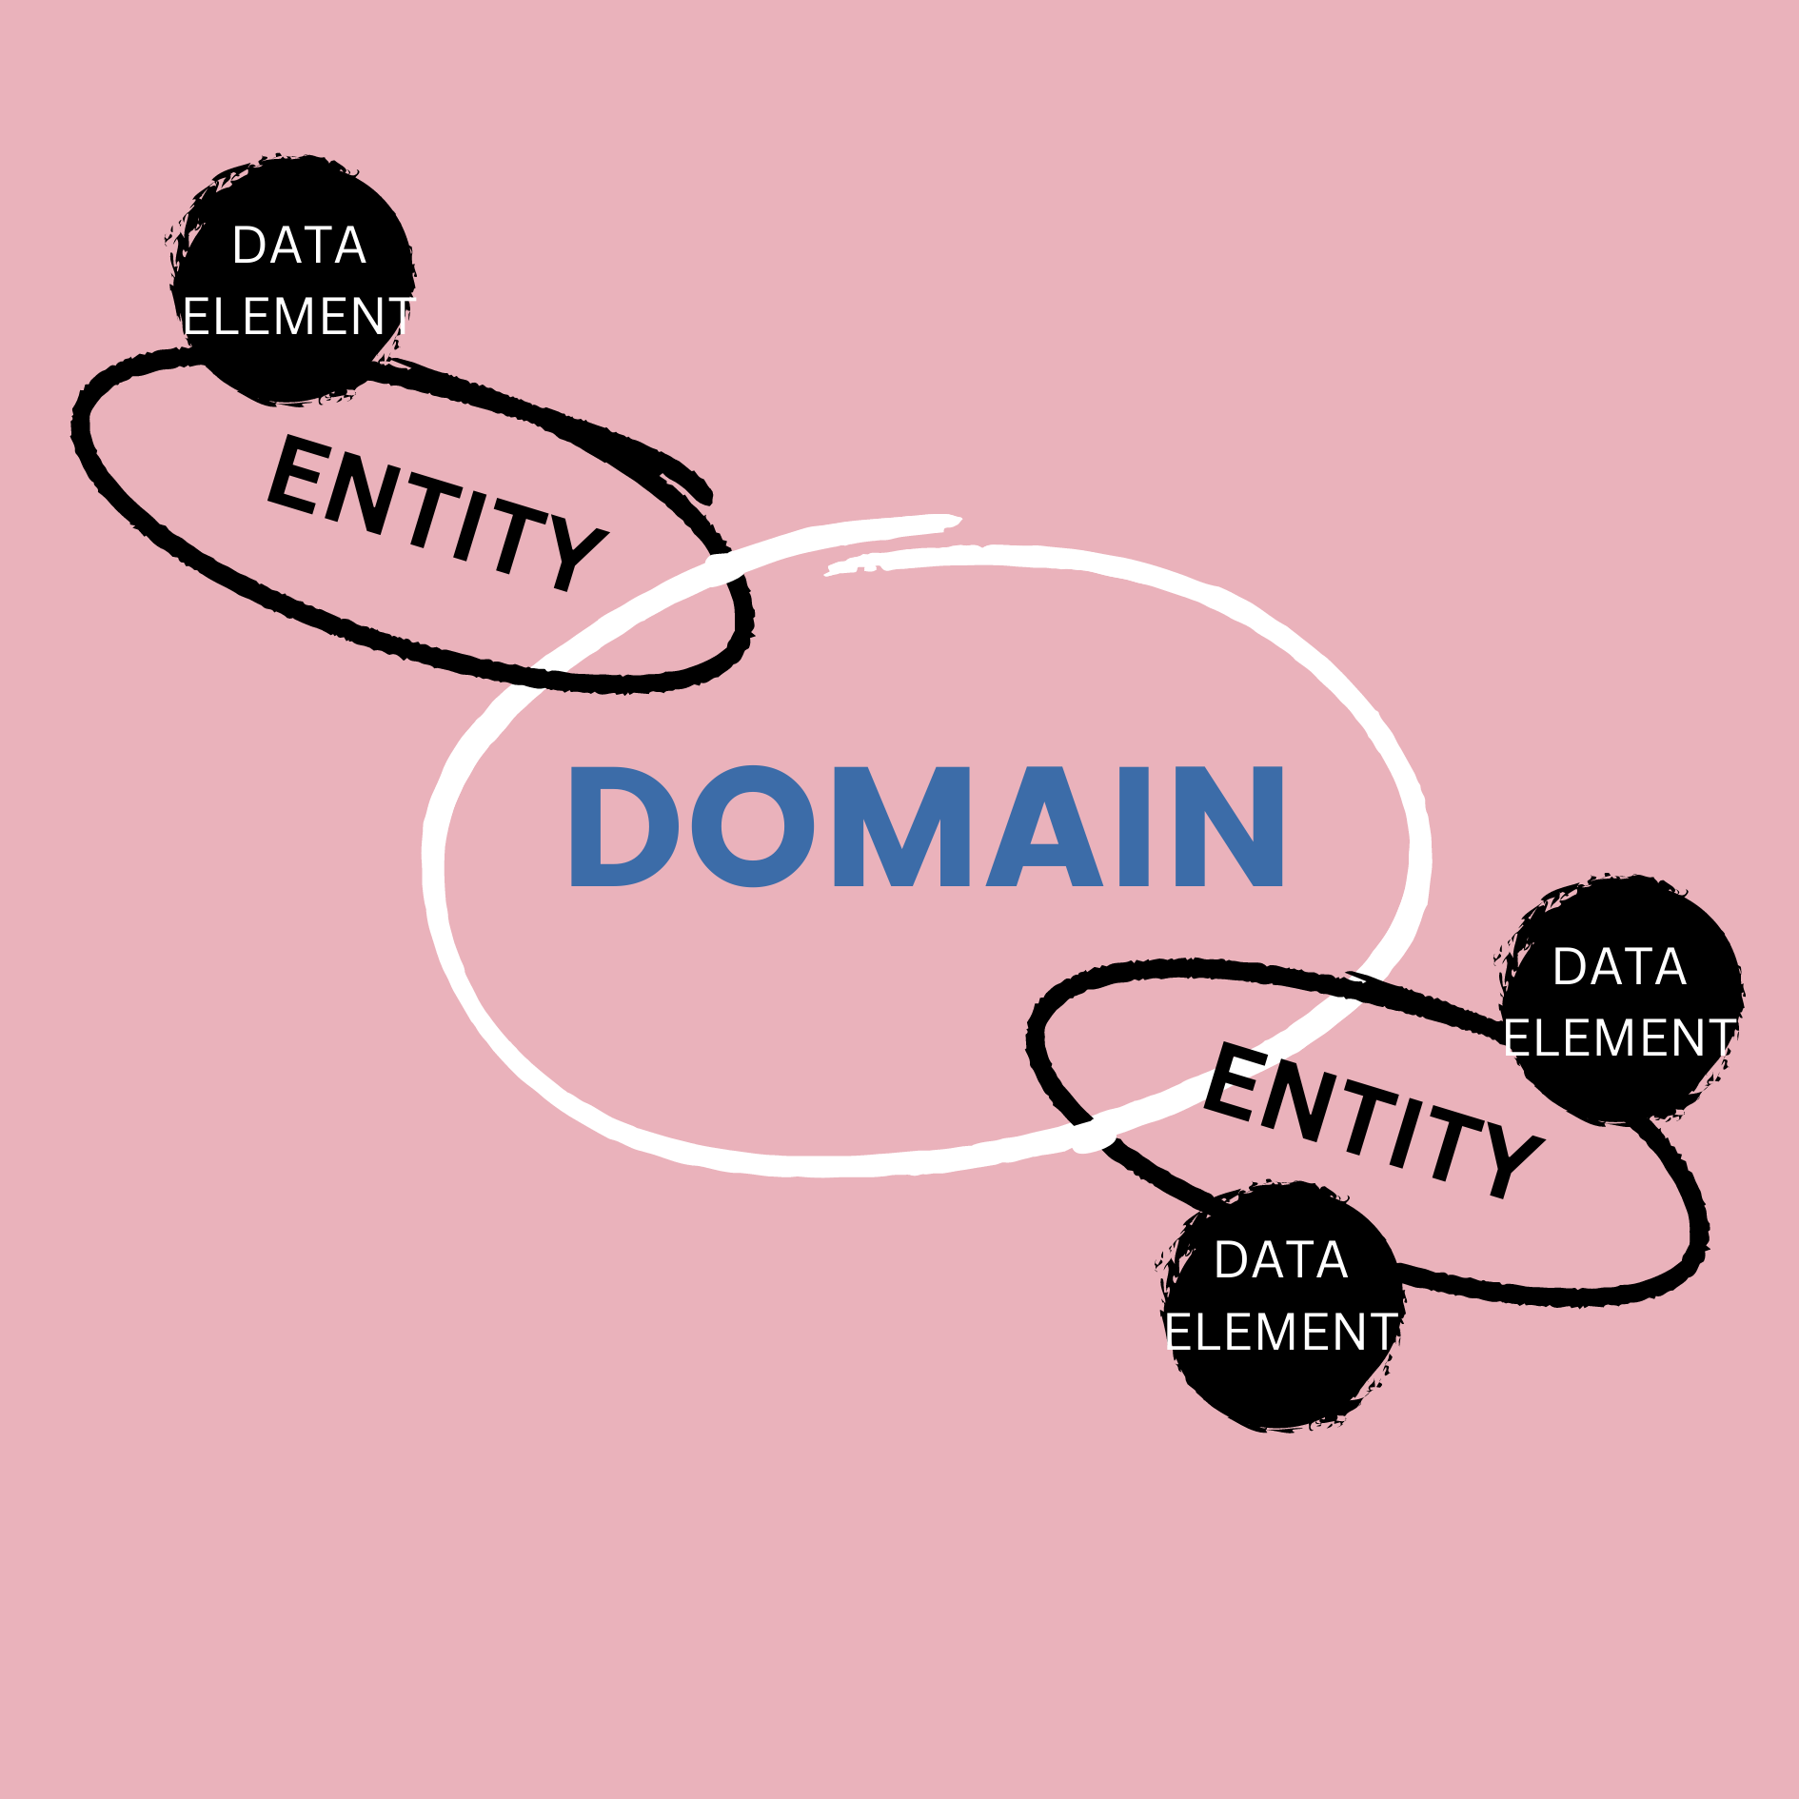
DATA RELATIONSHIPS
DOMAIN = COMPLEX TYPE
ENTITY = SUB COMPLEX
ASSOCIATION ENTITIES
(CONNECTED TO AN ENTITY)
DATA ELEMENTS
Notes:
Association entities

Slide 12
Validations
Notes:
Naomi presents

Slide 13
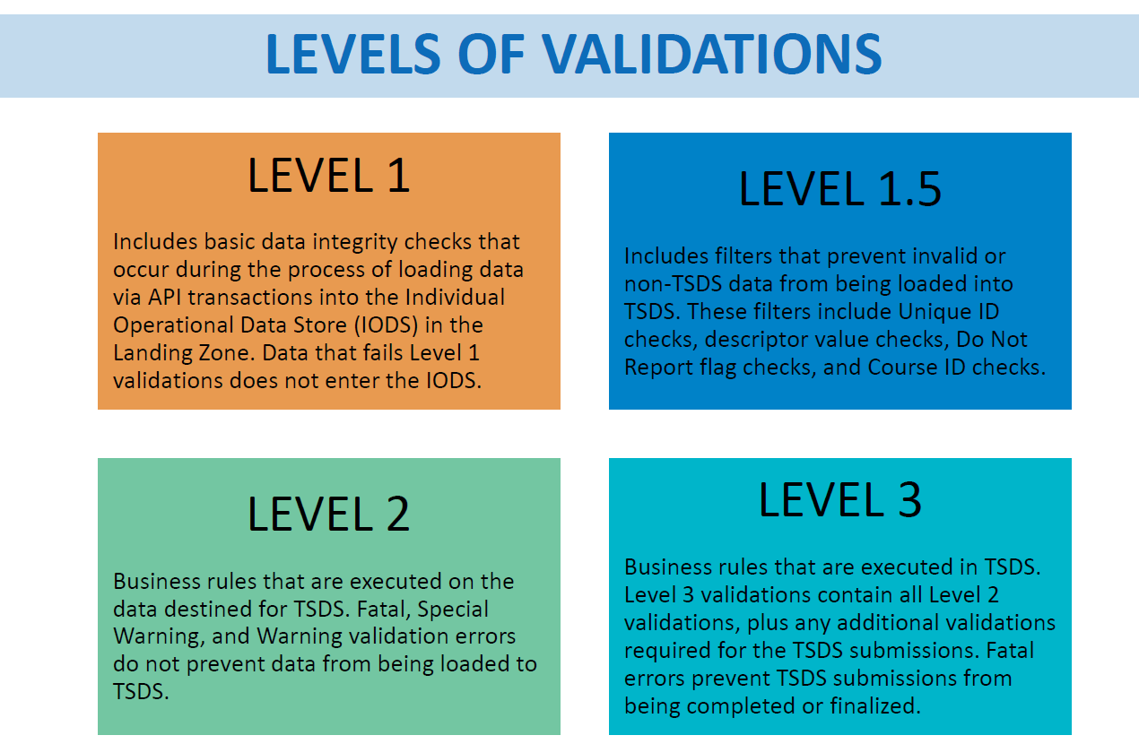

Slide 14
File Validation
API
XML

Slide 15
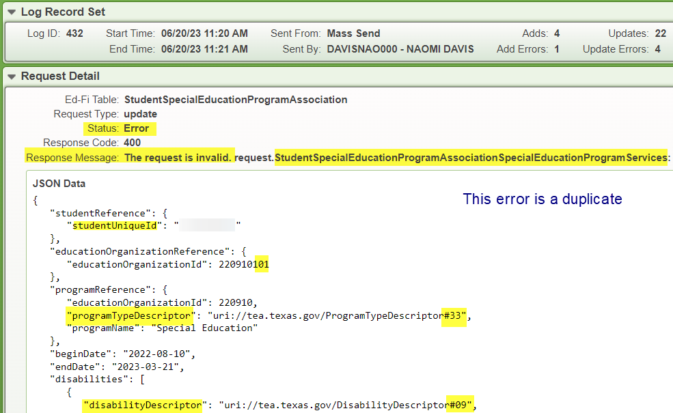
Level 1 Validation
SIS VENDOR

Slide 16
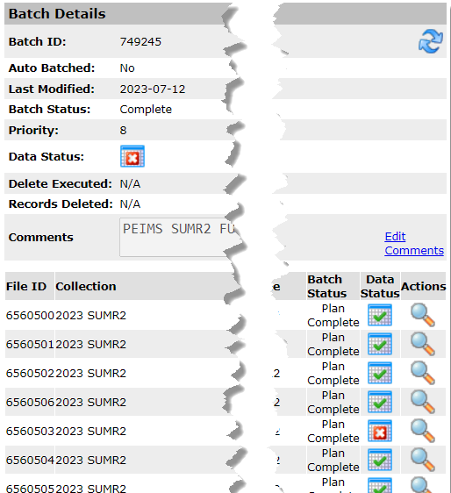
Batch Validation
API
XML

Slide 17
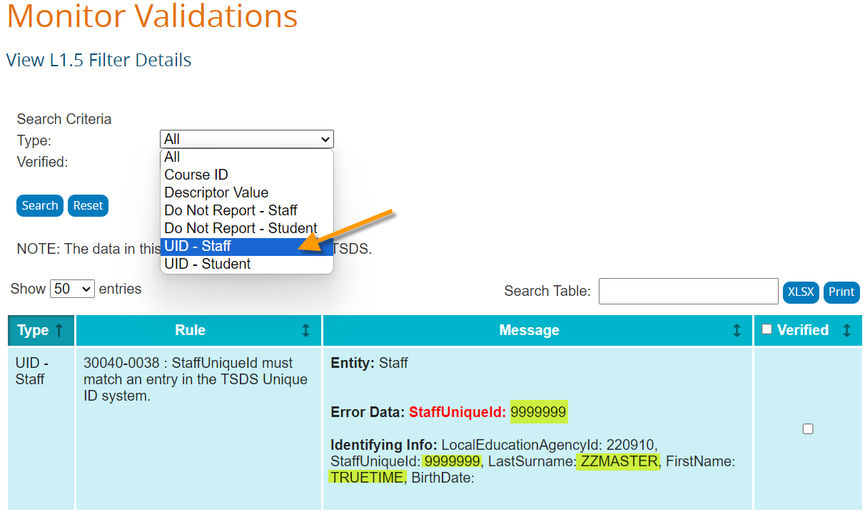
Level 1.5 Validation
TSDS PORTAL

Slide 18
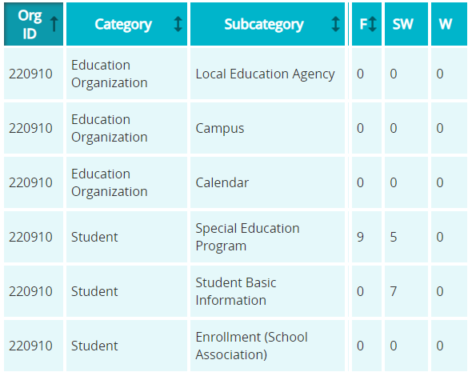
Business Rule Validation
early look
API

Slide 19
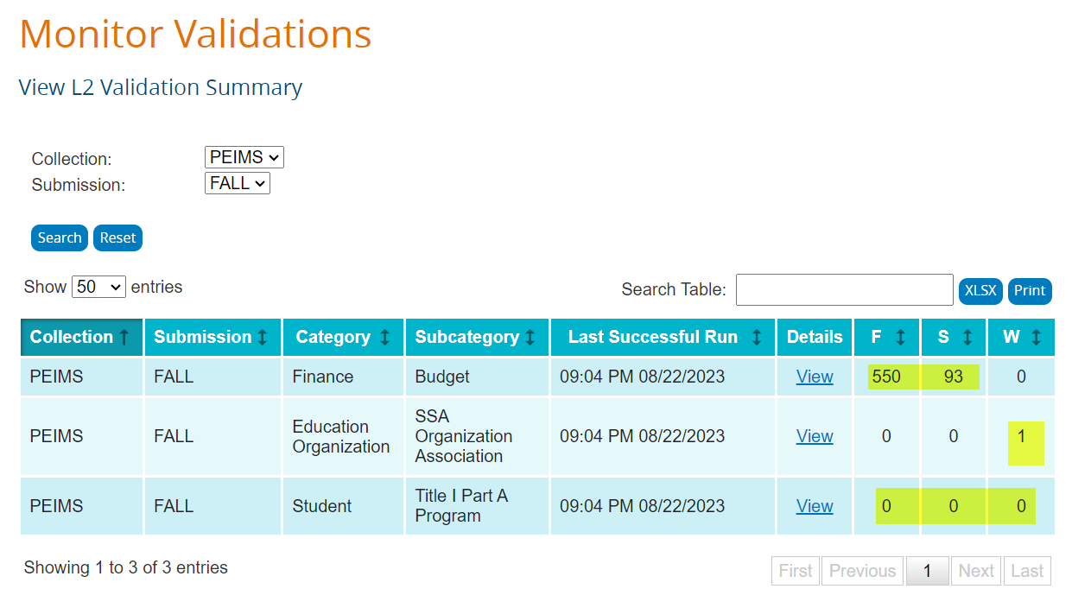
Level 2 Validation
TSDS PORTAL

Slide 20
Business Rule Validation
NO CHANGE

Slide 21
Level 3 Validation
TSDS PORTAL

Slide 22
Parallel Process
Notes:
Kim presents

Slide 23
WHERE IS YOUR SIS VENDOR?
Did vendor participate in Pilot?
How far along in the process of programming for the upgrade?
Has the vendor successfully pushed data from your SIS to your landing zone (IODS)?
What type of support is your vendor planning to provide to LEAs participating in Parallel?

Slide 24
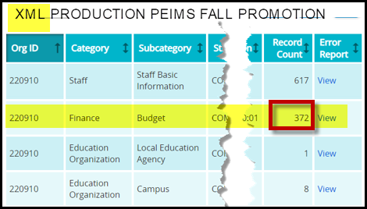
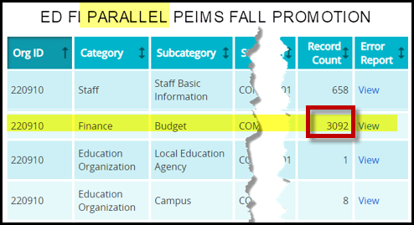
Who is Impacted?
Don’t Forget:
Finance and Human Resources - we all think Student…

Slide 25
Parallel Year
SIS Vendor needs Parallel to ensure the right data is flowing down the river.
TEA needs Parallel to ensure the data promoted, calculated and validated matches XML system to ensure Live in ‘25
Comparison of data
at Promotion
by Reports
What am I supposed to do?

Slide 26
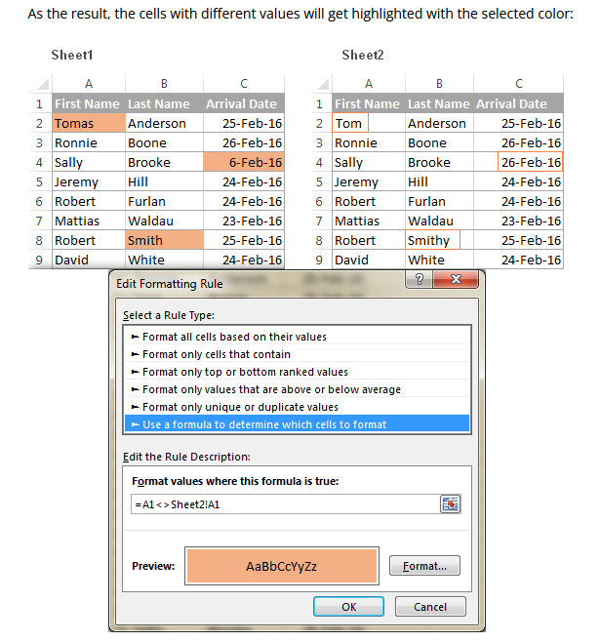
Comparison? Excel
Use Excel to compare Two Sheets
-MUST be same rows and columns

Slide 27
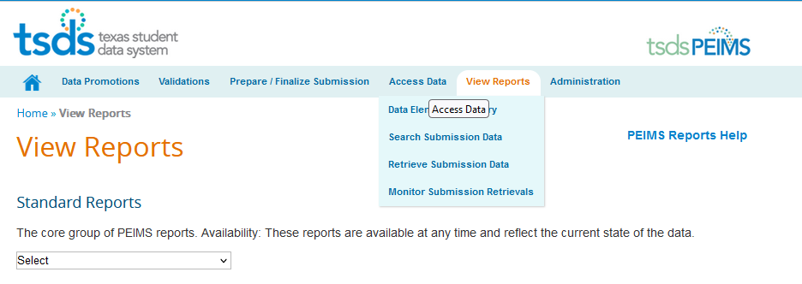
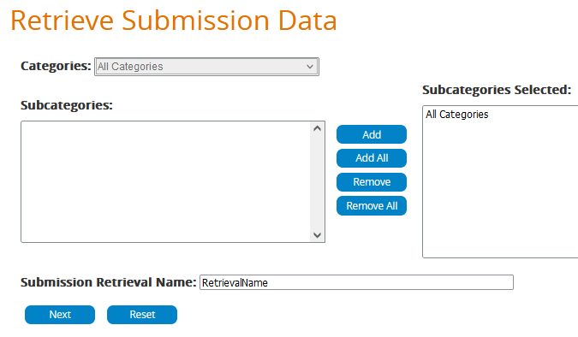
Comparison Data - Where?
TSDS PORTAL
1
2
3

Slide 28
Comparison Data - Where?
Ed Fi Upgrade:
TSDS DMC is scheduled to provide XLS exportable search inside the Transition Zone.
NO PICTURE AVAILABLE

Slide 29
Comparison? Google Sheets
HOW TO LINK

Slide 30
Lessons Learned
Notes:
Naomi presents

Slide 31
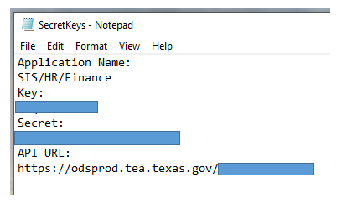
Lessons Learned
Key & Secret (Username & Password)
Copy and Paste to NOTEBOOK from DMC!
PATIENCE, PATIENCE, PATIENCE

Slide 32
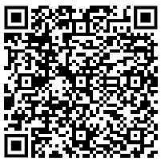
Lessons Learned
Data Dictionary XML to API
LIVE LINK CLICK HERE
PATIENCE, PATIENCE, PATIENCE

Slide 33
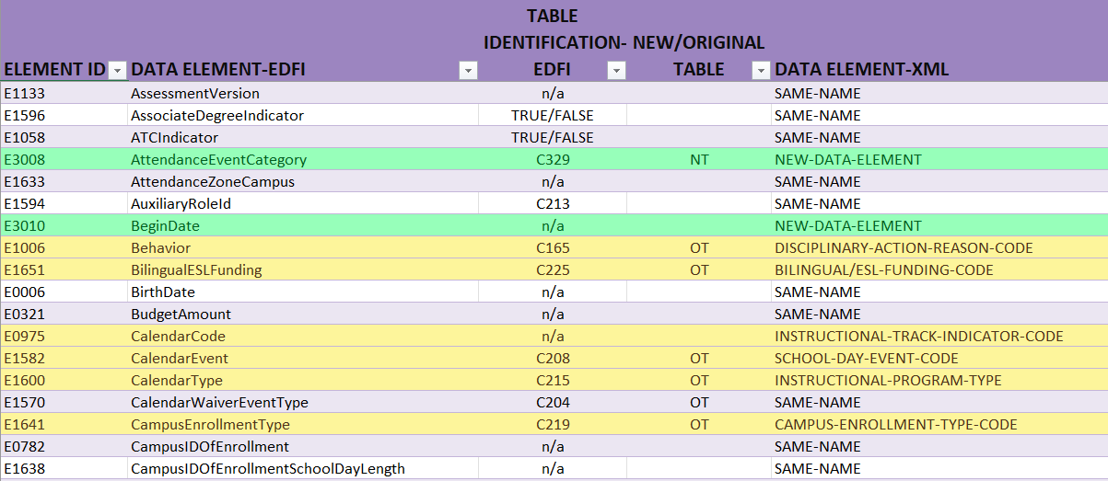
Lessons Learned
Data Dictionary XML to API

Slide 34
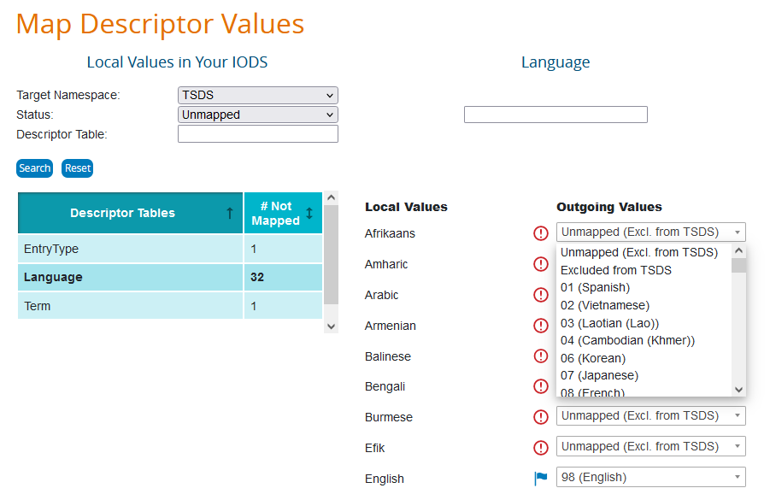
Lessons Learned
Mapping Descriptors in Data Management Center (DMC)
PATIENCE, PATIENCE, PATIENCE

Slide 35
Lessons Learned
Certain data sets, specifically SEOEA / SEOAA (staff) and SEOA (student) must have all parts in the Transition Zone to ensure Promotion
PATIENCE, PATIENCE, PATIENCE

Slide 36
Lessons Learned
NO DATA
EMPTY RECORD
ZERO PLACE HOLDER
PATIENCE, PATIENCE, PATIENCE

Slide 37
Let’s Go
Live in ‘25

