Slide 1
Cybersecurity Careers & How to Prepare Our Students For Them
Tom Dean, CISSP, PMP, ICP

Slide 2
Overview
What is Cybersecurity?
Cybersecurity vs. Information Technology
Practitioner Observations
Curriculum Needs/Requirements
Available programs you can start tomorrow
Certifications
Q&A

Slide 3
Cybersecurity
CISA Definition: "the protection of computer systems and networks from attacks by malicious actors that may result in unauthorized information disclosure, theft of, or damage to hardware, software, or data...“
U.K.: “Cyber security is the application of technologies, processes, and controls to protect systems, networks, programs, devices and data from cyber attacks. It aims to reduce the risk of cyber attacks and protect against the unauthorised exploitation of systems, networks, and technologies.”
The Need: (ISC)2 estimates a worldwide cybersecurity shortfall of 3.5 million by the end of 2025
"In this Cyber fight we must learn, adapt, and overcome collaboratively or die individually. It is a Binary Choice"
~Air Force Partnership with Industry

Slide 4
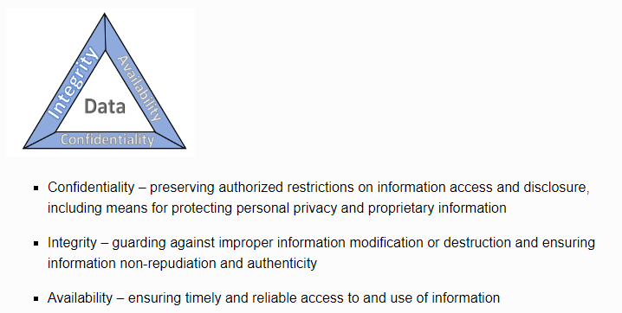
Cybersecurity vs. Information Technology
IT tends to focus on the availability of required communications & data
Cybersecurity tends to focus more on the Integrity and Confidentiality of required communications & data
Source: NIST SPECIAL PUBLICATION 1800-26A https://www.nccoe.nist.gov/publication/1800-26/VolA/index.html

Slide 5
Practitioner Observations
Required Mindset
H4ck3r
Sheepdog
Multi-disciplinary
Lifetime Student
Ethics
Lifestyle & Public Trust
Passion
Notes:
H4ck3r: In the classical sense, Individual has an inherent need to understand how things work, likes to tinker with everything, not satisfied with the status quo.
Sheepdog: Inherent need to protect others
Multi-disciplinary: Not just IT although IT is a big part of it, we’ll discuss more of this later
Lifetime student: must be able and willing to learn different disciplines
Like security tools, the Cybersecurity KSAs can easily be used offensively – hence need for individual ethics – this leads into the lifestyle of the practitioners
Since most cybersecurity positions involve some form of public trust, lifestyle must be a consideration, examples:
- Financial Public Trust
- Security Clearances
If you don’t have a passion for this lifestyle YOU WILL BURN OUT,

Slide 6
Curriculum Needs/Requirements
Developing a Cybersecurity Curriculum: DACUM/ISD models
Needs Analysis:
Historical approaches: Advisory Boards, Market Analysis
Current modeling (NIST, NICE Cybersecurity Framework)
National Initiative for Cybersecurity Careers and Studies (NICCS) https://niccs.cisa.gov/
Workforce Framework for Cybersecurity (NICE Framework) https://niccs.cisa.gov/workforce-development/nice-framework
Categories (7) – A high-level grouping of common cybersecurity functions
Specialty Areas (33) – Distinct areas of cybersecurity work
Work Roles (52) – Detailed groupings of cybersecurity work comprised of specific knowledge, skills, and abilities (KSAs) required to perform tasks in a Work Role
NICCS Cyber Career Pathway Tool: https://niccs.cisa.gov/workforce-development/cyber-career-pathways-tool
Involve your Human Resources department
“Tell me and I forget. Teach me and I remember. Involve me and I learn.” ~ Benjamin Franklin

Slide 7
NICE Framework
Seven Categories: https://niccs.cisa.gov/workforce-development/nice-framework
Analyze: (5 Specialties)
Collect & Operate: (3 Specialties)
Investigate: (2 Specialties)
Operate & Maintain: (6 Specialties)
Oversee & Govern: (6 Specialties)
Protect and Defend: (4 Specialties)
Securely Provision: (7 Specialties)

Slide 8
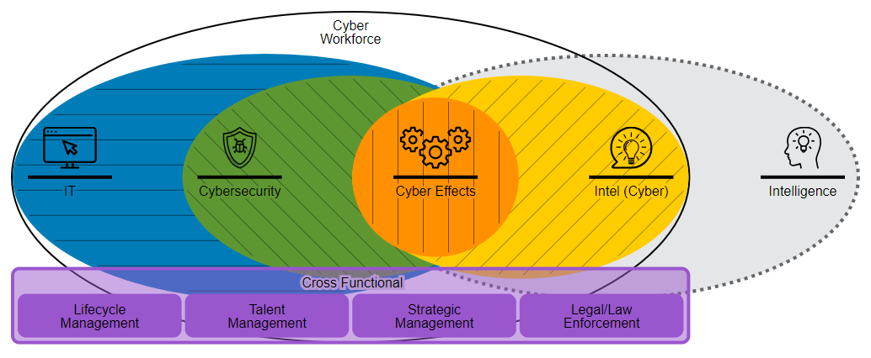
Cyber Career Pathway Tool
NICCS Cyber Career Pathway Tool: https://niccs.cisa.gov/workforce-development/cyber-career-pathways-tool
Demo & Discussion

Slide 9
Available programs you can start tomorrow
Cisco Networking Academy Program
Air & Space Force Association CyberPatriot
Elementary, Middle School, High School, & Seniors Education Programs
Middle & High School Competition
(ISC)²: Centre for Cyber Safety & Education, Certified in Cyber Security
DHS CISA: Resources & Training
UTSA: CIAS: National Collegiate Cyber Defense Competition (CCDC), Training, 24 Week Bootcamp (252 hours +) (Link)
Texas A&M TEEX: Free online courses (Continuing Ed & semester credit hrs)
SANS/GIAC: Training and certifications

Slide 10
Cisco Networking Academy
https://netacad.com
Operating Systems & IT (6 courses)
Infrastructure Automation (3 courses)
Networking (6 courses)
Programming (6 courses)
Internet of Things (3 courses & 1 hackathon)
Introduction to Data Science

Slide 11
CyberPatriot
https://www.uscyberpatriot.org/home
Middle & High School Competition (3 categories)
System Hardening for Windows & Linux
Two Cisco Academy specialty courses
Competition at local, regional/state & national levels
Scholarships & internships at local, regional/state & national levels
Schools always need volunteer Coaches & Tech Mentors

Slide 12
DHS CISA: Resources & Training
Cybersecurity Month: https://www.cisa.gov/resources-tools/resources/cybersecurity-awareness-month-2023-resources-and-partner-toolkit
News & Alerts
Linkage to the 16 Critical Infrastructure Sectors

Slide 13
(ISC)²
Certified in Cyber Security (CC): https://www.isc2.org/certifications/cc
Currently offering free training and testing
Entry level
New
Center for Cyber Safety & Education: https://www.iamcybersafe.org/s/
Volunteer programs
Elementary
Teens
Parents
Seniors
Scholarships

Slide 14
UTSA CIAS
Center for Infrastructure Assurance and Security: https://cias.utsa.edu/
National Collegiate Cyber Defense Competition:
Other competitions & exercises
Training

Slide 15
UTSA Bootcamp
(Link is too long so click here!)
24 Weeks
On-line & Self-paced
Six modules
Requires minimum of 9 hours online each week
3 weekday evening classroom sessions (3 hours each)
Will also require 20 hours on homework & projects
Discounts for military, vets, and alumni

Slide 16
Texas A&M TEEX
Texas Engineering Extension Service (TEEX):
https://teex.org/program/nerrtc-online-training/
You pay for these courses on 15 April each year through DHS/FEMA grants
Online self-paced Cybersecurity classes and more
Courses offer Continuing Education Units from the International Association of Continuing Education and Training
Cybersecurity online courses offer the opportunity to earn college credit hours as recommended by the American Council on Education (ACE)

Slide 17
Certifications
CompTIA:
A+
Net+
Server+
Security+
ISC²:
CC – Certified in Cybersecurity
SSCP – Security Administrator
SANS/GIAC:
GIAC Information Security Fundamentals (GISF)
GIAC Security Essentials (GSEC)

Slide 18
Summary
Certifications
Programs to get you and your students started
NICE Framework & tools
Curriculum Needs & Requirements
A view from the field
Cybersecurity & IT
QUESTIONS?

Slide 19
Sources
NIST: https://www.nccoe.nist.gov/publication/1800-26/VolA/index.html
DHS CISA: a) https://niccs.cisa.gov/ b) https://niccs.cisa.gov/workforce-development/nice-framework c) https://niccs.cisa.gov/workforce-development/cyber-career-pathways-tool d) https://www.cisa.gov/resources-tools/resources/cybersecurity-awareness-month-2023-resources-and-partner-toolkit
AFA CyberPatriot: https://www.uscyberpatriot.org/home
(ISC)2: a)https://www.iamcybersafe.org/s/ b) https://www.isc2.org/certifications/cc
UTSA: a) https://cias.utsa.edu/ b) https://cias.utsa.edu/competitions/nccdc/ c) (Long link: search for UTSA Cybersecurity Boot Camp)
SANS/GIAC: a) https://www.giac.org/certifications/information-security-fundamentals-gisf b) https://www.giac.org/certifications/security-essentials-gsec
TAMU TEEX: https://teex.org/program/nerrtc-online-training/
Cisco Network Academy: https://www.netacad.com/

