Slide 1
How data feed errors affect your district’s school first rating
Presenter: Rita Bunton
TASBO Summer Conference – JUNE 20, 2017

Slide 2
copyright
Copyright © Notice The materials are copyrighted © and trademarked ™ as the property of the Texas Education Agency (TEA) and may not be reproduced without the express written permission of TEA, except under the following conditions:
Texas public school districts, charter schools, and Education Service Centers may reproduce and use copies of the Materials and Related Materials for the districts’ and schools’ educational use without obtaining permission from TEA. Residents of the state of Texas may reproduce and use copies of the Material and Related Material for individual personal use only without obtaining written permission of TEA.
Any portion reproduced must be reproduced in its entirety and remain unedited, unaltered and unchanged in any way.
No monetary charge can be made for the reproduced materials or any document containing them; however, a reasonable charge to cover only the cost of reproduction and distribution may be charged.
Private entities or persons located in Texas that are not Texas public school districts, Texas Education Service Centers, or Texas charter schools or any entity, whether public or private, educational or non-educational, located outside the state of Texas MUST obtain written approval from TEA and will be required to enter into a license agreement that may involve the payment of a licensing fee or a royalty.
For information contact: Office of Intellectual Property, Texas Education Agency, 1701 N. Congress Ave., Austin, TX 78701-1494; phone 512-463-9270 or 512-463-9713; email: copyrights@tea.state.tx.us.

Slide 3
Notes on this presentation
The Data Feed and PEIMS data used in this presentation is actual data; however, the CDN of each district associated with the data has been removed.
The applicable data for each rating year will be extracted from the Data Feed, PEIMS, and other required collection systems to produce your school district’s final School FIRST rating.
The terms “school district” and “district” are used interchangeably throughout this presentation to refer to a school district.
The term Public Education Information Management System “PEIMS” is used throughout this presentation to refer to PEIMS Edit+ and the Texas Student Data System PEIMS (TSDS PEIMS).
Notes:
This presentation will provide a platform for an exchange of best practices.

Slide 4
agenda
Overview of the School Financial Integrity Rating System of Texas (FIRST)
In-depth review of Data Feed and Public Education Information Management System (PEIMS) data errors created by school districts
An examination of the actual points that may be lost, due to data errors by districts, if the Texas Education Agency (TEA) did not complete a manual correction of the data
The process that the TEA must complete to make manual corrections to a school district’s data in the School FIRST application.
Internal Controls
Best practices to evaluate current processes and reduce data errors
Useful Links
Contact Information

Slide 5
Overview of the school FIRST
What is School FIRST and What is its Purpose?
Rule and Statutory Authority
Criteria for Ratings

Slide 6
What is school first and what is its Purpose?
School FIRST is a financial accountability rating system that holds school districts accountable for the quality of their financial management practices.
School FIRST is designed to encourage Texas public schools to manage their financial resources better in order to provide the maximum allocation possible for direct instructional purposes.
School FIRST is a tool that creates transparency and discloses the quality of local management and decision-making processes that the school district uses concerning the financial resources the school district receives.

Slide 7
Rule and statutory authority
FIRST
19 Texas Administrative Code (TAC) §109.1001 and 19 TAC §97.1055
Texas Education Code (TEC), §39.052 and §39.082
Interventions and Sanctions
TEC, §39.102
House Bill 5 of the 83rd Legislature amended Education Code

Slide 8
Rule and statutory authority, continued
Financial accountability rating system should include processes for anticipating the future financial solvency of each school district and open-enrollment charter school
Including analysis of revenues and expenditures
Rating should be publicly available not later than August 8 of each year
19 TAC §109.1001(b)
The TEA will assign a financial accountability rating to each school district as required by the TEC, §39.082.
19 TAC §109.1001(c)
The commissioner of education will evaluate the rating system every three years as required by the TEC, §39.082, and may modify the system in order to improve the effectiveness of the rating system. If the rating system has been modified, the TEA will communicate changes to ratings criteria and their effective dates to school districts.

Slide 9
Criteria for ratings
19 TAC §109.1001(d)
The TEA will use the following sources of data in calculating the financial accountability indicators for school districts:
AFR
Data feed
PEIMS
Warrant holds
FSP
Other sources, including, but not limited to the Internal Revenue Service, Teacher’s Retirement System and Texas Workforce Commission

Slide 10
2016–2017 Ratings (Fy 2016 Data)
The indicators for 2016–2017 ratings are the same as the 2015–2016 ratings, but the point scales and ratings are different. This is the full phase-in year.
Maximum Points

Slide 11
2016–2017 Ratings (Fy 2016 Data) - Continued
2016 -2017 Ratings (Based on FY 2016 Data)
Must pass critical indicators to receive a passing rating (Superior, Above Standard, or Meets Standard rating)
A = Superior (90 – 100 points)
B = Above Standard (80 – 89 points)
C = Meets Standard (60 – 79 points)
F = Substandard Achievement
0 - 59 points or fail a critical indicator
Substandard data quality because the AFR and the data template was not submitted on time and/or not complete for FIRST analysis

Slide 12
In-depth review of data feed and PEIMS errors created by school districts
What are the Issues that are Causing Your District to Lose Points on School FIRST?
Overview of Data Sources for School FIRST Indicators
Data Feed Errors
PEIMS Errors

Slide 13
What are the issues that are causing your district to lose points on school first?
Failure to complete the data feed in its entirety
Failure to input the correct data/response into the data feed
Failure to review the data that is entered into the data feed
Failure to submit the required Public Education Information Management System (PEIMS) data
in its entirety;
accurately; and/or
failure to review the data that is entered into PEIMS.
Failure to create an internal control system that allows multiple staff members to review the data before it is finalized and submitted to the Texas Education Agency (TEA) via the required data collection systems

Slide 14
Overview of Data Sources for school first indicators
Data feed
Public Education Information Management System (PEIMS)
Schedule L-1
Questions contained on the L-1 schedule are directly linked to four of the five critical indicators in School FIRST.
There are also questions for indicators 8, 14, and 15 located on the Schedule L-1. Questions 8, 14, and 15 are worth up to 10 points each.
Schedules A-1 through C-2
Data from Schedules A-1 through C-2 is used in the calculation of indicators 5, 6, 7, 8, 9, 10, 12 and 13.
Data from PEIMS is used in the calculation of indicators 5, 8, 10,11, 12 and 13.

Slide 15
Data feed and PEIMS errors
Most of the errors that are observed each year are connected to the district’s failure to input responses to the Required Responses to Selected School FIRST Indicators questions on Schedule L-1 in the data feed or entering the incorrect data into Schedule L-1 in the data feed.
In addition to data feed errors, PEIMS errors are also observed.
Data errors may cause your school district to lose points or even fail School FIRST.

Slide 16
Data feed – Schedule l-1 Errors

Slide 17
Data feed Errors – schedule l-1
The illustration below discloses a Data Feed L-1 schedule that was completed by a school district for the 2015–2016 fiscal year.
Notes:
Can anyone tell me what is wrong with this L-1 schedule?

Slide 18
Data feed Errors– schedule l-1
Indicator 2: Auditor Opinion and Material Weakness
Was there an unmodified opinion in the AFR on the financial statements as a whole? The American Institute of Certified Public Accountants (AICPA) defines unmodified opinion. The external independent auditor determines if there was an unmodified opinion. The school district must pass 2.A to pass this indicator.
Did the external independent auditor report that the AFR was free of any instance(s) of material weaknesses in internal controls over financial reporting and compliance for local, state, or federal funds? (The AICPA defines material weakness.)
Critical Indicator – Yes or No response
School FIRST Data Source: Data Feed, Schedule L-1, Questions sf4 and sf5:
The illustration below discloses what occurs when a district fails to enter required data or enters the incorrect data into the data feed.
One district entered the incorrect response and the other district did not answer question sf4. If a manual correction is not made in the School FIRST application, both school districts will fail School FIRST.
CDN | Unmodified Opinion on AFR (2.A) | Pass or Fail Indicator
XXX-XXX | No response was entered | Fail
XXX-XXX | No | Fail

Slide 19
Data feed Errors– Schedule l-1
Indicator 3: Monetary Default on Debt
Was the school district in compliance with the payment terms of all debt agreements at fiscal year end? (If the school district was in default in a prior fiscal year, an exemption applies in following years if the school district is current on its forbearance or payment plan with the lender and the payments are made on schedule for the fiscal year being rated. Also exempted are technical defaults that are not related to monetary defaults. A technical default is a failure to uphold the terms of a debt covenant, contract, or master promissory note even though payments to the lender, trust, or sinking fund are current. A debt agreement is a legal agreement between a debtor (person, company, etc. that owes money) and their creditors, which includes a plan for paying back the debt.)
Critical Indicator – Yes or No response
School FIRST Data Source: Data Feed, Schedule L-1, Question sf2:
Failure to complete question sf2 in
its entirety, or
input the correct response to question sf2, may cause your district to automatically fail School FIRST.

Slide 20
Data feed Errors– Schedule l-1
Indicator 4: Overdue Payroll Tax
Did the school district make timely payments to the Teachers Retirement System (TRS), Texas Workforce Commission (TWC), Internal Revenue Service (IRS), and other government agencies?
(Payments to the TRS and TWC are considered timely if a warrant hold that was issued in connection to the untimely payment was cleared within 30 days from the date the warrant hold was issued.)
Critical Indicator – Yes or No response
School FIRST Data Source: Data Feed, Schedule L-1, Question sf7:
The illustration below discloses what occurs when a district fails to enter required data or enters the incorrect data into the data feed.
Two of the districts failed to enter a response to question sf7 and two entered the incorrect response. If a manual correction is not made in the School FIRST application, the districts will fail School FIRST.
CDN | Timely Payments to Government Entities | Pass or Fail Indicator
XXX-XXX | No response was entered | Fail
XXX-XXX | No response was entered | Fail
XXX-XXX | No | Fail
XXX-XXX | No | Fail

Slide 21
Data feed Errors– Schedule l-1
Indicator 5: Total Net Position
Was the total unrestricted net position (Net of accretion of interest for capital appreciation bonds) in the governmental activities column in the Statement of Net Position greater than zero? (Part 1)
(If the school district’s change of students in membership over 5 years was 10 percent or more, then the school district passes this indicator.) (Part 2)
Critical Indicator – Yes or No response
School FIRST Data Source: Data Feed, Schedule A-1, and Data Feed, Schedule L-1, Questions sf10 and sf12:
Notes:
We will review Part 1 of this indicator during this session.

Slide 22
Data feed Errors– Schedule l-1
Indicator 5: Total Unrestricted Net Position - Continued
Calculation:
Total Unrestricted Net Position Balance + Accumulated Accretion on CABS + Net Pension Liabilities >0 = Pass
The illustration below discloses what occurs when a district fails to enter required data or the district enters the incorrect data into the data feed.
In this illustration, one district failed to enter its NPL and the other entered the incorrect NPL amount causing both districts to fail critical indicator 5.
Failure to input the total accumulated accretion on CABs into Schedule L-1, question sf10, and or the net pension liabilities into Schedule L-1, question sf12, may cause your district to automatically fail School FIRST.
Unrestricted Net Position Balance | Accretion of Capital Appreciation Bonds | Net Pension Liabilities (NPL) | Total Unrestricted Net Position Balance | Unrestricted Net Position Balance >0?
($315,040) |  | $0 | ($315,040) | No
$10,594,532 | $0 | ($43,614,496) | ($33,019,964) | No

Slide 23
Data feed Errors– Schedules A-1 and l-1
Indicator 8: Long-term Liabilities to Total Assets
Was the ratio of long-term liabilities to total assets for the school district sufficient to support long-term solvency? (Part 1)
(If the school district’s change of students in membership over 5 years was 10 percent or more, then the school district passes this indicator.) (Part 2)
School FIRST Data Source: Data Feed, Schedule A-1, and Data Feed, Schedule L-1, Question sf12:
Notes:
We will review Part 1 of this indicator during this session.

Slide 24
Data feed Errors– Schedules A-1 and l-1
Indicator 8: Long-term Liabilities to Total Assets - Continued
Calculation: Long-term Liabilities – Net Pension Liability
Total Assets
Range of 0 to 10 points on a sliding scale
The illustration below discloses what occurs when a district fails to enter required data or enters the incorrect data into the data feed.
2502 (Column A) | 2516 (Column B) | Long-term Liabilities Total (Columns A+B) | Net Pension Liabilities | Total Assets | Long-term Solvency Ratio | 10 Points | 8 Points | 6 Points | 4 Points | 2 Points | 0 Points
$4,566,309 | $200,728 | $4,767,037 | $0 | $6,956,994 | 0.6852 |  | 8
$148,890,875 |  | $148,890,875 | ($43,614,496) | $288,148,910 | 0.6681 |  | 8
$1,386,180 |  | $1,386,180 | $2,483,880 | $0 | #DIV/0! | #DIV/0! | #DIV/0! | #DIV/0! | #DIV/0! | #DIV/0! | 0
$57,389,786 |  | $57,389,786 | $2,731,710 | $0 | #DIV/0! | #DIV/0! | #DIV/0! | #DIV/0! | #DIV/0! | #DIV/0! | 0

Slide 25
Data feed Errors– Schedules A-1 and l-1
Indicator 8: Long-term Liabilities to Total Assets - Continued
If the districts disclosed on rows 1 and 2 would have entered their district’s NPL into Schedule L-1 correctly, both district’s would have received 10 points on indicator 10. Instead, each lost 2 points.
The districts disclosed on rows 3 and 4 received zero points due to the divide by zero error. (Failure to enter the district’s total assets into Schedule A-1 of the data feed.) A net loss of 10 points.
None of the four districts passed Part 2 of indicator 8; therefore, without a manual correction in the School FIRST application, the districts’ scores would remain at eight and zero points, respectively.
2502 (Column A) | 2516 (Column B) | Long-term Liabilities Total (Columns A+B) | Net Pension Liabilities | Total Assets | Long-term Solvency Ratio | 10 Points | 8 Points | 6 Points | 4 Points | 2 Points | 0 Points
$4,566,309 | $200,728 | $4,767,037 | $0 | $6,956,994 | 0.6852 |  | 8
$148,890,875 |  | $148,890,875 | ($43,614,496) | $288,148,910 | 0.6681 |  | 8
$1,386,180 |  | $1,386,180 | $2,483,880 | $0 | #DIV/0! | #DIV/0! | #DIV/0! | #DIV/0! | #DIV/0! | #DIV/0! | 0
$57,389,786 |  | $57,389,786 | $2,731,710 | $0 | #DIV/0! | #DIV/0! | #DIV/0! | #DIV/0! | #DIV/0! | #DIV/0! | 0

Slide 26
Data feed Errors– schedule l-1
Indicator 14: Material Noncompliance
Did the external independent auditor indicate the AFR was free of any instance(s) of material noncompliance for grants, contracts, and laws related to local, state, or federal funds? (The AICPA defines material noncompliance.)
Covers local, state, and federal funds
Yes or No response
Worth 0 or 10 points
School FIRST Data Source: Data Feed, Schedule L-1, Question sf6:
The illustration below discloses what occurs when a district fails to enter required data or enters the incorrect data into the data feed.
One district entered the incorrect response and two districts did not answer question sf6.
Loss of 10 points on indicator 14 for each district.
CDN | Material Noncompliance | Pass or Fail Indicator
XXX-XXX | No response was entered | Fail
XXX-XXX | No response was entered | Fail
XXX-XXX | No | Fail

Slide 27
Data feed Errors– schedule l-1
Indicator 15: FSP Hardship
Did the school district not receive an adjusted repayment schedule for more than one fiscal year for an overallocation of Foundation School Program (FSP) funds as a result of a financial hardship?
Yes or No response
Worth 0 or 10 points
School FIRST Data Source: Data Feed, Schedule L-1, Question sf8:
Two hundred and eighty-two districts answered question sf8 incorrectly. Two hundred and seventy-eight districts input a “No” response into the data feed and four districts failed to input an answer to question sf8.
Each district will lose 10 points on indicator 15 if a manual correction is not made in the School FIRST application.

Slide 28
PEIMS Errors
Indicator 12: Student to Staff Ratio
Did the school district not have a 15 percent decline in the students to staff ratio over 3 years (total enrollment to total staff)? (If the student enrollment did not decrease, the school district will automatically pass this indicator.)
School FIRST Data Source: PEIMS Fall Collection Student Data Review reports, and PEIMS Fall Collection Staff FTE by Role reports:

Slide 29
Peims and Data Feed Errors
Indicator 12: Student to Staff Ratio - Continued
Worth 0 or 10 points
Calculation
OR
The illustration below discloses what occurs when a district fails to submit required PEIMS data.
This district failed to enter the total staff FTE count during the PEIMS Fall collection cycle. No manual correction can be made in the School FIRST application concerning PEIMS data that was not submitted or incorrect PEIMS data.
Loss of 10 points on indicator 12 for the district.
2013-2014 Total Student Enrollment | 2013-2014 Total FTE Staff | 2015-2016 Total Student Enrollment | 2015-2016 Total FTE Staff | Student to Staff Ratio – 2013-2014 | Student to Staff Ratio – 2015-2016 | Student to Staff Ratio for 3 Year Period | Student Enrollment for 3 Year Period | Student Enrollment Increase or Decrease over 3 Year Period: Yes = Increased or Stayed the Same, No = Decrease | (Worth 0 or 10 Points) Score
8,657 | 1,034.4876 | 8,500 | 0.0000 | 8.368394169 | #DIV/0! | #DIV/0! | -157.0000 | NO | 0

Slide 30
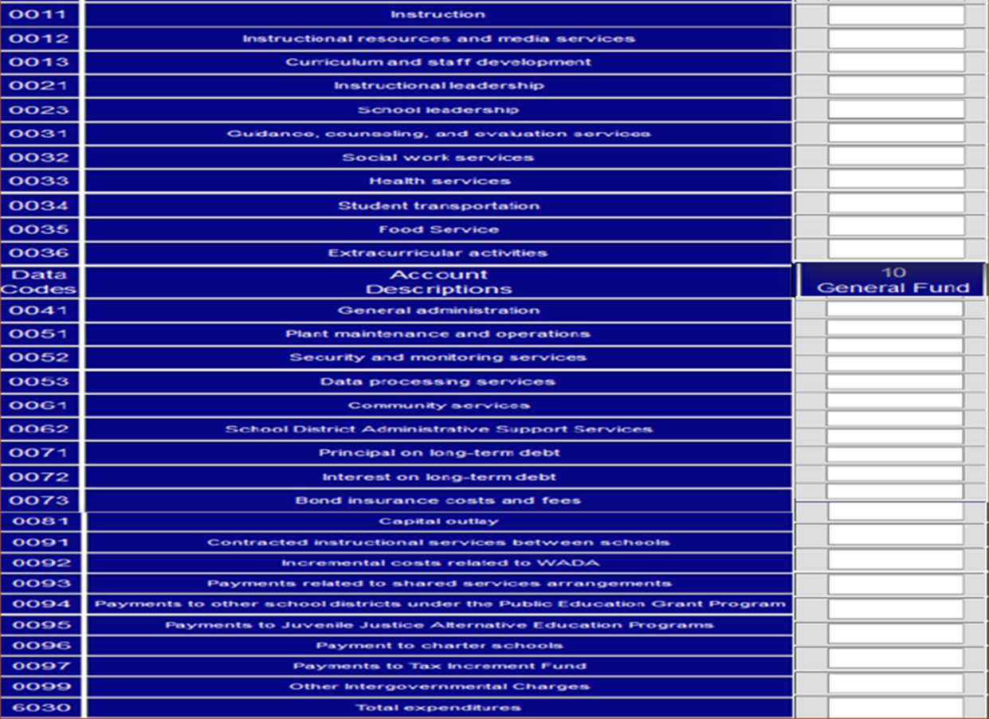
PEIMS Errors
Indicator 13: PEIMS Data Quality
Did the comparison of Public Education Information Management System (PEIMS) data to like information in the school district’s AFR result in a total variance of less than 3 percent of all expenditures by function?
School FIRST Data Source: Data Feed, Schedule C-2, and PEIMS:

Slide 31
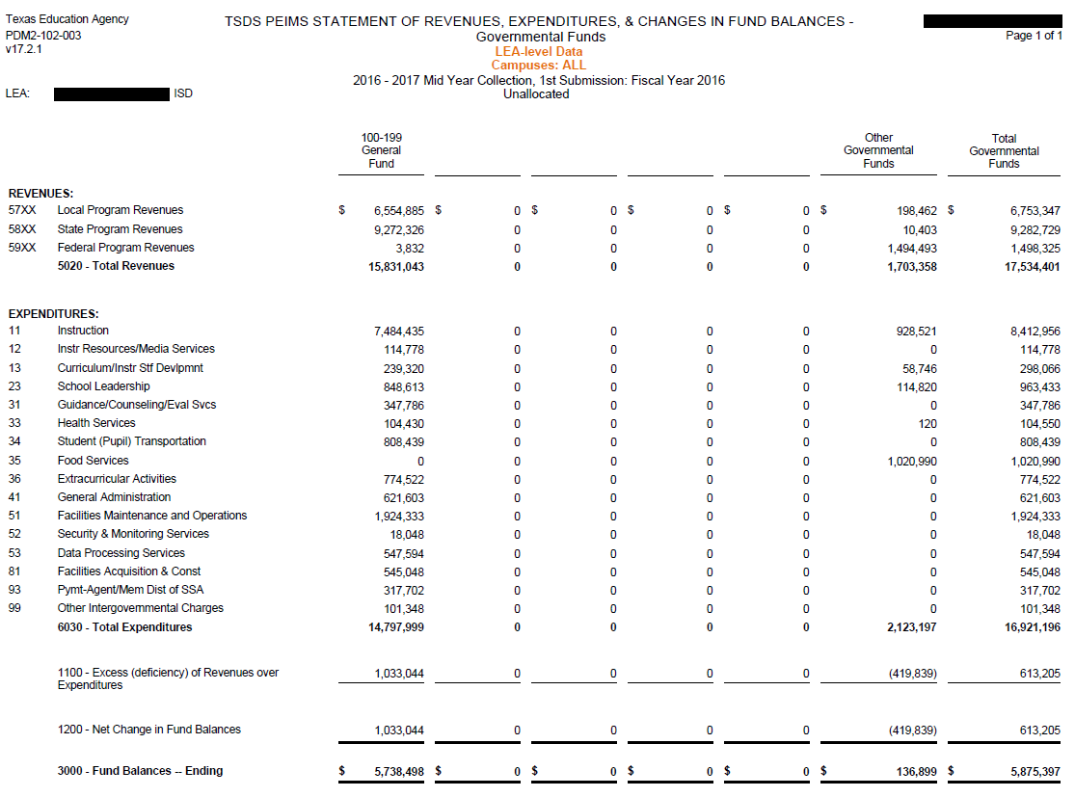
PEIMS Errors
Indicator 13: PEIMS Data Quality -Continued

Slide 32
Peims and Data Feed Errors
Indicator 13: PEIMS Data Quality - Continued
Calculation: Sum of the absolute values of all differences in expenditures between the Data Feed (Statement of Revenues, Expenditures, and Changes in Fund Balance (Schedule C-2)) and PEIMS, by function in Fund Code 199.
The illustration below discloses what occurs when a district’s PEIMS data does not reconcile with the data entered into Schedule C-2 in the data feed.
No manual correction will be made in the School FIRST application concerning indicator 13. The PEIMS data is considered inaccurate if the percent variance exceeds 3%.
Loss of 10 points on indicator 13 for each district.
CDN | PEIMS Total Function Expenditures (Fund 199) | Absolute Value Total for all Functions | Total Variance | (Worth 0 or 10 Points) Score
XXX-XXX | $10,869,669 | $767,119 | 7.0574% | 0
XXX-XXX | $6,224,481 | $2,533,592 | 40.7037% | 0
XXX-XXX | $3,687,929 | $1,500,231 | 40.6795% | 0
XXX-XXX | $66,674,453 | $19,724,976 | 29.5840% | 0
XXX-XXX | $11,464,028 | $27,963,796 | 243.9264% | 0
XXX-XXX | $4,639,426 | $159,582 | 3.4397% | 0

Slide 33
data feed, PEIMS errors, and your district’s first rating
Data feed and PEIMS errors may cause your school district to receive an F = Substandard Achievement.
The school district receives an F if it scores below the minimum passing score;
if it failed any critical indicator 1, 3, 4, 5, or 2.A;
if the AFR or the data were not both complete; or
if either the AFR or the data were not submitted on time for FIRST analysis.
Your district has the right to appeal its preliminary FIRST rating. However, 19 TAC 109.1001(l)(3) states the following,
(I) A school district or an open-enrollment charter school may appeal its preliminary financial accountability rating through the following appeals process.
(3) A school district or an open-enrollment charter school may appeal any adverse issue it identifies in the preliminary rating. However, the financial accountability rating system is required to apply the rules uniformly. Therefore, an error by a school district or an open-enrollment charter school in recording data or submitting data through the TEA data collection and reporting system is not a valid basis for appealing a preliminary rating and unlikely to negate concerns raised by the indicator. The appeals process is not a permissible method to correct data that were inaccurately reported by the school district or open-enrollment charter school after those data were certified as accurate. A request for exception to the rules for a school district or an open-enrollment charter school is disfavored and likely to be denied.
Notes:
Submitting accurate and timely data to the TEA is imperative.
An F = Substandard Achievement rating has an affect on your district’s accreditation status.

Slide 34
The effect of a District’s data errors on its first rating
Review of the Actual Statistics Concerning Data Errors Made by Districts
Review of the Number of Manual Corrections that the TEA completes in a School FIRST Rating Year
Review of Districts FIRST Ratings Before and After the Manual Corrections Made by the TEA

Slide 35
Districts data feed and peims errors

Slide 36
Tea Manual corrections to districts school First data

Slide 37
FY 2015 School First ratings before and After manual corrections

Slide 38
TEA’s MANUAL CORRECTION PROCESS FOR DISTRICTS DATA ENTRY ERRORS
Identification of Districts School FIRST Data Errors
Creation of Issues Document
Approval by Upper Management to Perform Manual Corrections on District Data
Correction of School District Errors in the School FIRST Application
Paper Trail that is Created During the Manual Correction of District Data Entry Errors
Manual Correction Letters

Slide 39
TEA’s School first manual correction process
Manual corrections made by the TEA to correct a school district’s School FIRST data errors are never made in the Data Feed or PEIMS. Manual corrections of School FIRST data are only made in the School FIRST application.
If the data error is a data error created in PEIMS by the school district, no manual correction is completed in the School FIRST application.
Information Gathering Stage
Input
Output
AFR,
Data Feed
and PEIMS
Reviewed
Manual
Corrections
Entered into
School FIRST
Application
Preliminary
School FIRST
Rating Testing
Conducted
Documentation
Gathered
Upper Level
Management
Approves or Denies
Manual Correction
of the District
Data Error
1
Districts Data Entry Errors Identified
2
3
Manual
Correction Letters
Sent to Districts
Districts
Data Errors
Recorded on
Issues
Document
Manual
Correction
Records
Created

Slide 40
Sample manual correction letter

Slide 41
BEST PRACTICES TO evaluate current processes and REDUCE DATA ERRORS
Internal Controls
Data Submittal Review Process
Evaluation of Current Processes
Key Benefits of a Successful Internal Control System

Slide 42
internal controls
Verification
Deter
Prevent
Reduction
of
Error Risk
Increased Transparency
Segregation
of
Duties
Authorization
Reconciliation
Internal controls are meant to help control various aspects of an organization’s activity and provide reasonable assurance that this activity is in accordance with its control objectives.
An internal control is also a process designed to provide reasonable assurance regarding the achievement of objectives in:
Effectiveness and efficiency of operations
Reliability and accuracy of financial reporting
Compliance with applicable laws and regulations
All district employees impact internal controls.
Effective internal controls:
allow the district to stay on course to meet its objectives, goals, and accomplish its mission; and
minimize surprises, such as a low score on School FIRST.
Notes:
An internal control system of any kind is a tool that provides management with an enhanced level of management control and insight into how the organization is working. An internal control gets the organization working according to the values and missions communicated by management. An internal control system is also a way of implementing best working practices, responsibility, and accountability. An internal control system should make those values an integral part of an organizations culture. An internal control system should clearly define who is responsible for what.
The graphic on this slide presents some components of preventive and detective internal controls. Reasonable assurance is not absolute assurance.

Slide 43
internal control Objectives
Operational Objectives
Achievement of goals and mission(s)
Effectiveness and efficiency of operations
Financial Reporting Objectives
Completeness and accuracy of accounting records
Timely preparation and submittal of reliable data and reports
Compliance Objectives
Adherence to applicable laws, regulations, and statutes
Transparency Objectives
Accurate presentation of the district’s financial and academic status communicated to stakeholders
Efficiency Objectives
Tasks are completed according to standards
Maintaining the district’s accreditation status
Processes take place without disruption
Receiving a passing rating on FIRST
Internal controls are constantly monitored, improved, and ineffective controls are eliminated
Notes:
Each school district must establish internal control objects for its district based on the goals, missions, values, and applicable laws and statutes that the district must adhere to. This slide discloses some examples of internal control objectives.

Slide 44
Elements of internal controls
Internal controls document transactions by creating an audit trail; therefore, your district’s internal controls should be able to detect data entry errors before the data is submitted to the TEA.
A strong and successful system of internal controls should:
have data entry checks (someone should be reviewing your data entries before they are finalized and submitted to the TEA);
prevent data errors by “spotlighting” data inaccuracies (error notification and correction);
ensure the accuracy and completeness of financial reporting;
require authorized signatures (electronic and/or manual, dependent upon the type of signature required) (The authorized signatory is actually reviewing and approving the data before it is submitted to the TEA.);
ensure compliance with required laws and regulations; and
have an internal review process that is designed to be ongoing, robust, and interactive.
Successful internal controls are dependent upon the actions and the people that carry out those actions.
Notes:
Remember, internal controls are mechanisms, rules, safeguards and processes whose purpose is to positively influence activity in your district. The internal controls that your district implement should advance the control objectives established by your district and reduce risks to those objectives. If an internal control is found to contain weaknesses the school district should increase supervision and monitoring and alter the internal control to reduce risk to the district due to the inherent weakness of the control.

Slide 45
data submittal review process
Internal Control Process
Plan
Check
Act
Analyze
Notes:
Plan – Create a timeline to submit the data and ensure that your district has the right staff in place to enter, review and submit the data. Check - Check the data before it is submitted (review process). Act/Do – enter and submit the accurate data on time. Do not rush to submit the data, because you will make mistakes. Analyze – Analyze/review the data that has been submitted. If you know that your district has made a data entry error and the final deadline to submit the data feed data has not passed please contact the TEA. We may be able to reopen the data feed if your district has not passed the deadline to submit the required data.
When your district submits inaccurate data the required transparency that districts must create and maintain with all stakeholders is breached.

Slide 46
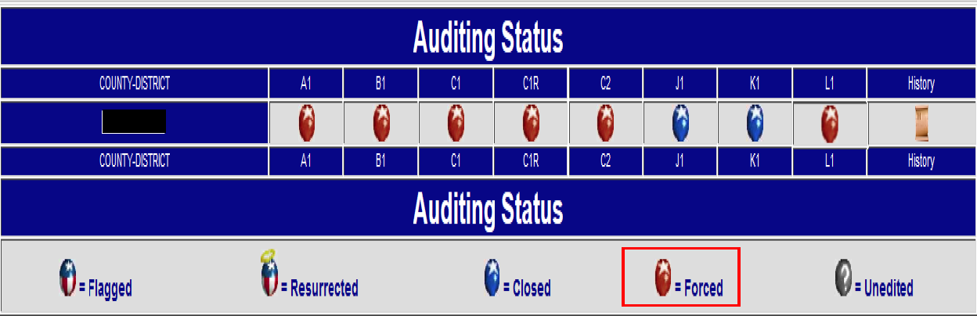
data submittal review process - Continued
Ensure your district’s data feed data agrees to your district’s AFR PDF copy by doing the following before pressing the “Finalize” button:
Verify that each row on your district’s data feed submission agrees to your district’s AFR.
Use the “Show Errors” button in the data feed to aid you in identifying errors.
Reconcile each line in the data feed to your district’s AFR PDF copy.
This should be completed for all schedules in the data feed (A1, B1, C1, C1R, C2, J1, J2, J3 (optional schedule), K1 and L1).
Notes:
Review your district’s auditing status for each schedule. See the pictures to the left.

Slide 47
data submittal review process - Continued
Review your district’s status page on the TEA website for the submittal dates of the data feed text file and the AFR PDF copy.
Notes:
Your district’s status page should look like the picture on the left.

Slide 48
EVALUATION OF CURRENT PROCESSES
1
2
3
4
5
Know your district’s internal control processes
Gain an understanding of your district’s current internal AFR and PEIMS data submittal processes and its current effectiveness
Who is responsible for approving, entering, and submitting data
What are the data format requirements
Where do we need to strengthen our controls
When is the data required to be submitted
Why is it important that the data be accurate
Review and create a control environment in which district staff are
fully competent,
mindful,
Knowledgeable,
committed to doing what is right and doing it the right way
Evaluate the current goals and objectives concerning data quality and required data submittals
Operations objectives
Financial reporting objectives
Compliance objectives
Know the end at the beginning
Know that the data that your district submitted to the TEA is 100% error free
Notes:
The methods and procedures implemented by management to control the operations of the district, so as to help the district in achieving desired ends is called the internal control system. In the internal control system the work of one person is verified by another. The internal control system is constantly checked.

Slide 49
EVALUATION OF CURRENT PROCESSES - Continued
During the evaluation of your district’s current data quality and submittal processes the following questions should be asked:
What are the required data submittal timelines?
What could go wrong?
How could we fail?
What must go right for us to succeed (and receive an A = Superior School FIRST rating)?
Where are we vulnerable?
How do we know whether we are achieving our objectives?
What complexities does our district encounter concerning the required data submittals to the TEA?
What is our greatest legal exposure?
Which data submittal requirements impact our district’s accreditation?
Who is ultimately responsible for the data that is submitted to the TEA?
Notes:
Communication is the key. Communication with district staff members about expectations, desired outcomes, and the overall internal systems that are in place is the key to constantly evaluating and improving your district’s internal control system. An effective internal control system ensures cost effectiveness through sound decisions and business transactions that have a greater benefit than cost. Your district maximizes efficiency through the productivity of all district staff. An effective internal control system also underscores your district’s accountability to all stakeholders, because you as a district are responsible and willing to answer to all stakeholders for all decisions make by the district. Each district should constantly ask if the internal controls that are currently in place are effective.
You know when an effective internal control system is in place, because employees are at their best and submit timely and accurate data to the TEA producing the best results for the district that ultimately benefit the students and all stakeholders of the district.

Slide 50
Key benefits of a successful internal control system
RISKS TO THE DISTRICT ARE DECREASED
HIGHER STANDARDS ACHIEVED
Compliance with Laws and Regulations
District assets are safeguarded
Sound business decisions are made and communicated to stakeholders
Positive public image is maintained and stakeholder trust in the district increases
Your district maintains its accreditation status
Improved Communication and Procedures
Maximization of resources and reduction of waste
Processes and procedures operate as intended
Reliability and integrity of financial information is improved (Data quality)
Risk of fraud reduced
Noncompliance issues are reduced or eliminated
Goals, objectives, and benchmarks are met
Notes:
School districts are responsible to the stakeholders and an effective internal control system allows school districts to gain stakeholder buy-in. An effective internal control system allows a school district to be transparent, ensuring that all facts, figures, financials, and processes are visible, predictable, and understood by all stakeholders.
Your district’s School FIRST ratings affect your district’s accreditation status; therefore, it is imperative that your district always submit accurate and time data to the TEA.

Slide 51
Useful links
Annual Financial and Compliance Report Submission
Electronic Submission for Districts
School FIRST Ratings on the TEA Website
Texas Administrative Code for FIRST Rules (19 TAC §109.1001)
Financial Accountability System Resource Guide (FASRG)
To the Administrator Addressed Letters

Slide 52
Useful links
Annual financial and Compliance Report
Annual Financial and Compliance Report Submission
Annual Financial and Compliance Report
Electronic Submissions for School Districts
Electronic Submissions
School FIRST
Ratings on TEA’s Website
Financial Integrity Rating System of Texas
Texas Administrative Code (TAC) for FIRST Rules
19 TAC §109.1001
Financial Accountability System Resource Guide (FASRG)
FASRG
TEA Correspondence
To the Administrator Addressed Correspondence

Slide 53
Contact Information
David Marx Director, Financial Compliance Division
(512) 463-2945 or david.marx@tea.texas.gov
Financial Accountability Section
financialaccountability@tea.texas.gov
Yolanda Walker Manager, Financial Accountability Section
(512) 463-0947 or yolanda.walker@tea.texas.gov
Robin Aldridge (512) 463-3940 or robin.aldridge@tea.texas.gov
Rita Bunton (512) 936-3712 or rita.bunton@tea.texas.gov
Chanda Williams (512) 475-2012 or chanda.williams@tea.texas.gov

