Slide 1
CCT Exam Topic 3: Cisco IOS Software Operation
Cisco Certified Technician: CCT
Supporting Cisco Routing & Switching Network Devices
Section 3.1
Describe the key role of Cisco IOS, IOS-XE, IOS-XR and NX-OS software

Slide 2
Cisco Certified Technician: CCT
Supporting Cisco Routing & Switching Network Devices
Cisco IOS Software Operation Key role of Cisco IOS, IOS-XE, IOS-XR and NX-OS software
IOS (Internetwork Operating System) is a proprietary operating system used on most Cisco routers and switches. IOS has a command-line interface. This operating system is used to configure routing, switching, internetworking and other features supported by a Cisco device.
IOS-XE: Cisco IOS-XE is built on Linux and adds support for symmetric multiprocessing and separate memory spaces.
IOS-XR: Found on Cisco service provider routers, for example, a Cisco XR 12000 Series router runs Cisco IOS-XR. A feature IOS-XR offers is the ability to have a single instance of the operating system controlling multiple chassis. Also, since IOS-XR targets service provider environments, it offers support for interfaces such as DWDM and Packet over SONET.
NX-OS: Found on Cisco Nexus switches located in data centers. For example, a Cisco Nexus 7000 Series switch runs Cisco NX-OS. NX-OS is built on a Linux kernel, and it natively supports the Python language for creating scripts on Cisco Nexus switches.

Slide 3
CCT Exam Topic 3: Cisco IOS Software Operation
Cisco Certified Technician: CCT
Supporting Cisco Routing & Switching Network Devices
Section 3.2
Navigate between different operating modes
(This topic is covered in Intro to Networks v7 – 2.2)

Slide 4
CCT Exam Topic 3: Cisco IOS Software Operation
Cisco Certified Technician: CCT
Supporting Cisco Routing & Switching Network Devices
Section 3.3
Determine the current mode of a device
(This topic is covered in Intro to Networks v7 – 2.2)

Slide 5
CCT Exam Topic 3: Cisco IOS Software Operation
Cisco Certified Technician: CCT
Supporting Cisco Routing & Switching Network Devices
Section 3.4
Copy and paste a configuration file from/to a
router or switch

Slide 6
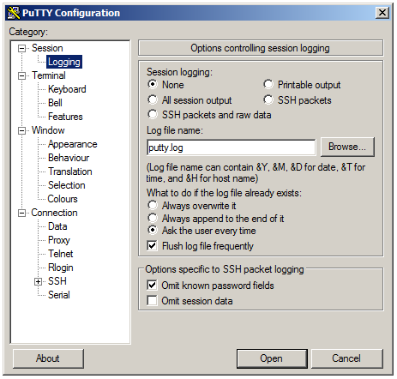
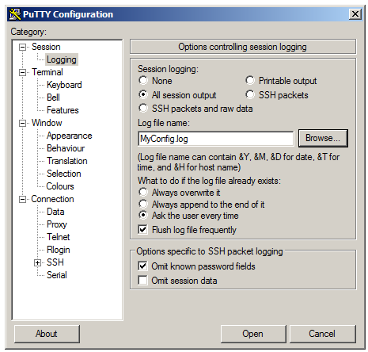
Cisco Certified Technician: CCT
Supporting Cisco Routing & Switching Network Devices
Cisco IOS Software Operation Copy and paste a configuration file from/to a router or switch.
Copy the configuration using terminal emulation software
Step 1. Open terminal emulation software, such as PuTTY or Tera Term, that is already connected to the router or switch. Click on the Logging in the Category window to enable logging in the terminal software.
Step 2. Assign a name to the log file (MyConfig.log) and click the Browse button to select the location to save the log file. The figure displays that All session output will be captured to the file specified (i.e., MyConfig.log).
Step 1
Step 2

Slide 7
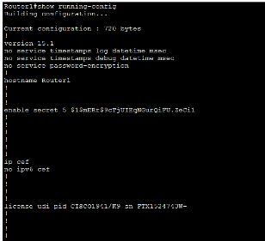
Cisco Certified Technician: CCT
Supporting Cisco Routing & Switching Network Devices
Cisco IOS Software Operation Copy and paste a configuration file from/to a router or switch.
Copy the configuration using terminal emulation software
Step 3. Execute the show running-config or show startup-config command at the privileged EXEC prompt. Text displayed in the terminal window will be placed into the chosen log file.
Step 4. To disable logging in the terminal software, choose the None session logging option.
The text file created can be used as a record of how the device is currently implemented. The file could require editing before being used to restore a saved configuration to a device.
Step 3
Step 4

Slide 8
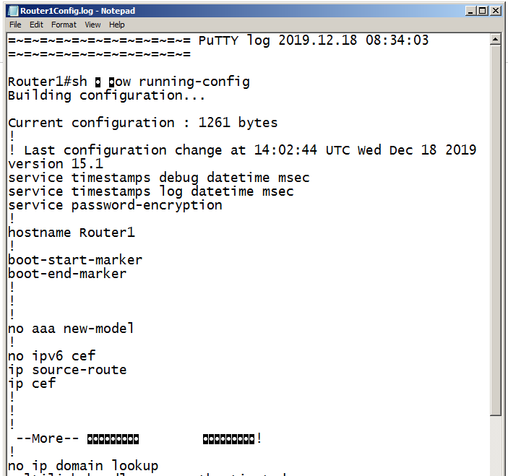
Cisco Certified Technician: CCT
Supporting Cisco Routing & Switching Network Devices
Cisco IOS Software Operation Copy and paste a configuration file from/to a router or switch.
To restore a configuration file to a device:
Step 1. Open the text file and copy the text (you may want to remove any unnecessary text).
Step 1

Slide 9
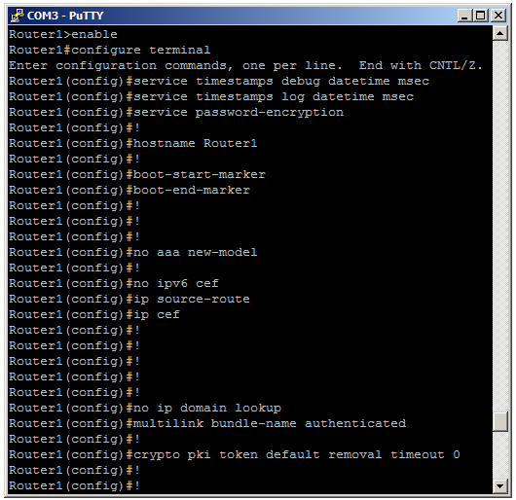
Cisco Certified Technician: CCT
Supporting Cisco Routing & Switching Network Devices
Cisco IOS Software Operation Copy and paste a configuration file from/to a router or switch.
To restore a configuration file to a device:
Step 2. Enter global configuration mode on the device.
Step 3. Paste the text file into the terminal window connected to the router or switch.
The text in the file will be applied as commands in the CLI and become the running configuration on the device. This is a convenient method of manually configuring a device.
Step 2 & 3

Slide 10
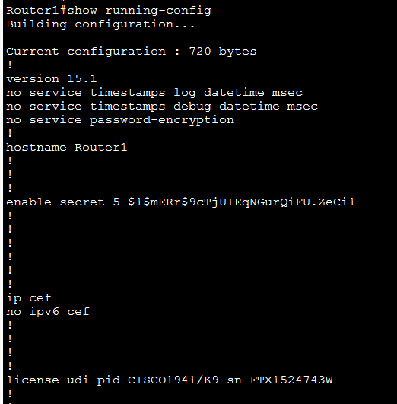
Cisco Certified Technician: CCT
Supporting Cisco Routing & Switching Network Devices
Cisco IOS Software Operation Using a text editor to copy and paste configurations.
Using a text editor to capture a configuration file
Access the router or switch using terminal emulations software, such as PuTTY or Tera Term
Issue the show running-config command on the device to list the configuration.
Scroll back to the beginning of the configuration, then highlight and copy the configuration.

Slide 11
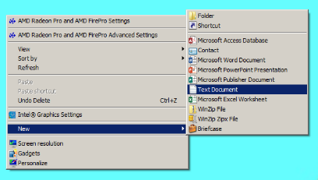
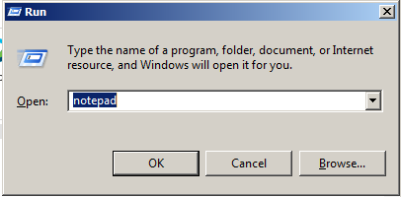
Cisco Certified Technician: CCT
Supporting Cisco Routing & Switching Network Devices
Cisco IOS Software Operation Using a text editor to copy and paste configurations.
Access Notepad and paste configuration commands
Option 1 - Right click on the Windows desktop and select New and then select Text Document. A new text file will be created on the desktop. Open the text file and paste the configuration commands into the text file. Save the file for future use.
Option 2 - Click on the Start menu, type Run and press Enter. Then type Notepad and click OK. This will open a new untitled text file. Paste the configuration commands into the text file.
This text file can be stored as a backup and copied and pasted into the switch or router CLI.
*Notepad the preferred text editor
** Note that the text file may require some editing prior to be a functional configuration.
Option1
Option 2

Slide 12
CCT Exam Topic 3: Cisco IOS Software Operation
Cisco Certified Technician: CCT
Supporting Cisco Routing & Switching Network Devices
Section 3.5
Use and interpret the basic Cisco IOS Software commands
(This topic is covered in Intro to Networks v7 – 2.3, 10.2.3 & 17.5.6)

Slide 13
CCT Exam Topic 3: Cisco IOS Software Operation
Cisco Certified Technician: CCT
Supporting Cisco Routing & Switching Network Devices
Section 3.6
Describe the location and process to change the configuration register parameter

Slide 14
Cisco Certified Technician: CCT
Supporting Cisco Routing & Switching Network Devices
Cisco IOS Software Operation Describe the location and process to change the configuration register parameter
The show version command displays information about the version of the Cisco IOS software currently running on the router, the version of the bootstrap program, and information about the hardware configuration, including the amount of system memory. It also displays the current configuration register setting.
The configuration register can be used to change router behavior such as:
How the router boots
Options while booting (ignore configuration, disable boot messages)
Console speed (baud rate for a terminal emulation session)
The factory default setting for the configuration register is 0x2102
Router#show version
Cisco IOS Software [Everest], ISR Software (X86_64_LINUX_IOSD-UNIVERSALK9-M), Version 16.6.4,RELEASE SOFTWARE (fc3)
Technical Support: http://www.cisco.com/techsupport
Copyright (c) 1986-2018 by Cisco Systems, Inc.
Compiled Sun 08-Jul-18 04:33 by mcpre
<output omitted>
Configuration register is 0x2102
Router#
<output omitted>

Slide 15
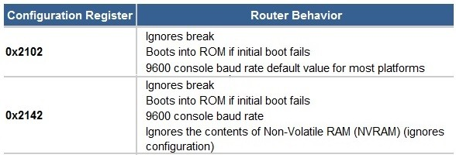
Cisco Certified Technician: CCT
Supporting Cisco Routing & Switching Network Devices
Cisco IOS Software Operation.
Describe the location and process to change the configuration register parameter
To change the configuration register setting from global configuration use the config-register command as shown.
Save the modified configuration by using the copy running-config startup-config command.
Then use the reload command or power cycle the device to re-start using the new configuration setting.
Use the show version command to verify the setting.
Router>enable
Router#configure terminal
Enter configuration commands, one per line. End with CNTL/Z.
Router(config)#enable secret class
Router(config)#config-register 0x2102
Router(config)#end
Router#
%SYS-5-CONFIG_I: Configured from console by console
Router#copy running-config startup-config
Destination filename [startup-config]?
Building configuration...
[OK]
Router#
Commonly used configuration registers

Slide 16
Cisco Certified Technician: CCT
Supporting Cisco Routing & Switching Network Devices
Cisco IOS Software Operation Describe the location and process to change the configuration register parameter
The user can press the ctrl+break keys to interrupt the router's booting process and this will allow entering into the ROMMON mode.
To change the configuration register setting from rom monitor use the confreg command as shown.
You must reset or power-cycle for the new configuration register to take effect.
rommon 1 > confreg 0x2142
rommon 2 > reset
Initializing Hardware ...
Checking for PCIe device presence...done
System integrity status: 0x610
Rom image verified correctly
System Bootstrap, Version 16.7(3r), RELEASE SOFTWARE
Copyright (c) 1994-2018 by cisco Systems, Inc.
<output omitted>

Slide 17
CCT Exam Topic 3: Cisco IOS Software Operation
Cisco Certified Technician: CCT
Supporting Cisco Routing & Switching Network Devices
Section 3.7
Identify a configuration file from a Cisco device (This topic is covered in Intro to Networks v7 – 2.5.1 - 2.5.3)

Slide 18
CCT Exam Topic 3: Cisco IOS Software Operation
Cisco Certified Technician: CCT
Supporting Cisco Routing & Switching Network Devices
Section 3.8
Describe the licensing process on different platforms.

Slide 19
Cisco Certified Technician: CCT
Supporting Cisco Routing & Switching Network Devices
Cisco IOS Software Operation Describe the licensing process on different platforms
Cisco Licensing before IOS 15.0
Software Image/Package | Features
IP Base | Entry level Cisco IOS image
IP Voice | Adds voice
Advanced Security | Adds security – VPN, IDS/IPS, IPsec.
Service Provider services | Adds secure shell/Secure Sockets layer(SSH/SSL), ATM, Multiprotocol Label Switching (MPLS)
Enterprise Base | Adds multiprotocol services
Enterprise services | Merges Enterprise Base and SP services.
Advanced IP services | Merges Advanced security and SP services. Adds IPv6
Advanced Enterprise Services | Merges advanced IP services and enterprise services.
Cisco Licensing before IOS 15.0
Prior to IOS version 15.0, the software images were based on the needs of the customer. There were 8 different images to satisfy various customer requirements. See table.
Cisco Licensing IOS 15.0 and later
Cisco IOS version 15 and later shipped with a universal image and corresponding feature set packages as shown in table.
Cisco Licensing IOS 15.0 and later
Software Image/Package | Features
IP Base | Entry-level IOS functionality
DATA | MPLS, ATM, Multiprotocol support
Unified Communications | VoIP, IP Telephony
Security | IOS Firewall, IPS, IPSec, 3DES, VPN

Slide 20
Cisco Certified Technician: CCT
Supporting Cisco Routing & Switching Network Devices
Cisco IOS Software Operation Describe the licensing process on different platforms
To view the licenses on a router use the command show license as seen in figure.
Router#show license ?
all Show license all information
detail Show license detail information
feature Show license feature information
udi Show license udi information
Router#show license feature
Feature name Enforcement Evaluation Subscription Enabled RightToUse
hseck9 yes no no no no
AdvUCSuiteK9 yes yes no no yes
FoundationSuiteK9 yes yes no no yes
appxk9 yes yes no no yes
cme-srst yes yes no no yes
ipbasek9 no no no yes no
securityk9 yes yes no yes yes
throughput yes yes no no yes
uck9 yes yes no no yes
internal_service yes no no no no
Router#

Slide 21
Cisco Certified Technician: CCT
Supporting Cisco Routing & Switching Network Devices
Cisco IOS Software Operation Describe the licensing process on different platforms
Installing a Permanent License
Permanent licenses, once installed, do not expire.
Installing an Evaluation License
An evaluation license is a temporary license for up to 60 days.
Command
R1# license install stored-location-url | Installs a license stored in the location identified by stored-location-url
R1# reload | Reloads the router
R1# show version | Verify that the new license has been installed
command
R1(config)#license boot module module name technology package package name | Enables the evaluation license
R1(config)#exit | Exit configuration mode
R1# reload | Reload to activate software package

Slide 22
Cisco Certified Technician: CCT
Supporting Cisco Routing & Switching Network Devices
Cisco IOS Software Operation Describe the licensing process on different platforms
Backing Up a License
command
R1# license save file-sys://lic-location | Save copy of license. Location can be a directory or URL that points to a file system
R1# license save flash: all_licenses.lic | Saves a copy of all licenses to the flash memory under name all_licenses.lic

Slide 23
Cisco Certified Technician: CCT
Supporting Cisco Routing & Switching Network Devices
Cisco IOS Software Operation Describe the licensing process on different platforms
Cisco Smart Software Licensing
This is a flexible software licensing model that streamlines the way customers activate and manage Cisco software licenses across their organization. Smart Licenses provide greater insight into software license ownership and consumption so customers know what they own and how it is being used. Gone are the days of lost or unknown PAKs. Cisco Smart Licensing establishes a pool of licenses or entitlements that can be used across the entire organization in a flexible and automated manner.
Smart Licensing is typically deployed on products in one of two ways:
Smart License only: These products support Smart Licensing as their only licensing option. Association of the licenses to the Smart Account is mandatory before the customer can successfully license their products.
Hybrid: These products had previously shipped with an older licensing model, such as Product Activation Key (PAK), Right-To-Use (RTU), or other proprietary license model. They will default to using their old licensing model, but the customer may opt into activating Cisco Smart Licensing on this product when ready.

Slide 24
CCT Exam Topic 3: Cisco IOS Software Operation
Cisco Certified Technician: CCT
Supporting Cisco Routing & Switching Network Devices
Section 3.9
Describe the Bundle Mode/Install Mode IOS-XE

Slide 25
Cisco Certified Technician: CCT
Supporting Cisco Routing & Switching Network Devices
Cisco IOS Software Operation Describe the Bundle Mode/Install Mode IOS-XE
IOS-XE supported switches such as the 3850 and 3650 support two modes, Bundle mode and Install mode. New switches, by default, are shipped with install mode.
Two or more switches must be in the same boot mode to form a switch stack.
Install Mode
The Install mode is the recommended mode for booting a switch.
With Install mode you no longer need to manually copy the IOS XE to each switch. This can be performed using an option during the upgrade procedure. This can be especially useful when managing a large number of switches.
To use Install mode in a switch stack, all switches in the stack must have the same license as the active switch.
Booting from a USB driver or TFTP in Install mode is not supported.
Bundle Mode
Bundle mode is where the switch/stack is booted using the .bin file. This is the traditional method of booting the switch. The switch extracts the .bin file to the RAM of the switch and runs the IOS from there.
This mode consumes more memory than the Install mode because the packages are extracted from the bundle and copied to RAM.
Auto-upgrade feature is disabled by default and is not available in the Bundle mode.

Slide 26
Cisco Certified Technician: CCT

