Slide 1
CCT Exam Topic 4: Service-Related Knowledge
Cisco Certified Technician: CCT
Supporting Cisco Routing & Switching Network Devices
Section 4.1
Locate and use a text editor such as Notepad

Slide 2
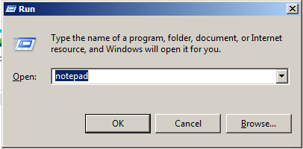
Cisco Certified Technician: CCT
Supporting Cisco Routing & Switching Network Devices
Describe Cisco IOS Software Operation Using a text editor to copy and paste configurations
Access Notepad and paste configuration commands
Option 1 - Right click on the Windows desktop and select New and then select Text Document. A new text file will be created on the desktop. Open the text file and paste the configuration commands into the text file. Save the file for future use.
Option 2 - Click on the Start menu, type Run and press Enter. Then type Notepad and click OK. This will open a new untitled text file. Paste the configuration commands into the text file.
This text file can be stored as a backup and copied and pasted into the switch or router CLI.
*Notepad the preferred text editor
** Note that the text file may require some editing prior to be a functional configuration.
Option1
Option 2

Slide 3
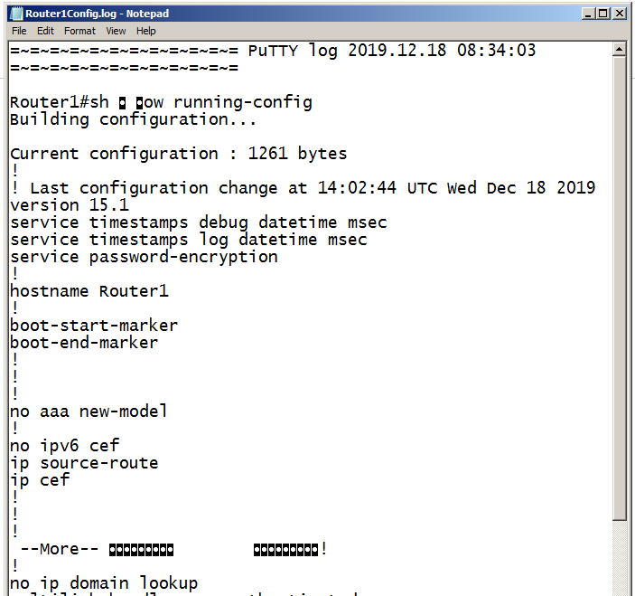
Cisco Certified Technician: CCT
Supporting Cisco Routing & Switching Network Devices
Describe Cisco IOS Software Operation Copy and paste a configuration file from/to a router or switch
Text files are often used to restore a configuration file to a device.
Step 1. Open the text file and copy the text (you may want to remove any unnecessary text).
Step 2. Enter global configuration mode on the device.
Step 3. Paste the text file into the terminal window connected to the router or switch.
The text in the file will be applied as commands in the CLI and become the running configuration on the device. This is a convenient method of manually configuring a device.
Step 1

Slide 4
CCT Exam Topic 4: Service-Related Knowledge
Cisco Certified Technician: CCT
Supporting Cisco Routing & Switching Network Devices
Section 4.2
Locate and use the Window command prompt

Slide 5
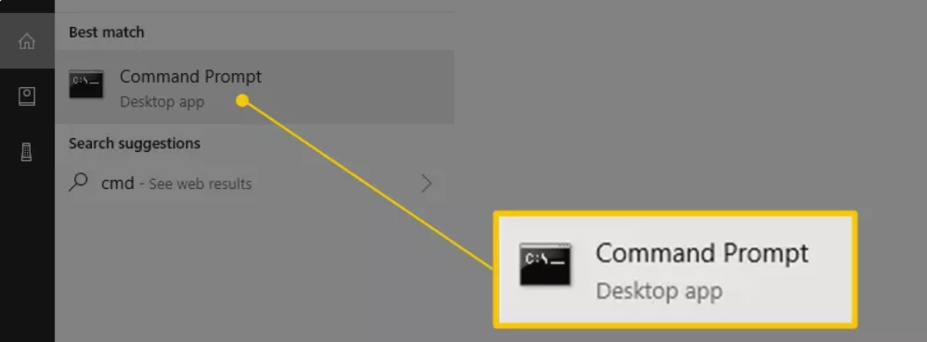
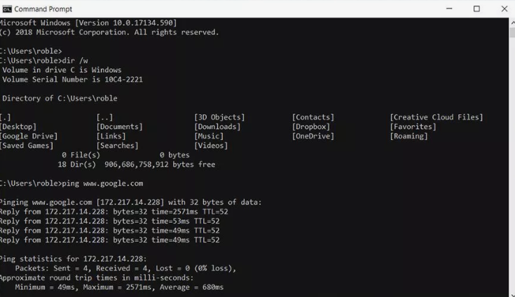
Cisco Certified Technician: CCT
Supporting Cisco Routing & Switching Network Devices
Service-Related Knowledge Locate and use the Window command prompt
The command prompt is one of the command-line interface programs used to execute commands in Windows operating systems.
To open:
Select Start, type cmd, press enter – or select it from the Menu that pops up.

Slide 6
CCT Exam Topic 4: Service-Related Knowledge
Cisco Certified Technician: CCT
Supporting Cisco Routing & Switching Network Devices
Section 4.3
Locate and use Terminal Emulation
(This topic is covered in Intro to Networks v7 – 2.1.5)
Lab 4.3.1 Lab – Managing Router configuration files with Terminal Emulation Software

Slide 7
CCT Exam Topic 4: Service-Related Knowledge
Cisco Certified Technician: CCT
Supporting Cisco Routing & Switching Network Devices
Section 4.4
Configure network settings for Ethernet port on a laptop (IP address, subnet mask and default gateway) and establish a connection with Ethernet ports on Cisco equipment
Part 1 is covered in Intro to Networks v7 – 2.7.1
Part 2 – complete lab 4.4 – Connect Ethernet ports

Slide 8
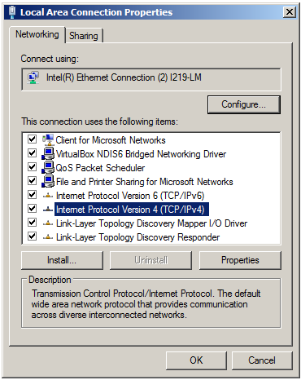
Cisco Certified Technician: CCT
Supporting Cisco Routing & Switching Network Devices
Service-Related Knowledge Configure network settings for Ethernet port on a laptop and establish a connect with Ethernet ports on Cisco equipment
Part 1 – Configure network settings for Ethernet port on a laptop – is covered in Intro to Networks v7 – 2.7.1
Part 2 – Is covered in lab 4.4
Complete lab 4.4
Connect Ethernet ports

Slide 9
Activity to Complete
Cisco Certified Technician: CCT
Supporting Cisco Routing & Switching Network Devices
4.4.1 - Lab - Connect Ethernet Ports

Slide 10
CCT Exam Topic 4: Service-Related Knowledge
Cisco Certified Technician: CCT
Supporting Cisco Routing & Switching Network Devices
Section 4.5
Make a physical connection from laptop to Cisco console port

Slide 11
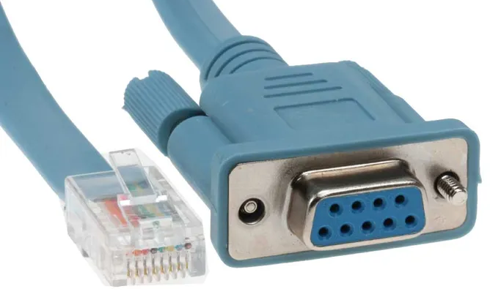
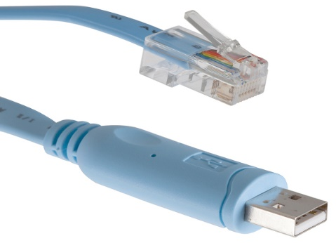
Cisco Certified Technician: CCT
Supporting Cisco Routing & Switching Network Devices
Service-Related Knowledge Make a physical connection from laptop to Cisco console port
The console port is used to make a physical connection from a PC to a router/switch. This connection is used to configure the device.
The cable that is used is a special cable. It is known as a Rollover cable or a Console cable. It is a type of null-modem cable that is often used to connect a computer terminal to a router's console port. This cable is typically flat (and has a light blue color) to help distinguish it from other types of network cabling. It gets the name rollover because the pinouts on one end are reversed from the other, as if the wire had been rolled over and you were viewing it from the other side.
There are different varieties of console cables:
DB-9
USB
NOTE: if using the DB-9 cable, a USB to serial adapter may be required.
Complete lab 4.5 Connect laptop or computer to console port
USB
DB-9
Console cables

Slide 12
Activity to Complete
Cisco Certified Technician: CCT
Supporting Cisco Routing & Switching Network Devices
4.5.1 - Lab - Connect laptop or computer to console port

Slide 13
CCT Exam Topic 4: Service-Related Knowledge
Cisco Certified Technician: CCT
Supporting Cisco Routing & Switching Network Devices
Section 4.6
Connect, configure, and verify operation status of a device interface
(This topic is covered in Intro to Networks v7 – 2.4)
Lab 4.6.1 Connect Ethernet Ports

Slide 14
CCT Exam Topic 4: Service-Related Knowledge
Cisco Certified Technician: CCT
Supporting Cisco Routing & Switching Network Devices
Section 4.7
Configure and use TFTP and FTP servers
https://appuals.com/how-to-setup-and-configure-tftp-server-on-windows-10/ (Set up TFTP server)
https://www.windowscentral.com/how-set-and-manage-ftp-server-windows-10 (Set up FTP server)

Slide 15
CCT Exam Topic 4: Service-Related Knowledge
Cisco Certified Technician: CCT
Supporting Cisco Routing & Switching Network Devices
Section 4.8
Perform software upgrade or downgrade using TFTP, xmodem, tftpdnld, or USB storage

Slide 16
Cisco Certified Technician: CCT
Supporting Cisco Routing & Switching Network Devices
Describe Cisco IOS Software Operation Perform software upgrade or downgrade using TFTP
It is good practice to keep a backup copy of the Cisco IOS Software image in case the system image in the router becomes corrupted or accidentally erased.
Using a network TFTP server allows image and configuration uploads and downloads over the network. The network TFTP server can be another router, a workstation, or a host system.
In the example, the network administrator wants to create a backup of the current image file on the router (isr4300-universalk9.16.06.04.SPA.bin) to the TFTP server at 172.16.1.100.
Flash
R1
TFTP Server
172.16.1.100
isr4300-universalk9.16.06.04.SPA.bin

Slide 17
Cisco Certified Technician: CCT
Supporting Cisco Routing & Switching Network Devices
Describe Cisco IOS Software Operation Perform software upgrade or downgrade using TFTP
To create a backup of the Cisco IOS image to a TFTP server, perform the following three steps:
Step 1. Ensure that there is access to the network TFTP server. Ping the TFTP server to test connectivity, as shown in Step 1.
Step 2. Verify that the TFTP server has sufficient disk space to accommodate the Cisco IOS Software image. Use the show flash command on the router to determine the size of the Cisco IOS image file. The file in the example is 486899872 bytes long, as shown in Step 2.
Step 3. Copy the image to the TFTP server using the copy source-url destination-url command, as shown in Step 3.
After issuing the command using the specified source and destination URLs, the user is prompted for the source file name, IP address of the remote host, and destination file name. The transfer will then begin.
Verify connectivity to the server
R1#ping 172.16.1.100
Type escape sequence to abort.
Sending 5, 100-byte ICMP Echos to 172.16.1.100, timeout is 2 seconds:
!!!!!
Success rate is 100 percent (5/5), round-trip min/avg/max = 0/0/1 ms
R1#
Step 1
Verify the image size
R1#show flash
System flash directory:
File Length Name/status
3 486899872isr4300-universalk9.16.06.04.SPA.bin
<output omitted>
[486899872 bytes used, 2767693471 available, 3254849162 total]
R1#
Step 2
Copy image to TFTP server
R1#copy flash tftp
Source filename []? isr4300-universalk9.16.06.04.SPA.bin
Address or name of remote host []? 172.16.1.100
Destination filename [isr4300-universalk9.16.06.04.SPA.bin]?
Writing isr4300-universalk9.16.06.04.SPA.bin...
!!!!!!!!!!!!!!!!!!!!!!!!!!!!!!!!!!!!!!!!!!!!!!!!!!!!!!!!
<output omitted>
[OK - 486899872 bytes]
486899872 bytes copied in 9.245 secs (169666 bytes/sec)
R1#
Step 3

Slide 18
Cisco Certified Technician: CCT
Supporting Cisco Routing & Switching Network Devices
Describe Cisco IOS Software Operation Perform software upgrade or downgrade using TFTP
Cisco frequently releases new versions of the IOS to resolve bugs and provide new features.
Follow these steps to upgrade the software on a Cisco router:
Step 1. Select a Cisco IOS image file that meets the requirements in terms of platform, features, and software. Download the file from cisco.com and transfer it to the TFTP server.
Step 2. Verify connectivity to the TFTP server. Ping the TFTP server from the router. The output in Figure 2 shows the TFTP server is accessible from the router.
Flash
isr4300-universalk9.16.06.07.SPA.bin
Step 1
R1
TFTP Server
172.16.1.100
Verify connectivity to the server
R1#ping 172.16.1.1
Type escape sequence to abort.
Sending 5, 100-byte ICMP Echos to 172.16.1.1, timeout is 2 seconds:
!!!!!
Success rate is 100 percent (5/5), round-trip min/avg/max = 0/0/1 ms
R1#
Step 2

Slide 19
Cisco Certified Technician: CCT
Supporting Cisco Routing & Switching Network Devices
Describe Cisco IOS Software Operation Perform software upgrade or downgrade using TFTP
Step 3. Ensure that there is sufficient flash space on the router that is being upgraded. The amount of free flash can be verified using the show flash command. Compare the free flash space with the new image file size. The show flash command in Step 3 is used to verify free flash size. Free flash space in the example is 2761893909 bytes.
Step 4. Copy the IOS image file from the TFTP server to the router using the copy command shown in Step 4. After issuing this command with specified source and destination URLs, the user will be prompted for IP address of the remote host, source file name, and destination file name. The transfer of the file will begin.
Complete Packet Tracer Lab
Using TFTP to upgrade a Cisco image
Upgrading IOS with TFTP - https://www.youtube.com/watch?v=8cmF-aPEbgs
Verify the image size
R1#show flash
System flash directory:
File Length Name/status
3 489799653isr4300-universalk9.16.06.07.SPA.bin
<output omitted>
[487155691 bytes used, 2761893909 available, 3249049600 total]
3.17338e+06K bytes of processor board System flash (Read/Write)
R1#
Step 3
Copy image to TFTP server
R1#copy flash tftp
Source filename []? isr4300-universalk9.16.06.07.SPA.bin
Address or name of remote host []? 172.16.1.100
Destination filename [isr4300-universalk9.16.06.07.SPA.bin]?
Writing isr4300-universalk9.16.06.04.SPA.bin...
!!!!!!!!!!!!!!!!!!!!!!!!!!!!!!!!!!!!!!!!!!!!!!!!!!!!!!!!
<output omitted>
[OK - 489799653 bytes]
489799653 bytes copied in 9.245 secs (169666 bytes/sec)
R1#
Step 4

Slide 20
Cisco Certified Technician: CCT
Supporting Cisco Routing & Switching Network Devices
Use USB Ports to Back Up and Restore a Configuration
USB Ports
The Universal Serial Bus (USB) storage feature enables certain models of Cisco routers to support USB flash drives.
The USB flash feature provides an optional secondary storage capability and an additional boot device. Images, configurations, and other files can be copied to or from the Cisco USB flash memory with the same reliability as storing and retrieving files by using the Compact Flash card.
In addition, modular integrated services routers can boot any Cisco IOS Software image saved on USB flash memory. Ideally, USB flash can hold multiple copies of the Cisco IOS and multiple router configurations. The USB ports of a Cisco 4321 Router are shown in the figure.
Use the dir command to view the contents of the USB flash drive

Slide 21
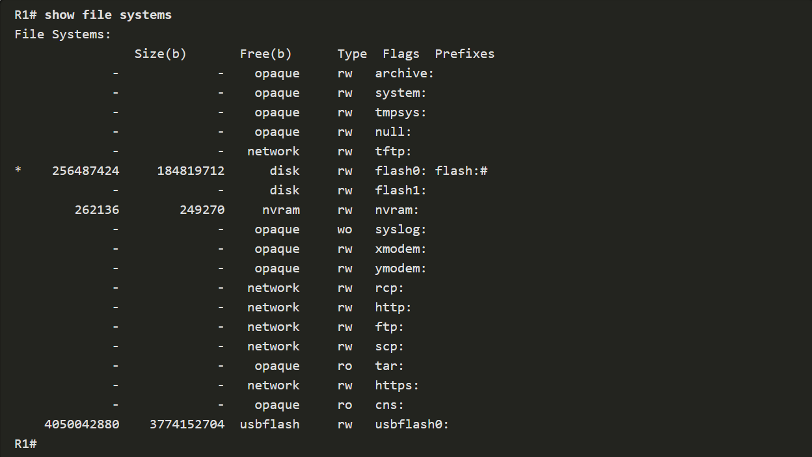
Cisco Certified Technician: CCT
Supporting Cisco Routing & Switching Network Devices
Use USB Ports to Back Up and Restore a Configuration
When backing up to a USB port, it is a good idea to issue the show file systems command to verify that the USB drive is there and confirm the name, as shown in the example.
Notice that the last line of output shows the USB port and name: “usbflash0:”

Slide 22
Cisco Certified Technician: CCT
Supporting Cisco Routing & Switching Network Devices
Use USB Ports to Back Up and Restore a Configuration
Next, use the copy run usbflash0:/ command to copy the configuration file to the USB flash drive. Be sure to use the name of the flash drive, as indicated in the file system. The slash is optional but indicates the root directory of the USB flash drive.
The IOS will prompt for the filename. If the file already exists on the USB flash drive, the router will prompt to overwrite, as shown in the examples.
When copying to USB flash drive, with no pre-existing file, this is the output:
When copying to USB flash drive, with the same configuration file already on the
Drive, the following output will display:

Slide 23
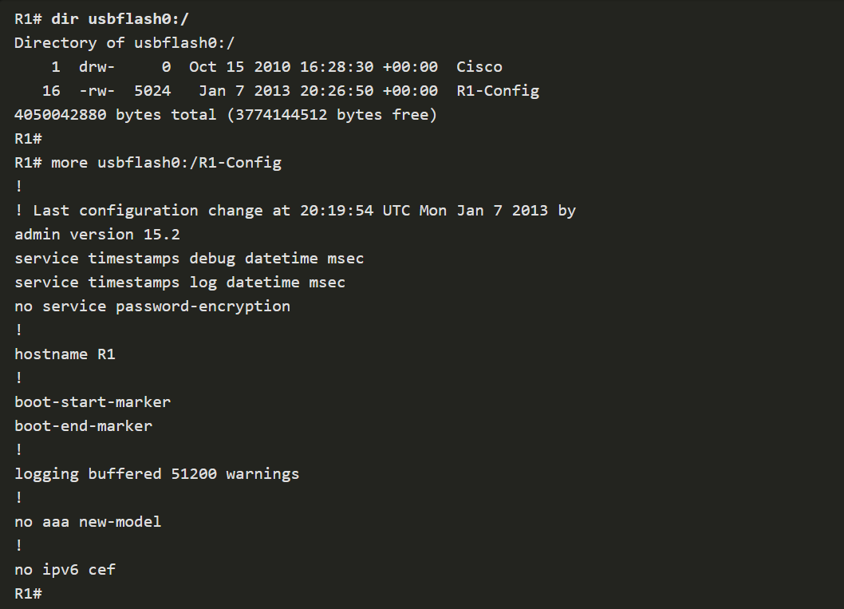
Cisco Certified Technician: CCT
Supporting Cisco Routing & Switching Network Devices
Use USB Ports to Back Up and Restore a Configuration
To restore configurations with a USB Flash Drive, you will have to edit the USB R1-Config file with a text editor, then use copy usbflash0:/R1-Config running-config to restore to running configuration.
Use the dir command to see the file on the3 USB drive and use the more command to see the contents, as shown below:

Slide 24
Activity to Complete
Cisco Certified Technician: CCT
Supporting Cisco Routing & Switching Network Devices
4.8.1 - Lab – Use TFTP, Flash, and USB to Manage Configuration Files
4.8.1b – Packet Tracer – Using a TFTP Server to Upgrade a Cisco IOS Image.

Slide 25
CCT Exam Topic 4: Service-Related Knowledge
Cisco Certified Technician: CCT
Supporting Cisco Routing & Switching Network Devices
Section 4.8
Use xmodem to upgrade IOS
https://www.youtube.com/watch?v=yVEBimiHwB8
https://www.freeccnaworkbook.com/workbooks/ccna/recovering-a-corrupt-cisco-ios-image-on-a-catalyst-switch

Slide 26
CCT Exam Topic 4: Service-Related Knowledge
Cisco Certified Technician: CCT
Supporting Cisco Routing & Switching Network Devices
Section 4.9
Manage configurations via the TCP/IP network
4.9.1 - Lab - Managing Device Configuration Files Using TFTP, Flash, and USB
4.9.2 – Packet Tracer – Backing up Configuration Files

Slide 27
CCT Exam Topic 4: Service-Related Knowledge
Cisco Certified Technician: CCT
Supporting Cisco Routing & Switching Network Devices
Section 4.10
Perform password recovery on a Cisco device
4.10.1 lab Password Recovery
4.10.2 Configure and verify Password Recovery

Slide 28
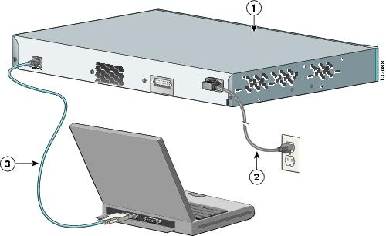
Cisco Certified Technician: CCT
Supporting Cisco Routing & Switching Network Devices
Describe Cisco IOS Software Operation Perform password recovery on a Cisco device
If the password to a device has been forgotten or accidently entered incorrectly during configuration, the user will not have access to the device. In order to regain access, the user will need to have physical access to the device and will have to perform a password recovery procedure.
The password recovery procedure allows the user to bypass the current running configuration, then access the global configuration mode. Once the user has access the password can be reconfigured.
There are basic steps to follow for this procedure, but it can differ from one device model to another. If the user is unfamiliar with the procedure for the particular model device, they should perform a quick search on the Internet.
NOTE: The procedure for switches is very different from routers.

Slide 29
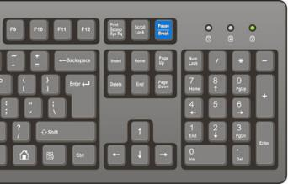
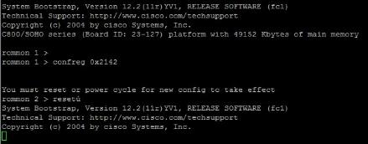
Cisco Certified Technician: CCT
Supporting Cisco Routing & Switching Network Devices
Describe Cisco IOS Software Operation Perform password recovery on a Cisco device
Starting the password recovery procedure on a router
Connect console cable to router.
Power cycle the router
Press the Break key on the keyboard within 60 seconds.
The router will boot to rommon mode
Complete lab
2.9 Lab
Step 1
Step 2
Step 3
Step 4

Slide 30
CCT Exam Topic 4: Service-Related Knowledge
Cisco Certified Technician: CCT
Supporting Cisco Routing & Switching Network Devices
Section 4.11
Identify and correct common network problems at Layers 1 and 2
4.11a Serial or ethernet interface status
4.11b Ethernet layer 2 (full and half duplex, speed issues)
4.11c WAN serial loopback test (T1, 56K and Telco assisted loopback)

Slide 31
CCT Exam Topic 4: Service-Related Knowledge
Cisco Certified Technician: CCT
Supporting Cisco Routing & Switching Network Devices
4.11a Serial or ethernet interface status

Slide 32
Cisco Certified Technician: CCT
Supporting Cisco Routing & Switching Network Devices
Serial Interface Status
Show interfaces command is very important as it shows the line and data-link protocol status
The 1st parameter refers to the physical later of the OSI model and reflects whether the interface is receiving CD (Carrier Detect). The 2nd parameter refers to the data link layer, whether keep-alives are being received or not
Show interfaces serial command (show interface serial 2/0) will show info about a serial interface. If both are up, that is the proper status.
Carrier detect
Keep alives
Layer 2 issue
Layer 1 issue
Manually disabled

Slide 33
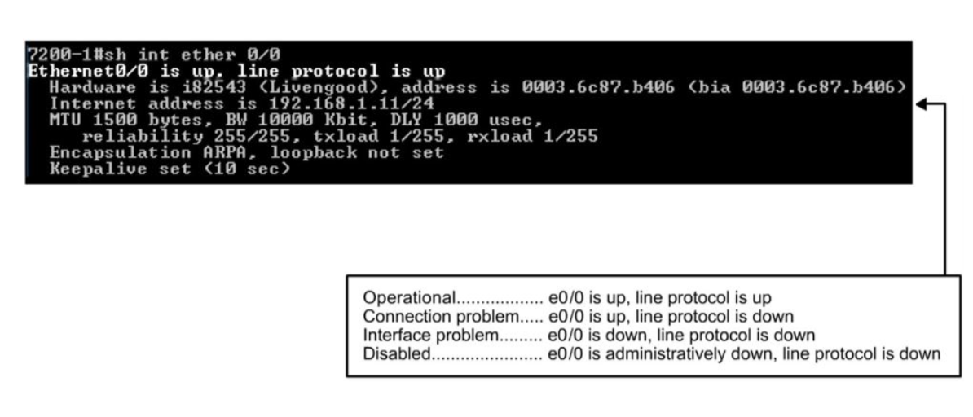
Cisco Certified Technician: CCT
Supporting Cisco Routing & Switching Network Devices
Ethernet Interface Status
Show interfaces ethernet command specific to Ethernet interfaces
Possible Ethernet interface status:
Up and up – the interface is fully functional at Layer 1 and Layer 2
Up and down – Layer 2 problem such as Layer 2 mismatch in encapsulation type
Down and down – Layer 1, physical problem – a cable might not be attached properly, or there is a speed or duplex mismatch with another LAN device
Administratively down – must to “no shutdown” on the interface

Slide 34
CCT Exam Topic 4: Service-Related Knowledge
Cisco Certified Technician: CCT
Supporting Cisco Routing & Switching Network Devices
4.11b Ethernet layer 2 (full and half duplex, speed issues)

Slide 35
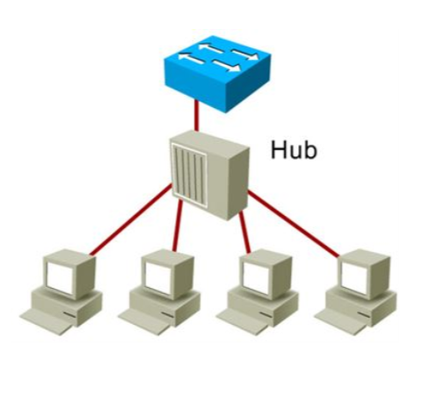
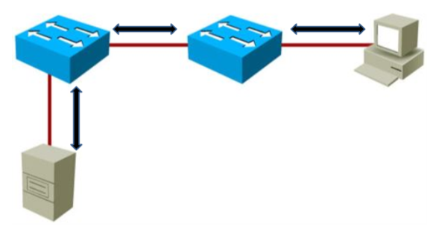
Cisco Certified Technician: CCT
Supporting Cisco Routing & Switching Network Devices
Ethernet Related Issues
Duplex mismatch is a Layer 1 problem between 2 Ethernet devices. Half duplex is shared media with only 1 device able to use 1 circuit at a time. This would cause collisions if both try transmit at the same time.
Full duplex is point to point between only 2 devices that provides bidirectional data flow. Full duplex is collision-free.
Half Duplex
Multipoint
Unidirectional data flow
High potential for collision
Full duplex
Point to point only
Bidirectional data flow
Collision-free

Slide 36
Cisco Certified Technician: CCT
Supporting Cisco Routing & Switching Network Devices
Duplex Related Issues

Slide 37
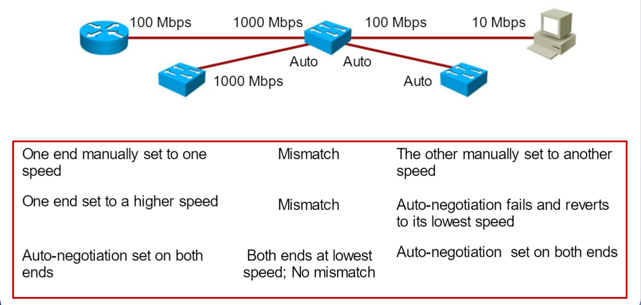
Cisco Certified Technician: CCT
Supporting Cisco Routing & Switching Network Devices
Speed Related Issues

Slide 38
Cisco Certified Technician: CCT
Supporting Cisco Routing & Switching Network Devices
Speed Related Issues

Slide 39
CCT Exam Topic 4: Service-Related Knowledge
Cisco Certified Technician: CCT
Supporting Cisco Routing & Switching Network Devices
4.11c WAN serial loopback test (T1, 56K and Telco assisted loopback)

Slide 40
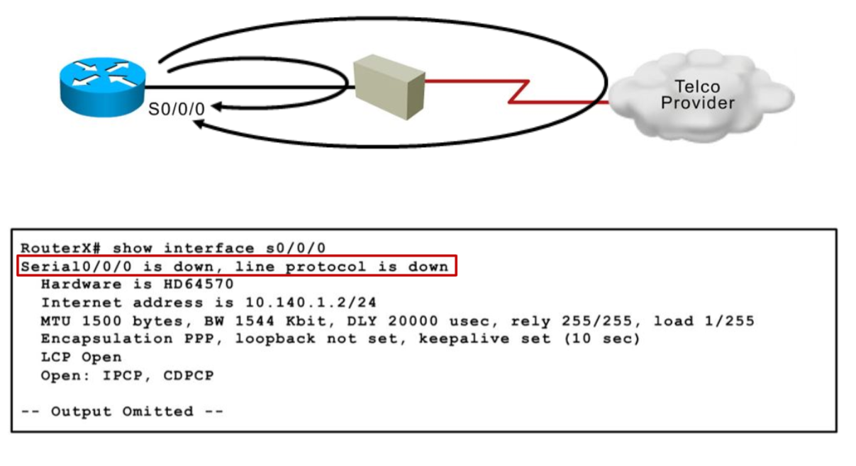
Cisco Certified Technician: CCT
Supporting Cisco Routing & Switching Network Devices
WAN Serial Loopback Tests
When a serial line does not come up, the show interface command may display a status of down/down. The best way to troubleshoot the circuit is to perform loopback tests. They allow you to isolate pieces of the circuit, and test them separately. Proper testing begins with a CSU/DSU loopback plug
Then test should go to the Telco-assisted loopback tests that involve the provider. When testing, no traffic will be able to cross the link.

Slide 41
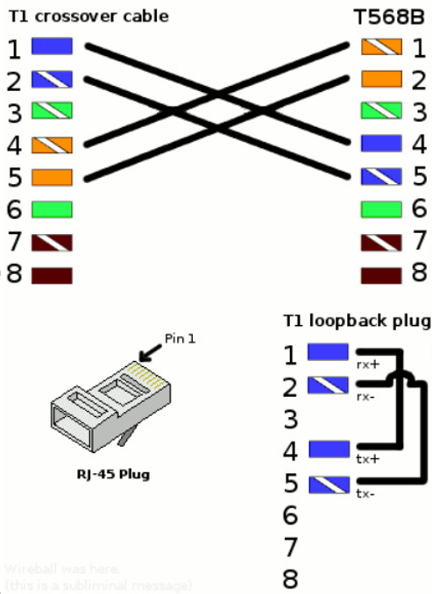
Cisco Certified Technician: CCT
Supporting Cisco Routing & Switching Network Devices
Local Loopback Testing with a T1 Loopback Plug
Local loopbacks test the customer premises equipment, the router, serials cable, and CSU/DSU.
You have to loop the local circuit back from the CSU/DSU to the router using a loopback plug.

Slide 42
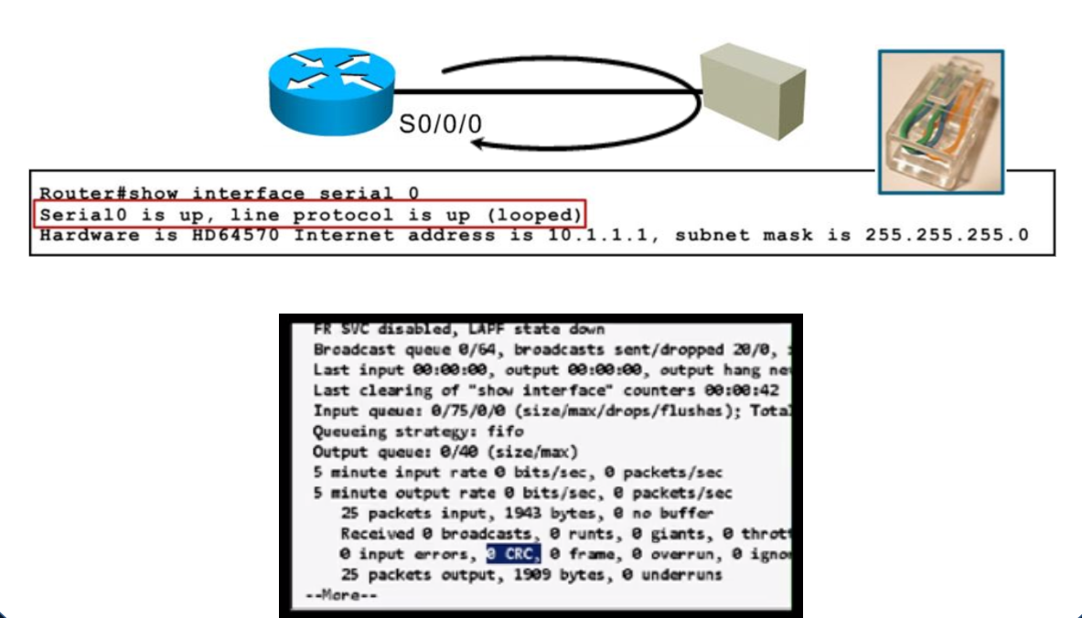
Cisco Certified Technician: CCT
Supporting Cisco Routing & Switching Network Devices
Local Loopback Testing with a T1 Loopback Plug
Once the loopback plug has been created, insert into the Telco side of the CSU/DSU. Do an extended ping and monitor the show interfaces serial command on the interface.
Look at this show int serial command to verify packets have been received and see if input errors have increased.

Slide 43
CCT Exam Topic 4: Service-Related Knowledge
Cisco Certified Technician: CCT
Supporting Cisco Routing & Switching Network Devices
Supplemental Material

Slide 44
Cisco Certified Technician: CCT
Supporting Cisco Routing & Switching Network Devices
Service-Related Knowledge Make a physical Ethernet connection from laptop to Cisco device Ethernet port using correct cable
Selection of the correct cable is critical in making an Ethernet connection. The types of devices that are being connected determine the type of cable that needs to be used for the connection.
The diagram at the right shows the pin out for straight-through and crossover cables.
The 568B is seen as the default wiring scheme for twisted pair structured cabling. If you are unsure of which to use, choose 568B.
TIA/EIA 568B
Straight-through
TIA/EIA 568B
Crossover
TIA/EIA 568A
Straight-through
TIA/EIA 568A
Crossover

Slide 45
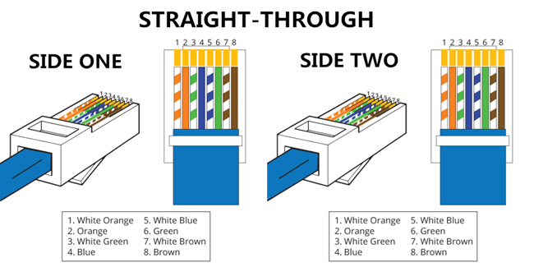
Cisco Certified Technician: CCT
Supporting Cisco Routing & Switching Network Devices
Service-Related Knowledge Make a physical Ethernet connection from laptop to Cisco device Ethernet port using correct cable
A straight through cable is a type of twisted pair cable that is used in local area networks to connect a computer to a network hub such as a router.
The straight through is the most common type and is used to connect computers to hubs or switches. They are most likely what you will find when you go to your local computer store and buy a patch cable.
This type of cable is also sometimes called a patch cable.
Straight through cable use one wiring standard: both ends use T568B wiring standard.
The figure below shows a straight through cable of which both ends are wired as the T568B standard.
Straight-through Cable

Slide 46
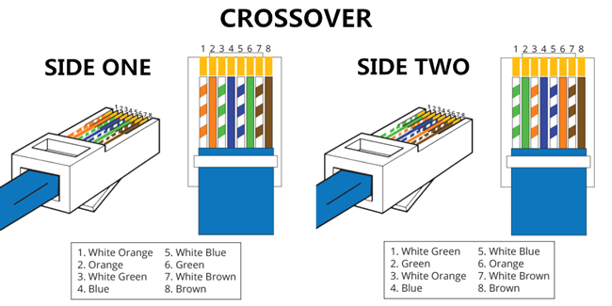
Cisco Certified Technician: CCT
Supporting Cisco Routing & Switching Network Devices
Service-Related Knowledge Make a physical Ethernet connection from laptop to Cisco device Ethernet port using correct cable
A crossover Ethernet cable is a type of Ethernet cable used to connect computing devices together directly.
It is most often used to connect two devices of the same type: e.g. two computers (via network interface controller) or two switches to each other.
Unlike straight through cable, the RJ45 crossover cable uses two different wiring standards: one end uses the T568A wiring standard, and the other end uses the T568B wiring standard. The internal wiring of Ethernet crossover cables reverses the transmit and receive signals.
Crossover Cable

Slide 47
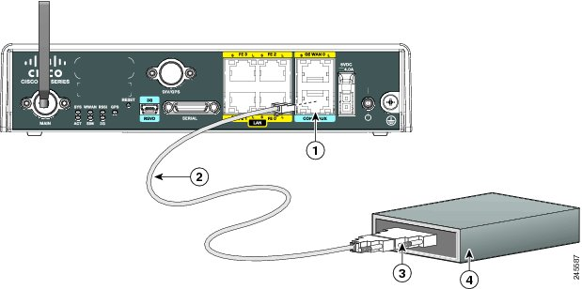
Cisco Certified Technician: CCT
Supporting Cisco Routing & Switching Network Devices
Service-Related Knowledge Use a modem to connect to Cisco console port and phone line
Having a modem connected to a router allows the user remote access. It can be used to recover passwords remotely, it is beneficial if you need to access the router for configuration or management and leave the AUX port free for dial-on-demand routing (DDR).
Some routers (for example, Cisco 1600s) do not have AUX ports. If you want to connect a modem to the router and leave the serial port(s) free for other connections, the console is the only option.
Step 1 Connect the RJ-45 end of the adapter cable to the Console port on the router
Step 2 Connect the DB-9 end of the console cable to the DB-9 end of the modem adapter.
Step 3 Connect the DB-25 end of the modem adapter to the modem.
Step 4 Make sure that your modem and the router console port are configured for the same transmission speed and support mode control with data carrier detect (DCD) and data terminal ready (DTR).

Slide 48
Cisco Certified Technician: CCT
Supporting Cisco Routing & Switching Network Devices
Service-Related Knowledge Configure the correct DIP switch settings on the modem
The dip switched on a modem allow the user to turn specific settings on and off.
Dip switches

Slide 49
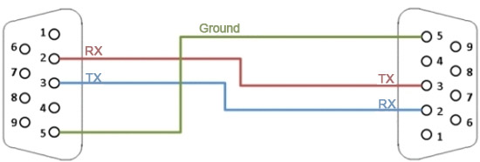
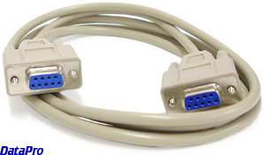
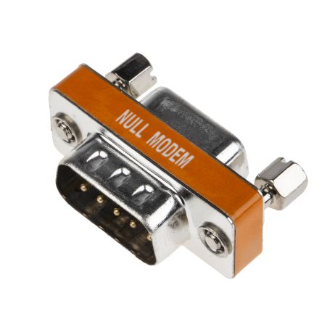
Cisco Certified Technician: CCT
Supporting Cisco Routing & Switching Network Devices
Service-Related knowledge Identify null modem cable and application
A null modem cable is a RS-232 serial cable where the transmit and receive lines are crosslinked.
It is used to directly connects two DTEs (computer, terminal, printer, etc.) using an RS-232 serial cable.
In many situations a straight-through serial cable is used, together with a null modem adapter. The adapter contains the necessary crosslinks between the signals.

Slide 50
Cisco Certified Technician: CCT

