Slide 1
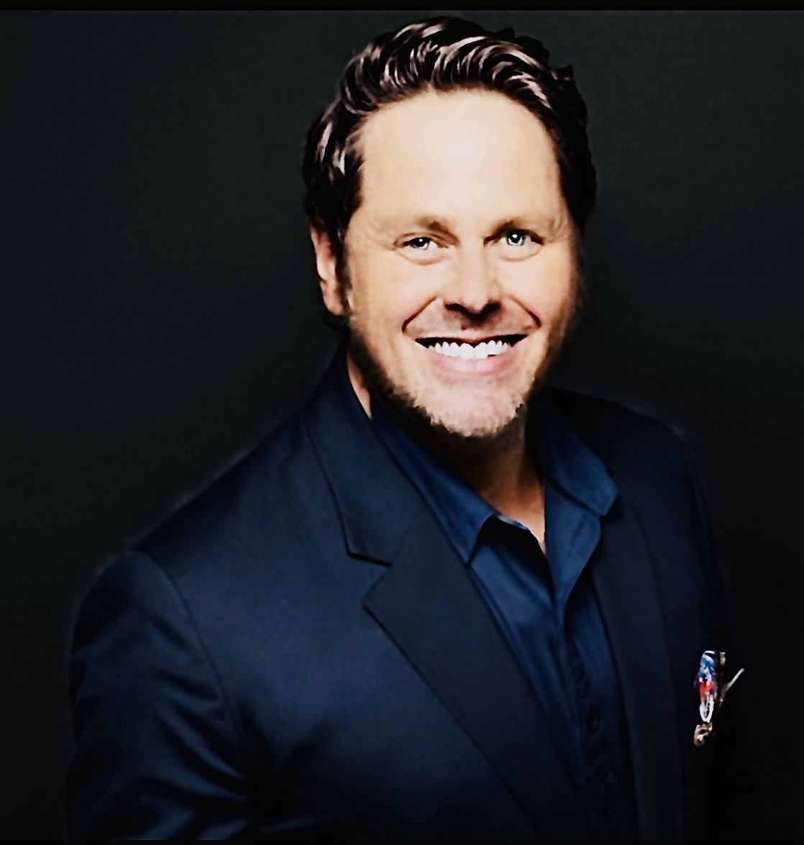
Cisco Academy Instructor Conference
Dustin Fitzner
NetAcad/Digital Impact Office (DIO) BDM Texas, NM, AR, AL & MS
dfitzner@cisco.com
Let’s Connect

Slide 2
Recognition Program Stakeholders
The Cisco Networking Academy® Recognition Program formally acknowledges the outstanding accomplishments and contributions of instructors, academies and ASC/ITC partners around the world.
Partners
Academies
Instructors
Learners
ASC and ITC partners provide support to academies and prepare and authorize new and current Cisco Networking Academy instructors to teach Cisco Certification Aligned courses.
Academies teach technical skills and provide career building opportunities to learners using the Cisco Networking Academy curriculum, services and tools.
Instructors are teachers at academies who deliver Cisco Networking Academy content and support learners along their learning journey.
Learners consume Networking Academy content from academies through in-person or remote instruction and self-enrol options to improve their career prospects in IT.

Slide 3
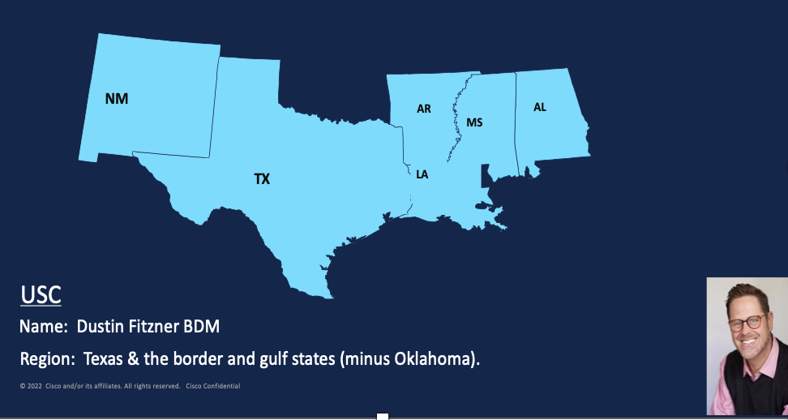
Dustin Fitzner
NetAcad Digital Impact Office (DIO) BDM Texas, NM, AR, AL & MS
dfitzner@cisco.com

Slide 4
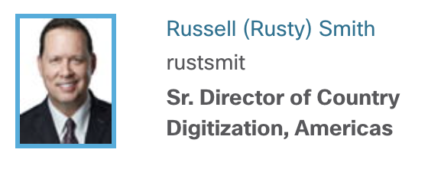
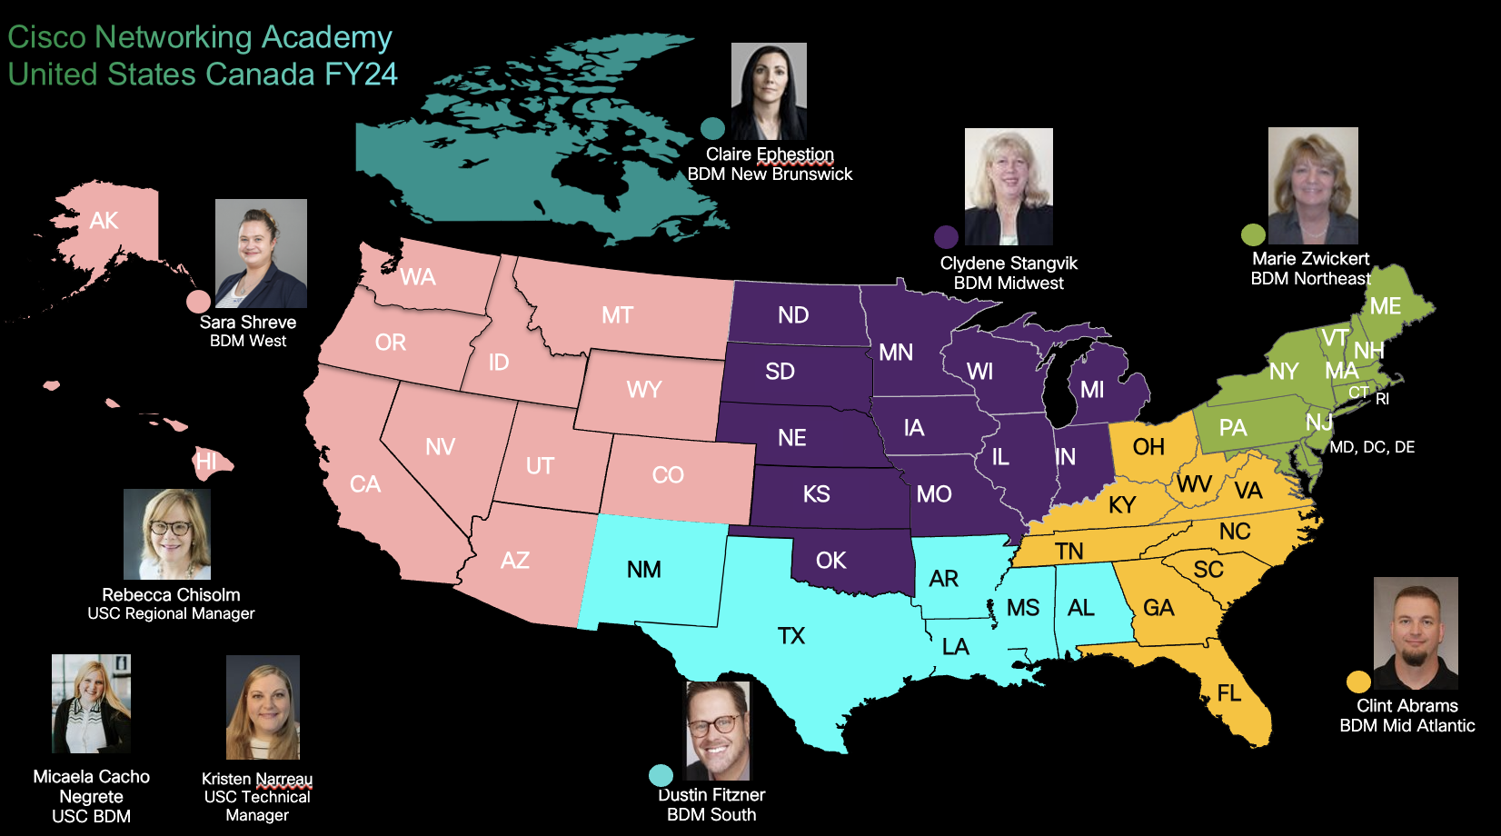

Slide 5
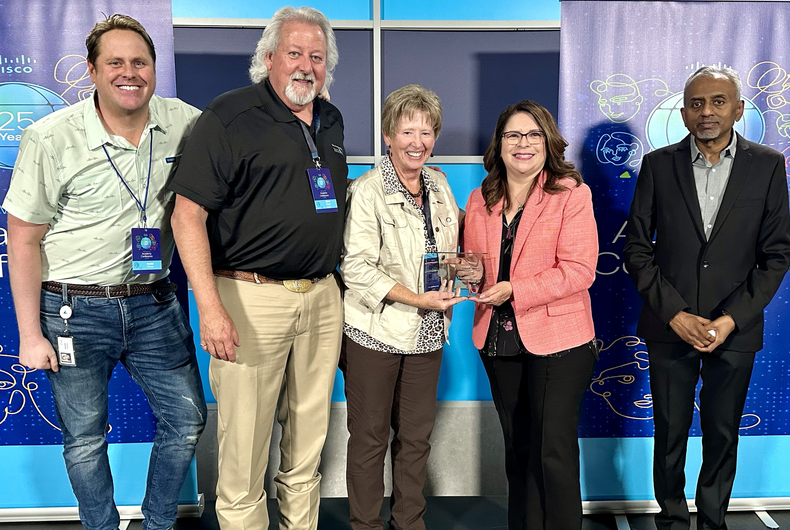
Simply The Best! Better than all the rest!
Premier + Academy Service Center and Instructor Training Center
Top 5% scoring in the “Partnership Health Index FY24 - Premier +
Gay & Glenn

Slide 6
Instructor Shout out Tenure, one year, 5 years, 10 years and 10 plus?

Slide 7
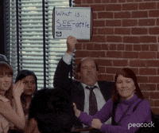
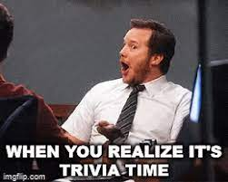
Apps, Computers, websites and IT stuff ☺
TRIVIA for TECHY’s

Slide 8
Control your Rage!
Apps, Websites, and Computers
Trivia Question # 1: What was the most downloaded app of the 2010s?
Trivia Question # 2: What programming language is named after a type of Indonesian coffee?
Trivia Question # 3: One gigabyte is equal to how many megabytes?
Trivia Question # 15:
As of 2019, what company was the source of the largest-known data breach in history?
Trivia Question # 16:
What British computer scientist is widely credited with inventing the World Wide Web?
Trivia Question # 17:
Unicode, the standard for character encoding used to represent multilingual text as binary, is the successor to what US encoding standard?

Slide 9
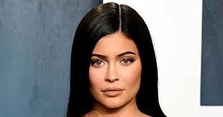
Let’s begin folks!
Apps, Websites, and Computers
Question: Who did Forbes name the youngest "self-made billionaire ever" in 2019?

Slide 10
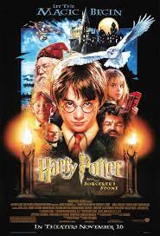
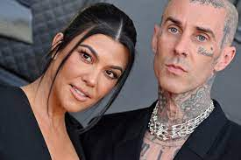
Apps, Websites, and Computers

Slide 11
Apps, Websites, and Computers
K Dashian

Slide 12
Apps, Websites, and Computers
Delixioua Computer term cookie

Slide 13
Pay pal Hawaii Kayak
Cambridge

Slide 14
Networking, Routing concepts or preparing for CISCO EIGRP exams. It has multiple choice questions. So, let's try out this quiz. Take your...
Questions: 14 | Attempts: 115 | Last updated: Mar 20, 2023
Sample Question
W

Slide 15
